Slide 1
Earth to Vik:
Where Art and Nature Meet
By Laura Brand
BYU Museum of Art Evening for Educators Fall 2021

Slide 2
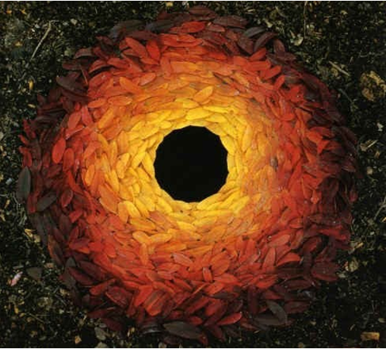
What is earth art?
“When I make something, in a field, street or altering the landscape, it may vanish, but it’s part of the history of those places”
Goldsworthy
Andy Goldsworthy
Rowan Leaves
Laid Around a Hole, 1987
Earth Art // Ephemeral // Site-Specific // Installation // Bricolage
Notes:
Andy Goldsworthy: Site-specific installations with natural materials, about the passage of time.
Rowan Leaves Laid Around a Hole,1987
“Andy Goldsworthy is a British artist known for his site-specific installations involving natural materials and the passage of time. Working as both sculptor and photographer, Goldsworthy crafts his installations out of rocks, ice, leaves, or branches, cognizant that the landscape will change, then carefully documents the ephemeral collaborations with nature through photography. “It's not about art,” he has explained. “It's just about life and the need to understand that a lot of things in life do not last.’
“When I make something, in a field, street or altering the landscape, it may vanish, but it’s part of the history of those places” -Goldsworthy
This photo, the above information, and additional info can be found at: http://www.artnet.com/artists/andy-goldsworthy/

Slide 3
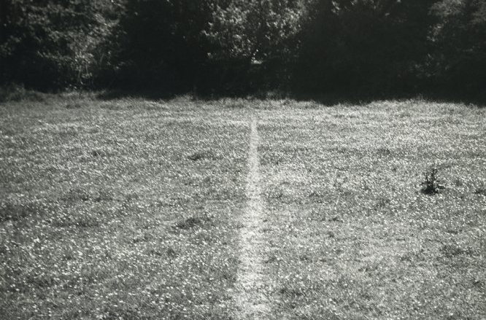
Richard Long
A Line Made by Walking, 1967
Notes:
Richard Long: Worked with earth, rocks, mud, stones, and other natural materials
A Line Made by Walking, 1967
“Sir Richard Julian Long, (born 2 June 1945) is an English sculptor and one of the best-known British land artists….Long's work has broadened the idea of sculpture to be a part of performance art and conceptual art. His work typically is made of earth, rock, mud, stone and other nature-based materials. In exhibitions his work is typically displayed with the materials or through documentary photographs of his performances and experiences.”
The above information is from https://www.tate.org.uk/art/artists/richard-long-1525
More information about Richard Long can be found at: http://www.richardlong.org/index.html

Slide 4
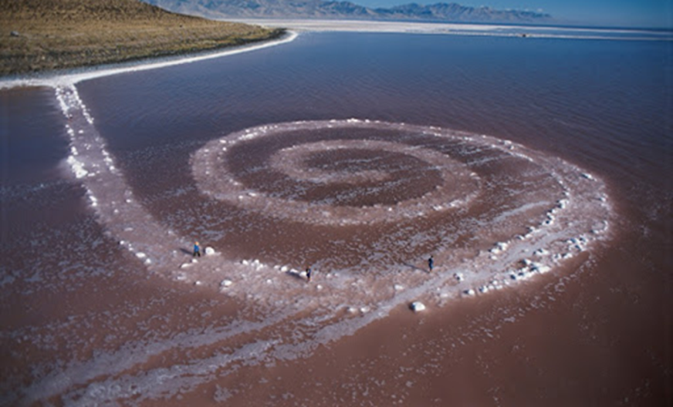
Located in the Great Salt Lake,
Utah
Robert Smithson
The Spiral Jetty, 1970
Notes:
Robert Smithson: One of the founders of land art
Spiral Jetty, 1970
Northeastern shore of Great Salt Lake
6,000+ tons of black basalt rocks from site
Coil is 1,500 feet long and 15 feet wide
For over fifty years, Robert Smithson's work and ideas have influenced artists and thinkers, building the ground from which contemporary art has grown. Born in New Jersey in 1938, Smithson' early interests in cartography, geology, prehistory, philosophy, science-fiction, and language spiral through his work. From his landmark earthworks to his “quasi-minimalist” sculptures, Nonsites, writings, proposals, collages, drawings, and radical rethinking of landscape, Smithson's ideas are profoundly urgent for our times.
This photo, the above information about Smithson, and more information can be found at: https://holtsmithsonfoundation.org/

Slide 5
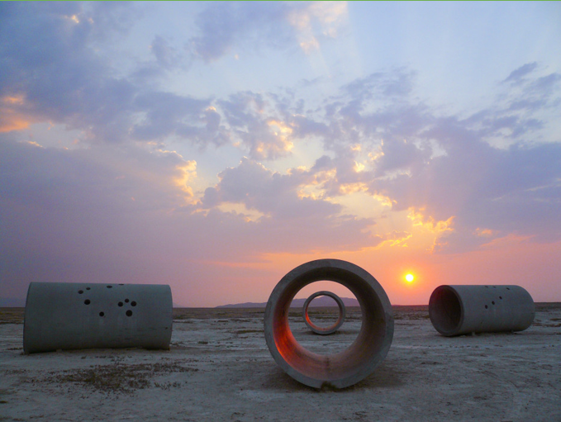
Located in the Great Basin Desert, Northern Utah
Nancy Holt
Sun Tunnels, 1973
Notes:
Nancy Holt: Understanding our place in the world, site specific installations, expanded the places where art could be found
Sun Tunnels, 1973
Nancy Holt (April 5, 1938 – February 8, 2014) was a member of the earth, land, and conceptual art movements. A pioneer of site-specific installation and the moving image, Holt recalibrated the limits of art. She expanded the places where art could be found and embraced the new media of her time. Across five decades she asked questions about how we might understand our place in the world, investigating perception, systems, and place.
The above information is derived from and more info can be found on https://holtsmithsonfoundation.org/

Slide 6
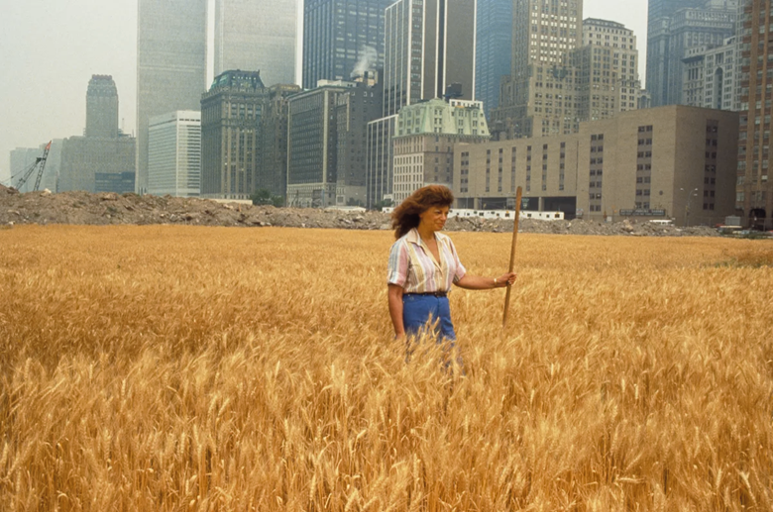
"Investigating science, philosophy, linguistics, psychology, poetry, history, and music, Denes's artistic practice is distinctive in terms of its aesthetics and engagement with socio-political ideas."
Agnes Denes
Wheatfield - A Confrontation:
Battery Park Landfill, Downtown Manhattan,
1982
Notes:
Agnes Denes: Planted a two-acre field of wheat on a landfill near Wall Street in NYC, commentary on economics, the future of humanity, world hunger, etc.
Wheatfield - A Confrontation: Battery park Landfill, Downtown Manhattan (1982)
The following information is from her website: http://www.agnesdenesstudio.com/catalog.html
“[Agnes is] A primary figure among the concept-based artists who emerged in the 1960s and 1970s, Agnes Denes is internationally known for works created in a wide range of mediums. A pioneer of several art movements, she is difficult to categorize. Investigating science, philosophy, linguistics, psychology, poetry, history, and music, Denes's artistic practice is distinctive in terms of its aesthetics and engagement with socio-political ideas. As a pioneer of environmental art, she created Rice/Tree/Burial in 1968 in Sullivan County, New York which, according to the renowned art historian and curator Peter Selz, was "probably the first large scale site-specific piece anywhere with ecological concerns."

Slide 7
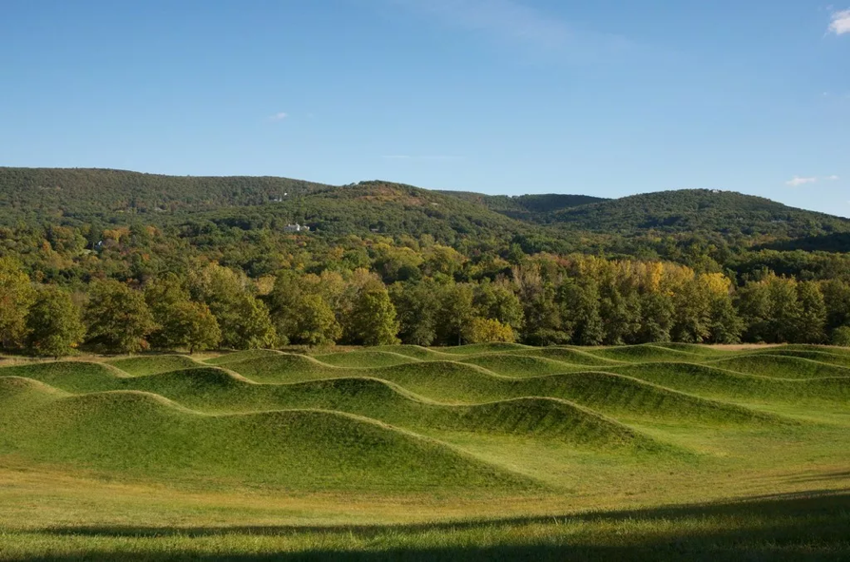
Maya Lin
Storm King Wavefield, 2008
Notes:
Maya Lin: Known for the Vietnam Memorial, but she did land art too!
Storm King Wavefield, 2008
Storm King Wavefield encompasses an 11-acre site, with the artwork covering four acres, at the southwest edge of Storm King Art Center in New Windsor, NY. Wavefield is comprised of seven rows of undulating rolling waves of earth and grass.
More info on her website: https://www.mayalinstudio.com/art/storm-king-wavefield

Slide 8
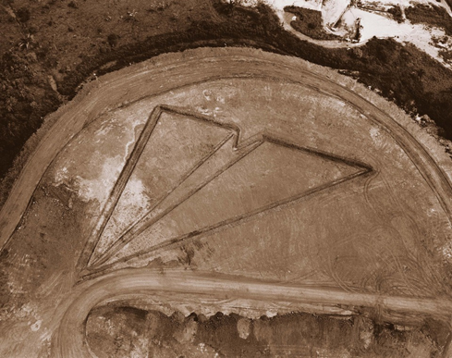
Vik Muniz
Earthworks Series
Paper Plane (Sossego, Copper Mine), 2005
"Muniz’s Earthworks include drawings carved by bulldozers in vast landscapes, photographed by helicopter, as well as small scale of land art made on a tabletop in his studio. It is deliberately difficult to differentiate between the two, illustrating what Muniz calls ‘the gap between the scales of reality and representation'. In blurring the line between big and small, Muniz poses powerful questions about the nature of perception.”
Kenneth Hartvigsen, BYU MoA Curator
Notes:
“Muniz’s work question[s] the differences between garbage and art, photography and draw[s] on memory and history. He also asks viewers to reconsider something so intuitive we often take it completely for granted— our sense of scale—as he makes massive objects appear tiny and recreates particles barely visible to the naked eye at enormous size. In blurring the line between big and small, Muniz poses powerful questions about the nature of perception.
For his Earthworks series, Muniz took inspiration from land art, such as Robert Smithson’s Spiral Jetty, the full scope of which is experienced from a distant perspective. Muniz’s Earthworks include drawings carved by bulldozers in vast landscapes, photographed by helicopter, as well as small scale of Land Art made on a tabletop in his studio. It is deliberately difficult to differentiate between the two, illustrating what Muniz calls ‘the gap between the scales of reality and representation.’”
Kenneth Hartvigsen, Curator at BYU Museum of Art
More information on Vik Muniz and his work can be found at:
https://vikmuniz.net/
https://www.theartstory.org/artist/muniz-vik/life-and-legacy/

Slide 9
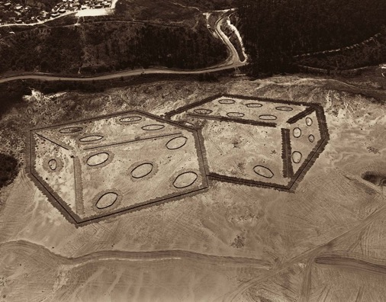
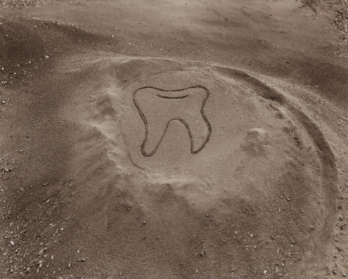
Vik Muniz Earthworks Series
Dice (Itabira, Iron Mine), 2005
Tooth (The Sarzedo Drawings), 2002
Notes:
How do photographs let you lie and tell the truth?
Find clues that tell you whether the images in this series are of “real earthworks” (made by construction equipment) or “fake earthworks” (made by Vik Muniz in his studio).

Slide 10
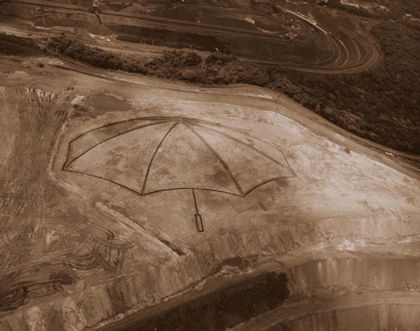
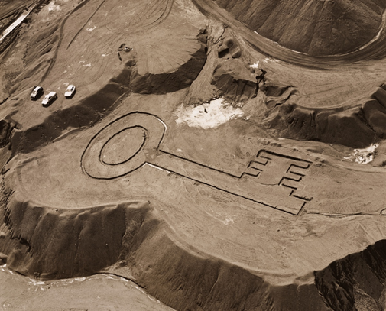
Vik Muniz Earthworks Series
Umbrella (Feijao, Iron Mine), 2006
Key (The Sarzedo Drawings), 2002

Slide 11
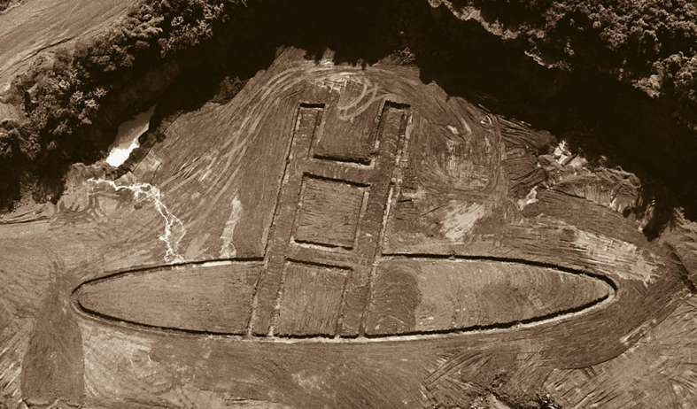
Vik Muniz Earthworks Series
Hole (Carajas N4, Iron Mine), 2006

