Slide 1
The Colors of Us
By Dayna Koch

Slide 2
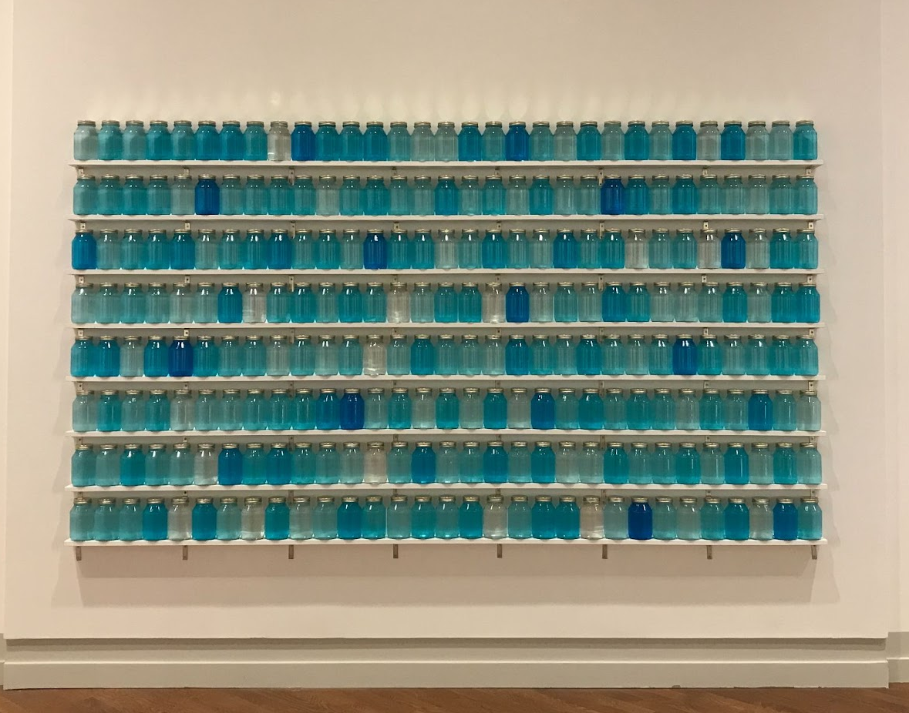
Rebecca Campbell (b.1971), Two-Year Supply: Clean, 2016, Windex, tin plated steel, glass, wood, digital projection, 23 13/16 x 30 inches. Brigham Young University Museum of Art.

Slide 3
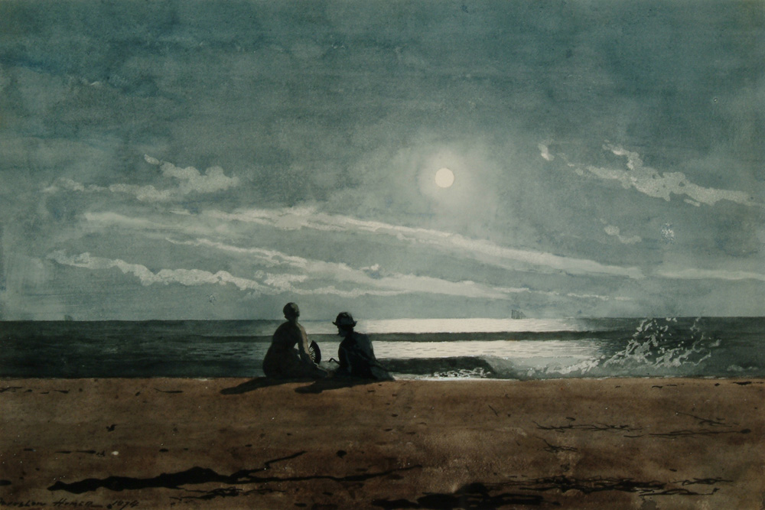
Winslow Homer, Moonlight, 1874

Slide 4
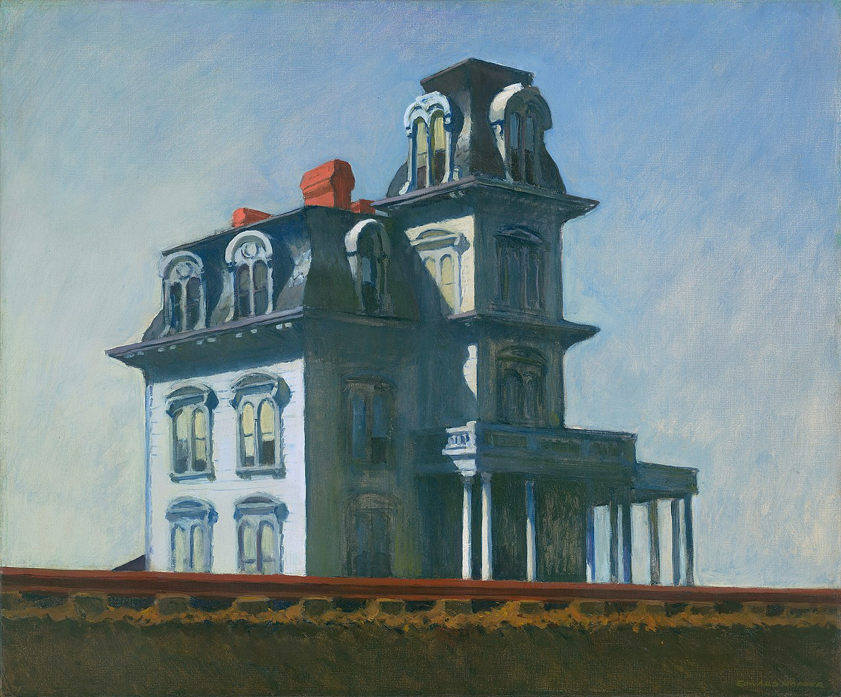
Edward Hopper, House by the Railroad, 1925

Slide 5
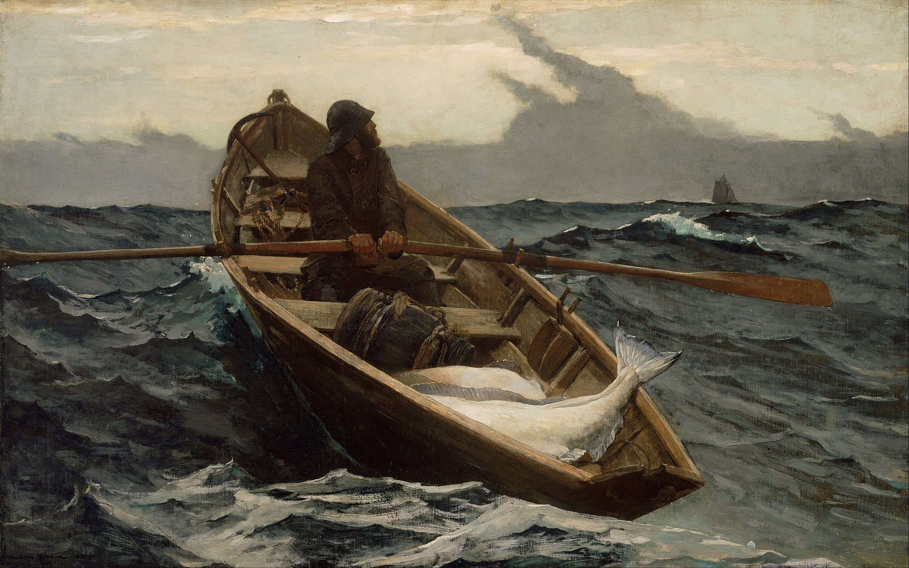
Winslow Homer, Fog Warning, 1885

