Slide 1
Monuments, Anselm Kiefer, & Reconciling Our Histories
By Mark Graham

Slide 2
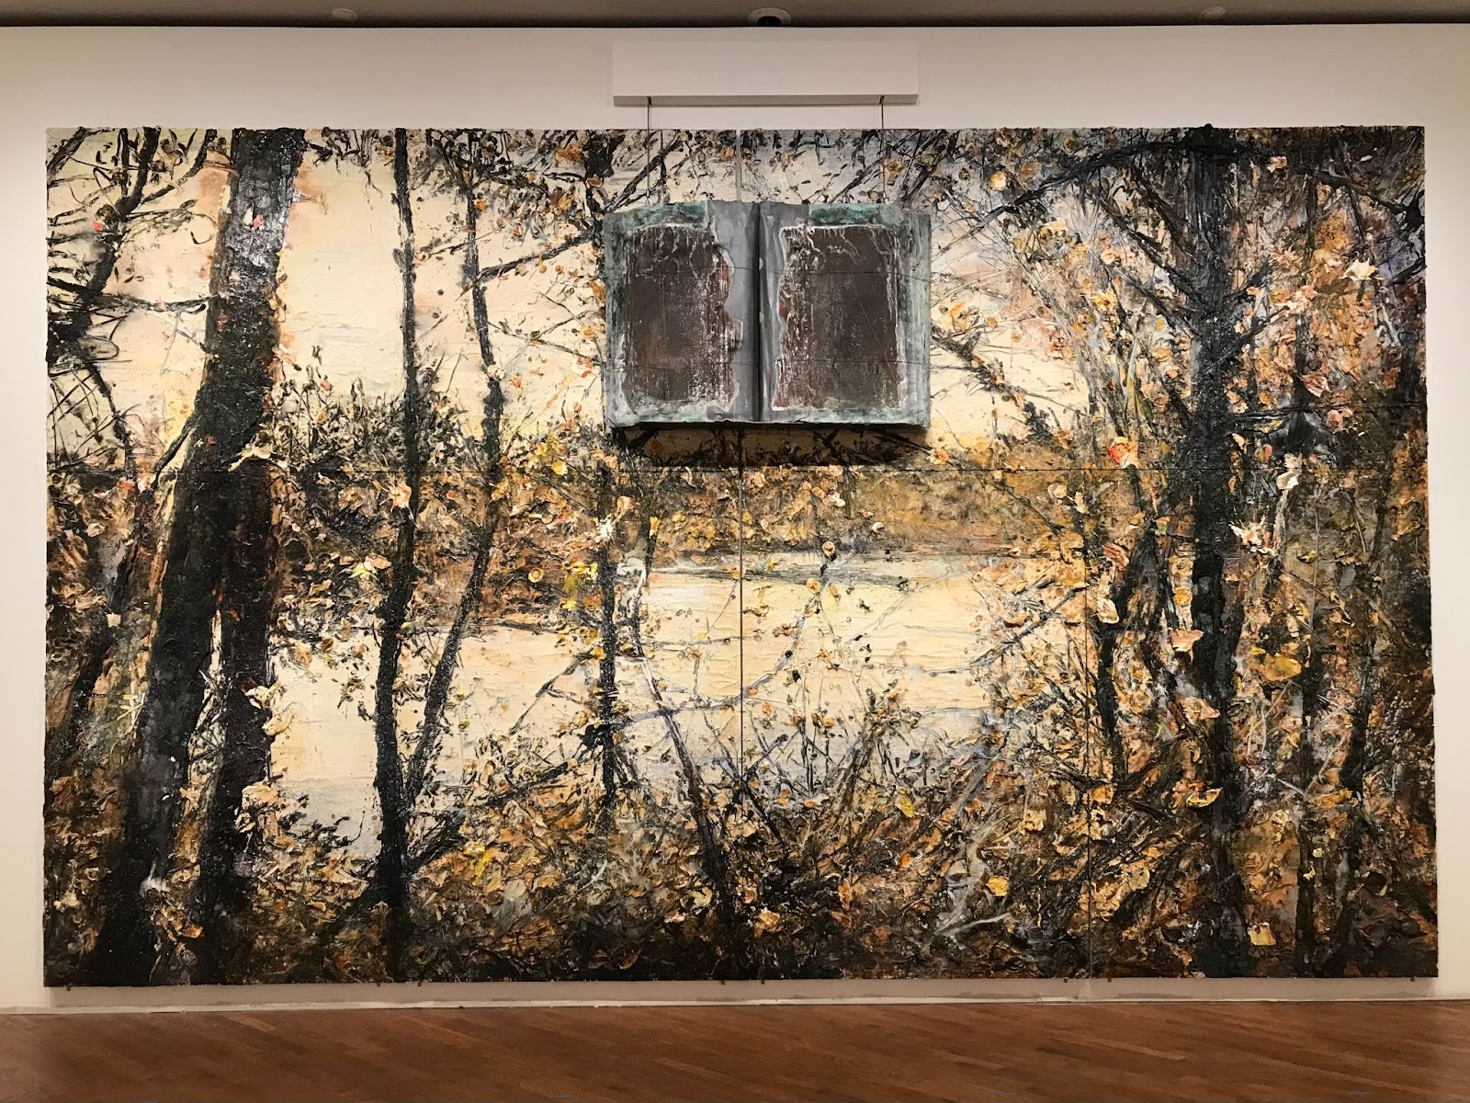
Notes:
Anselm Kiefer (1945-)
Untitled, 2016
Oil, acrylic, emulsion, shellac, lead, metal and sediment of electrolysis on canvas
Courtesy of the Parker Foundation

Slide 3
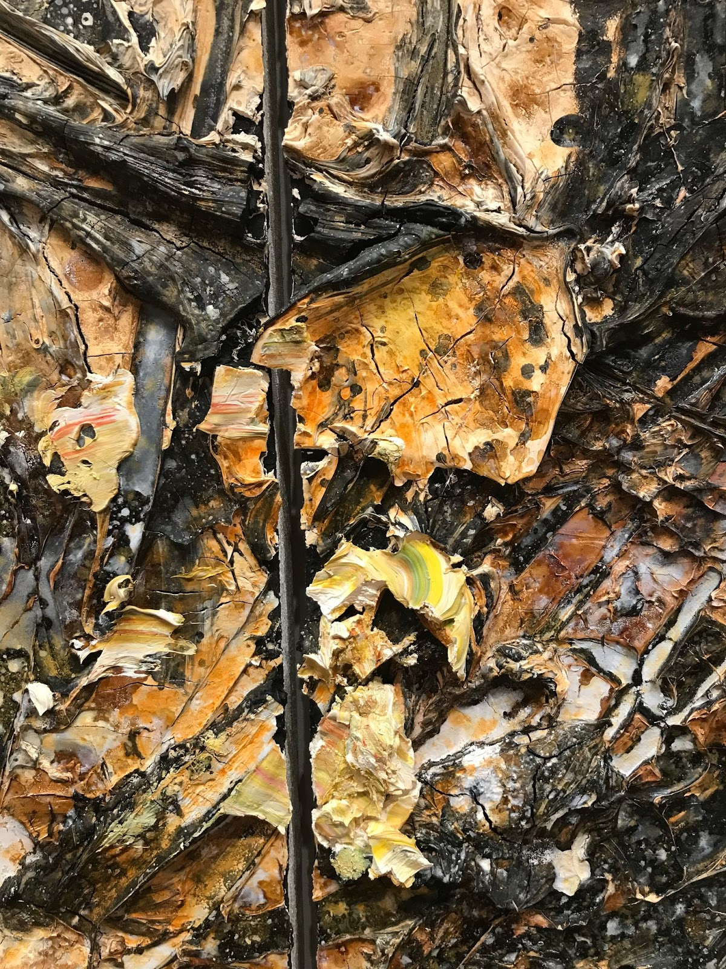
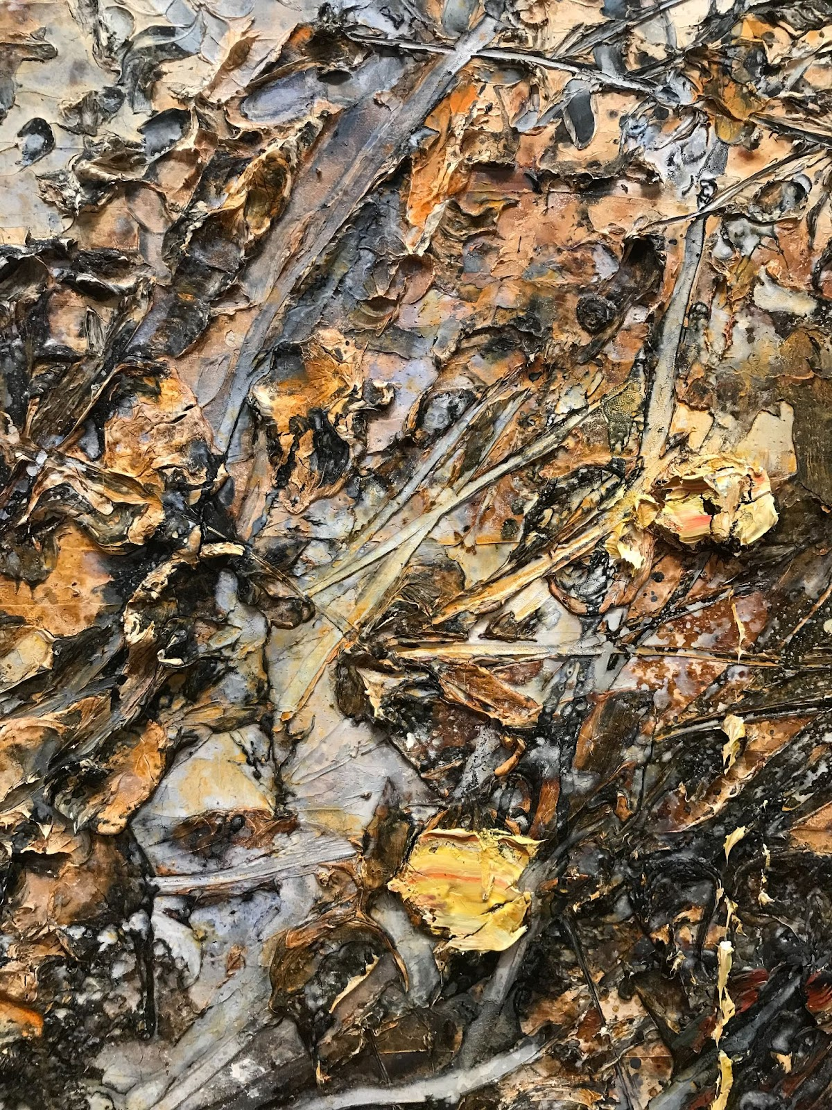

Slide 4
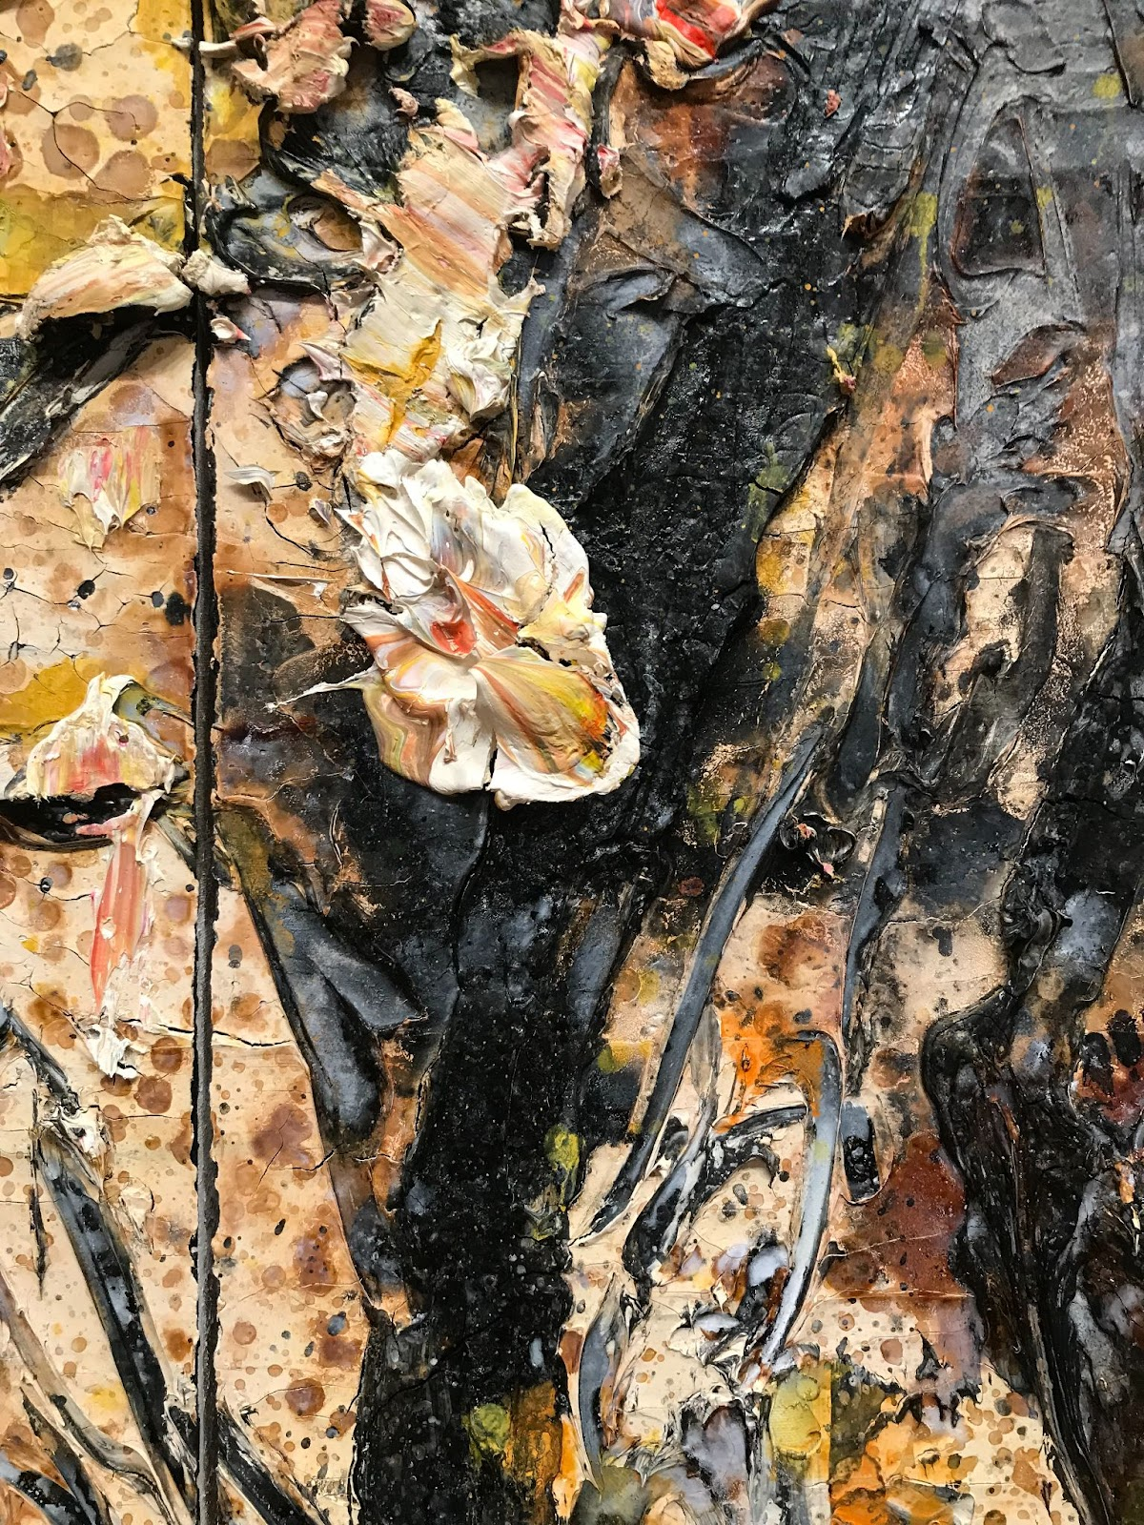
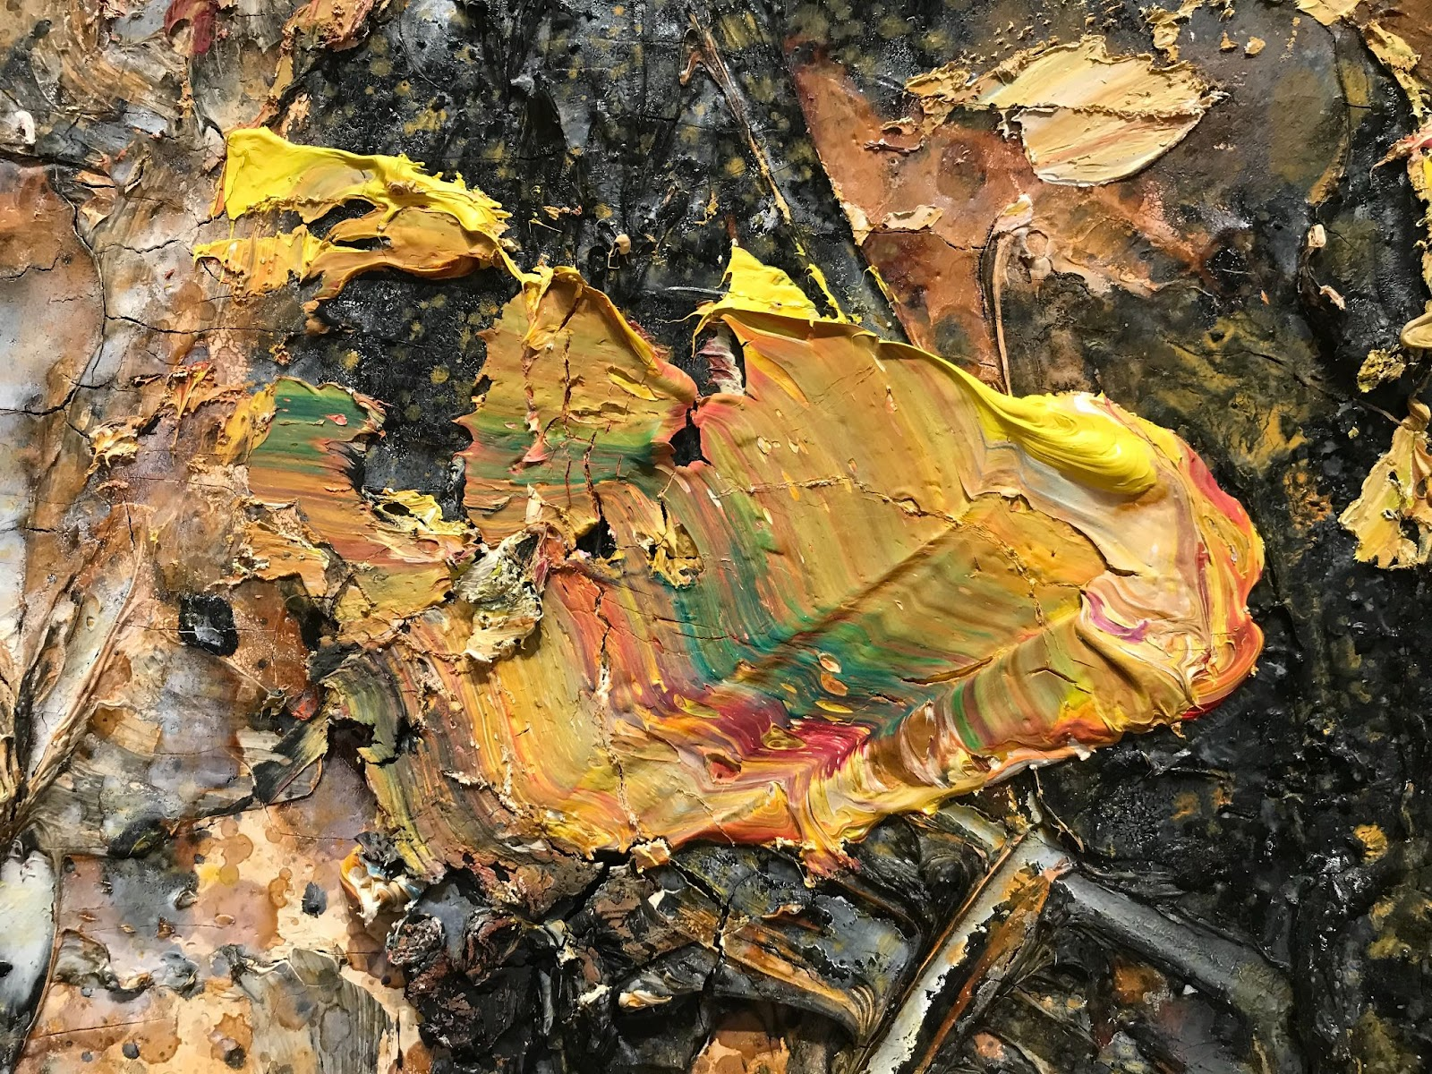

Slide 5
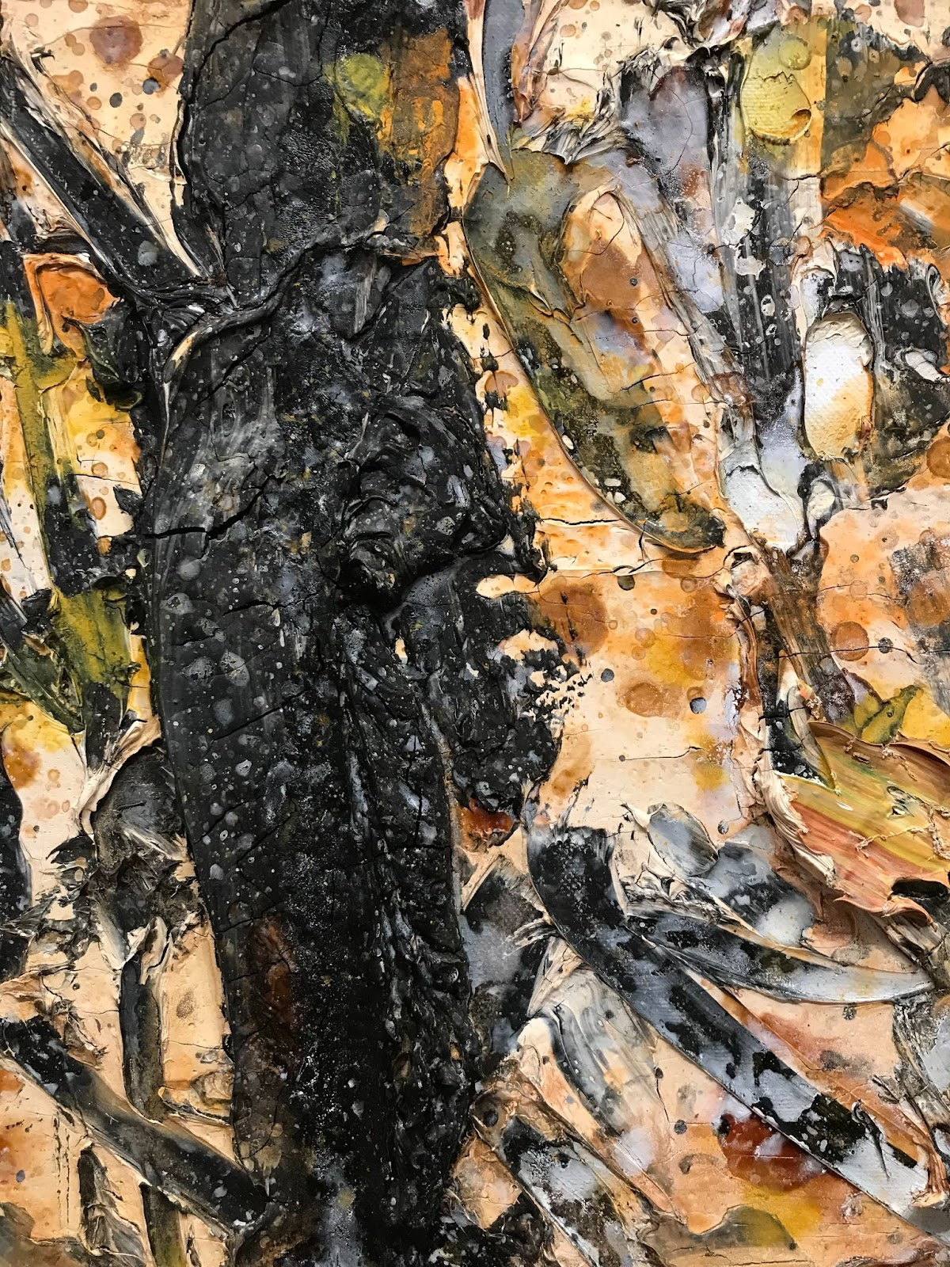
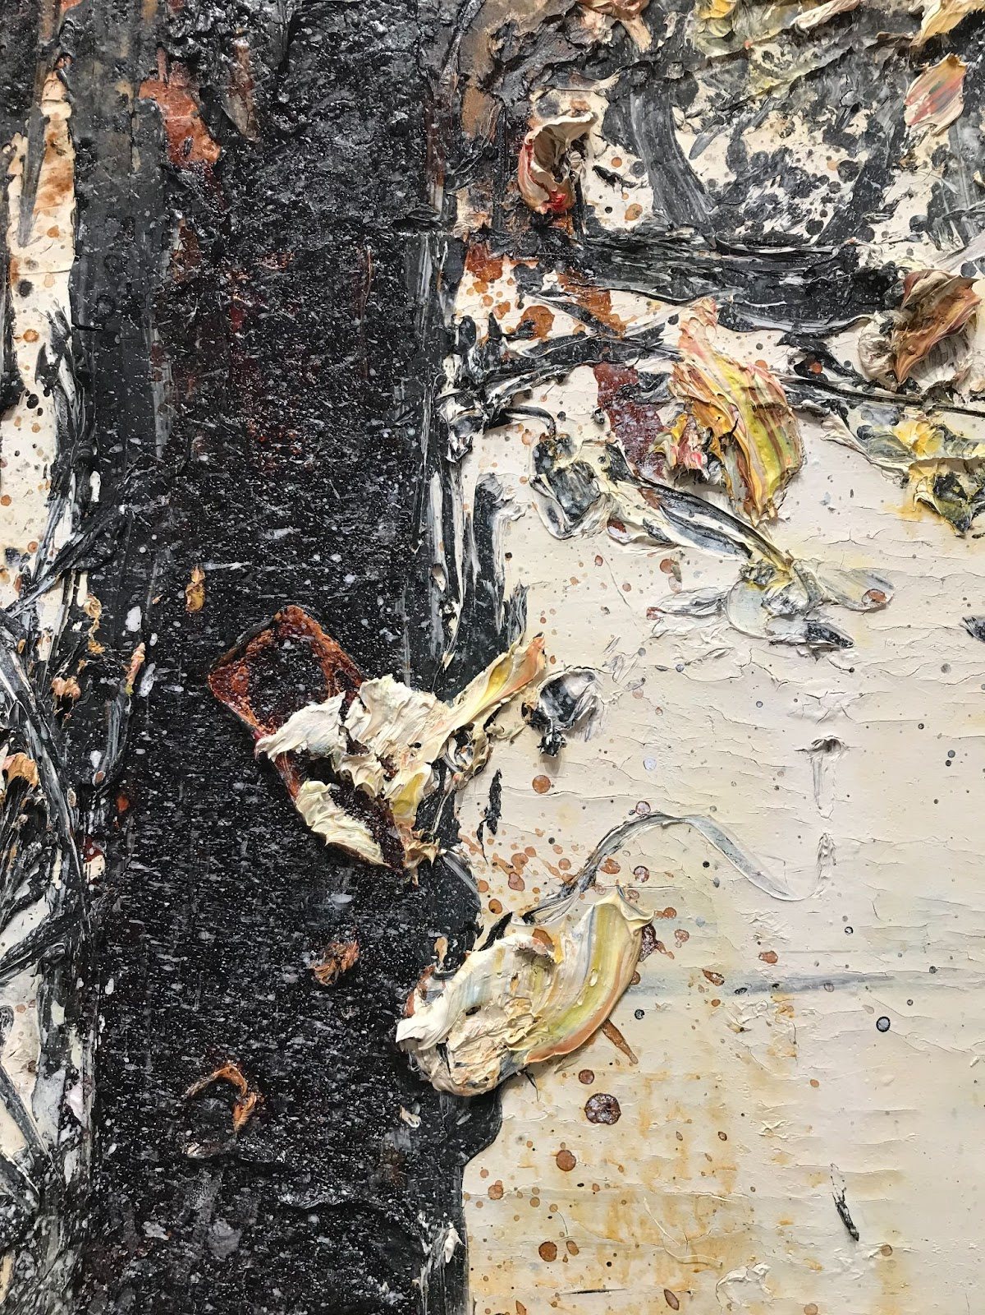

Slide 6
