Slide 1
MONUMENTS
Mark Graham
Notes:
Images of Anselm Kiefer’s artworks can be found through the links in this presentation.

Slide 2
What is the importance of a monument? What do they look like? How can they be either good or bad?

Slide 3
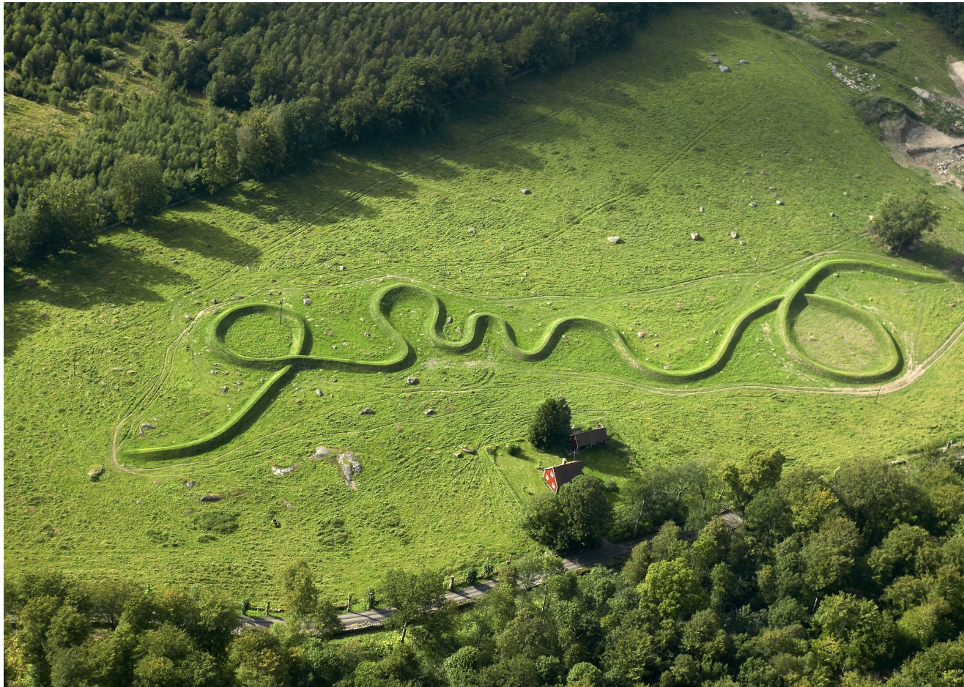
Maya Lin, Eleven Minute Line, Sweden, 2004 - Very large - 12 feet tall - 965 feet long

Slide 4
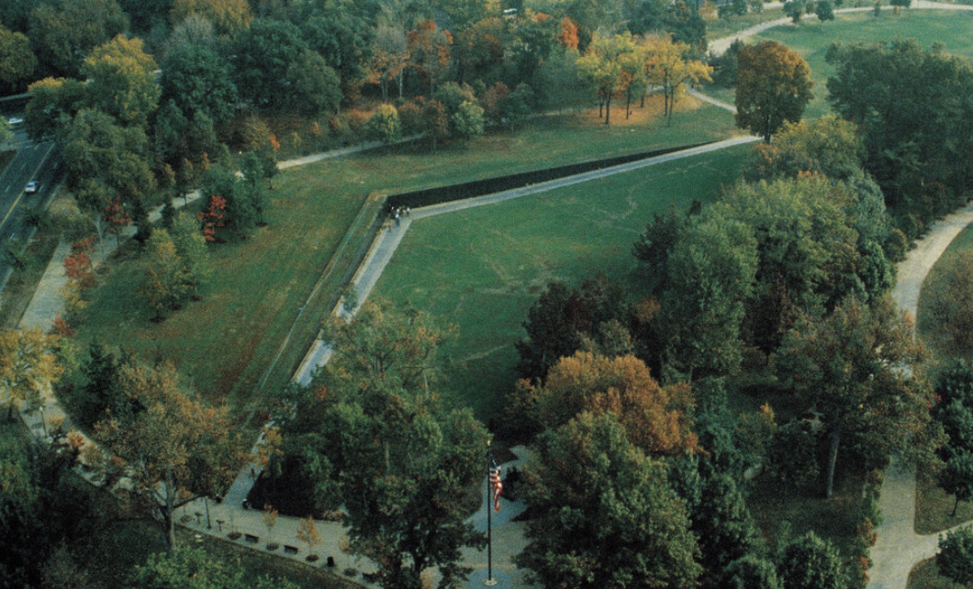
Maya Lin, Vietnam Memorial, Washington D.C., 1982 - Unconventional monument - No figures - Only words are the names of those who died in the war

Slide 5
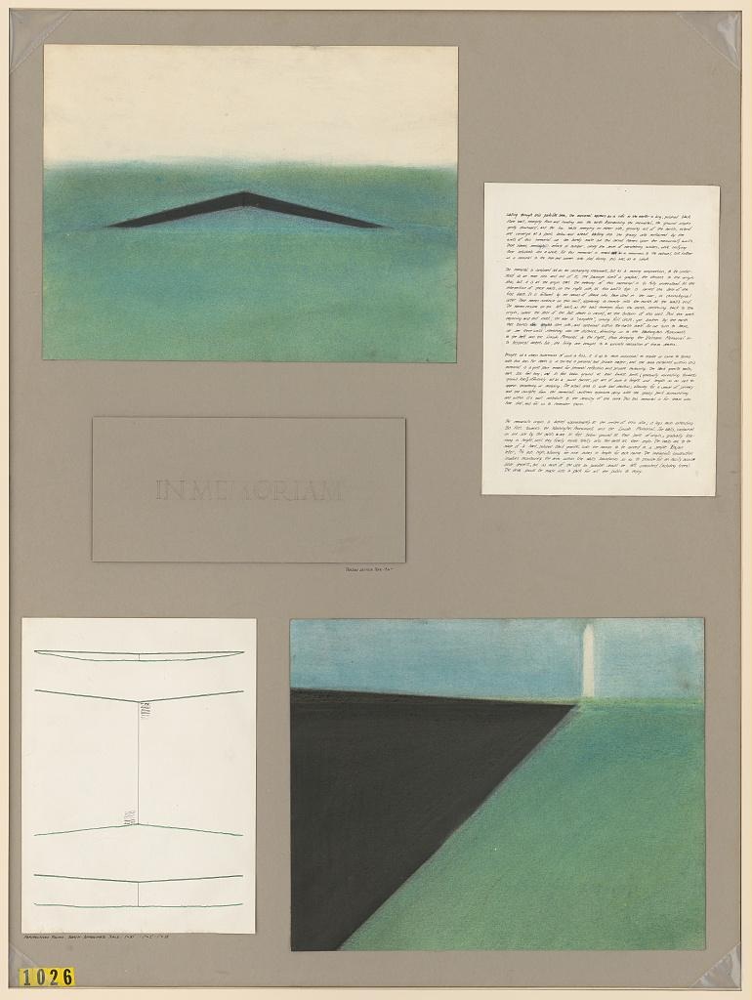
Lin, Maya Ying, Architect. Vietnam Veterans Memorial. Competition drawing. Washington D.C, 1981. Photograph.

Slide 6
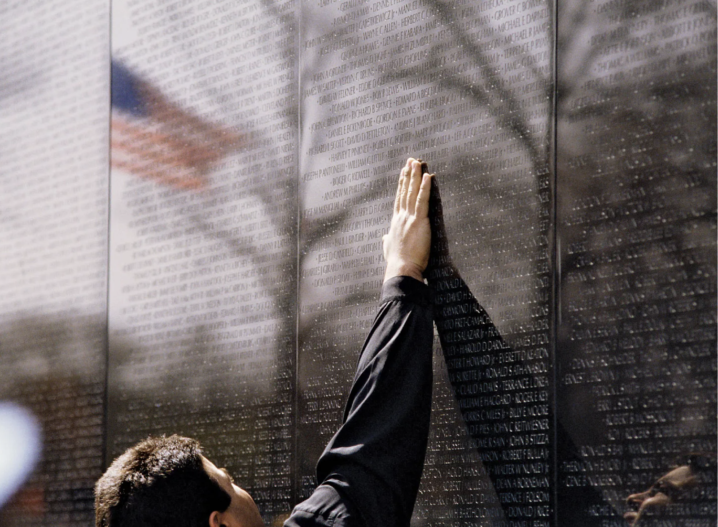
Maya Lin, Vietnam Veterans Memorial, Washington D.C., 1982

Slide 7
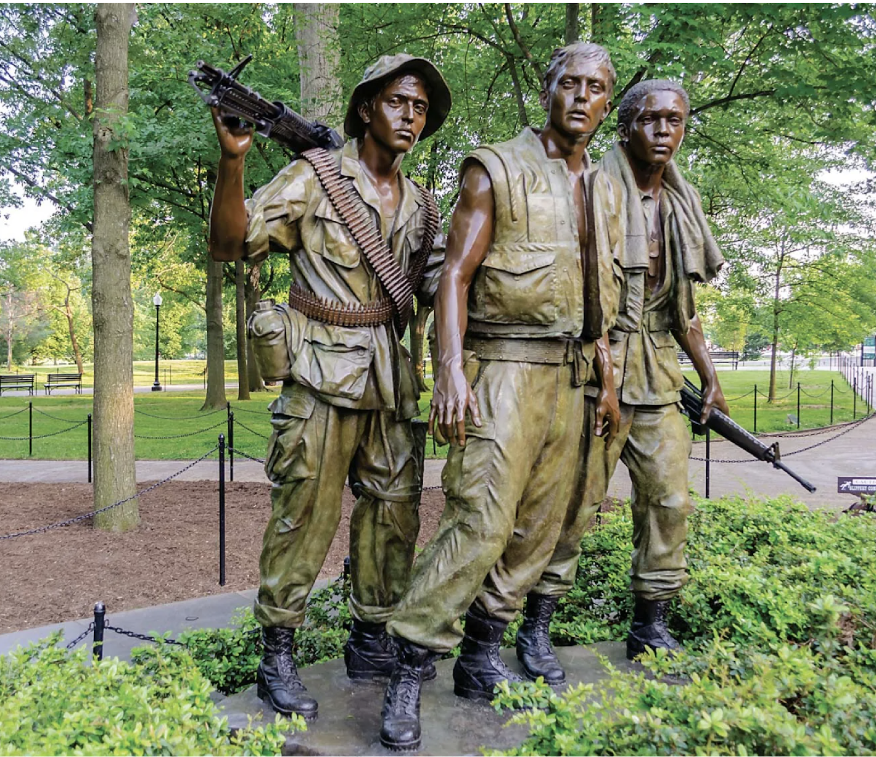
Frederick Hart, The Three Servicemen, Washington D.C., 1984 Considering some of the negative press from Maya Lin’s memorial, this more traditional monument was built close by.

Slide 8
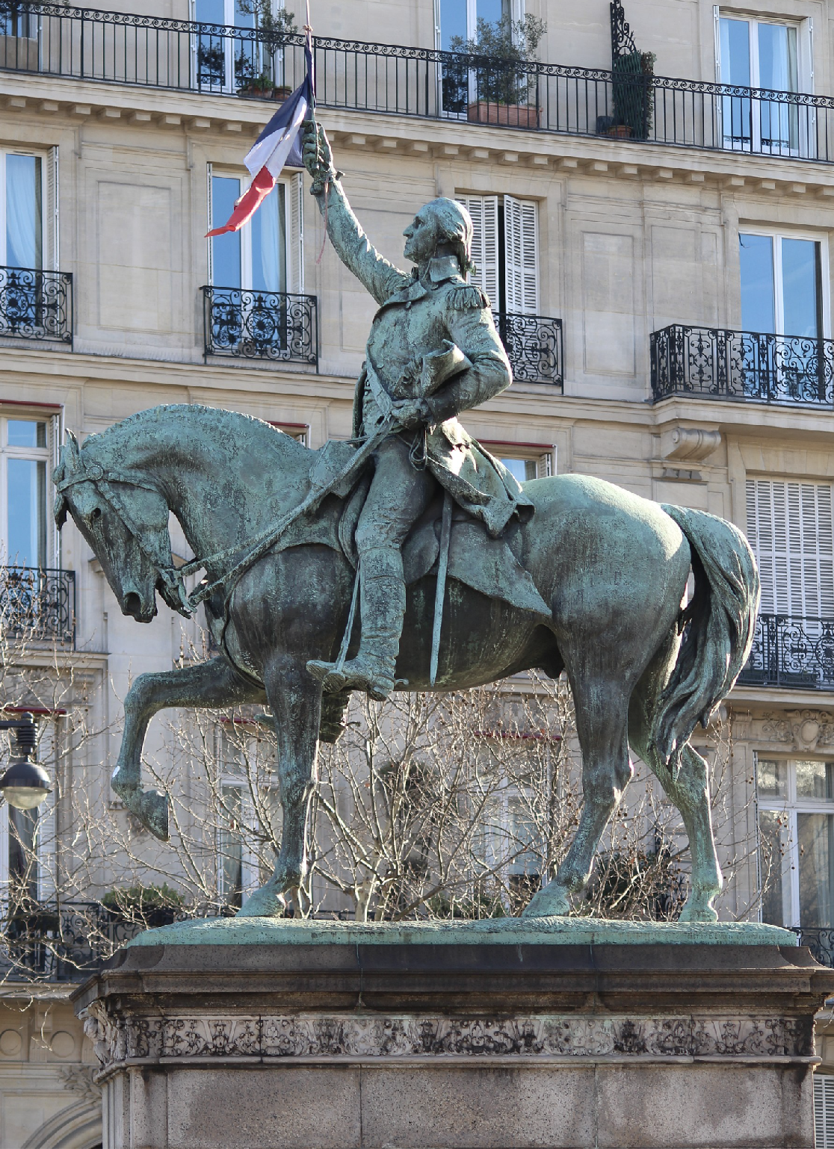
Daniel Chester French and Edward Clark Potter, George Washington, Paris, 1900 This monument was a gift to France as a thank you for their help in the Revolutionary War.

Slide 9
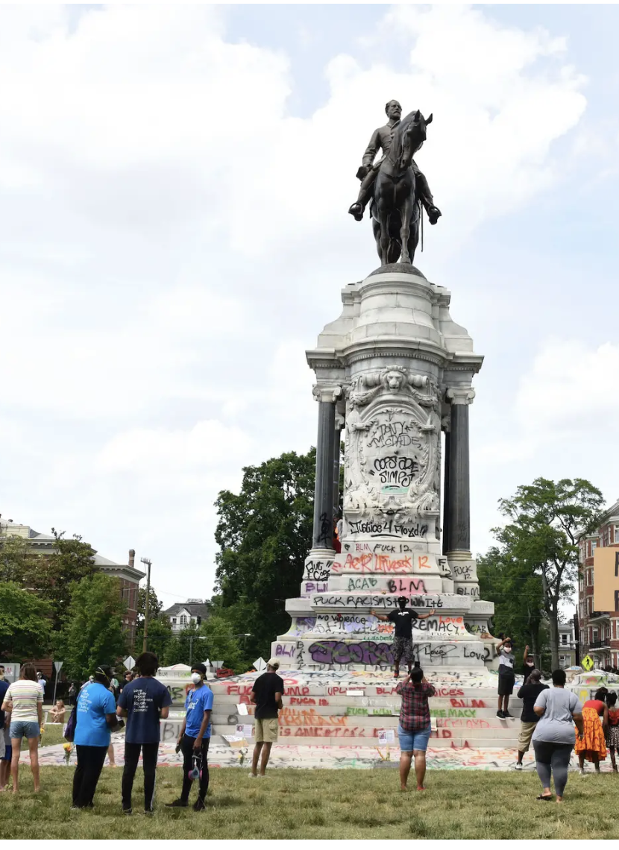
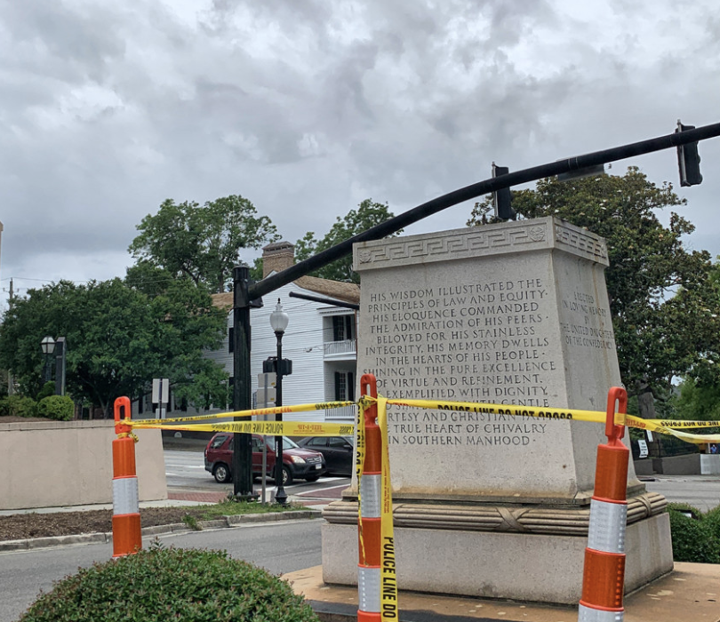
Protesters gather around the statue of Confederate General Robert E. Lee on Monument Avenue on June 6, 2020 in Richmond, Virginia, amidst protests over the death of George Floyd in police custody. Virginia Gov. Ralph Northam announced plans to remove the statue.
The pedestal remains, but the statue of Confederate George Davis in downtown Wilmington, North Carolina, is removed. June 25, 2020.

Slide 10
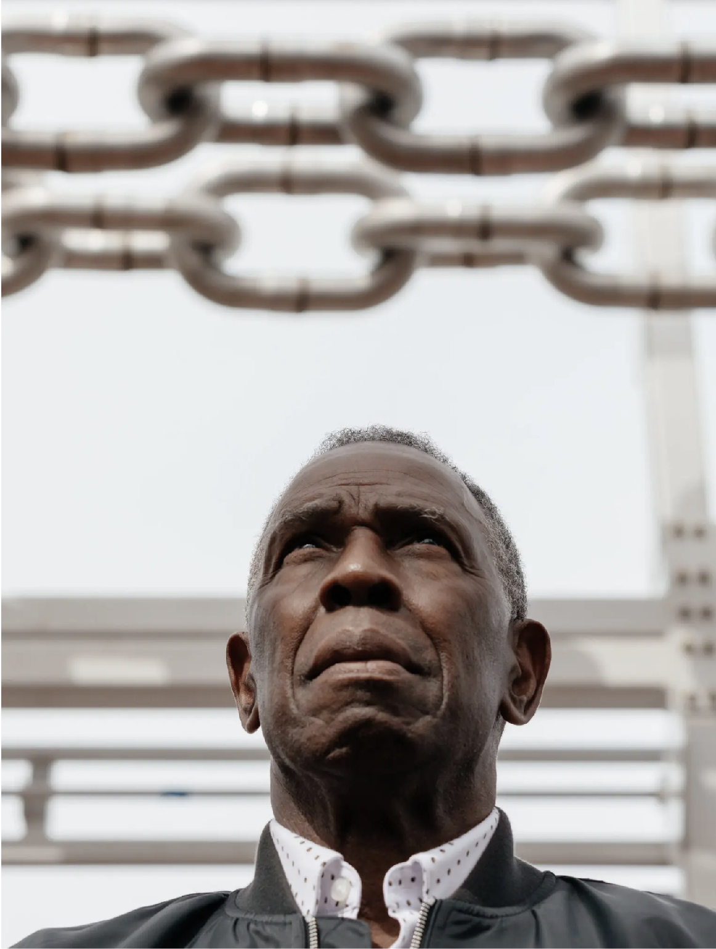
Charles Gaines, The American Manifest, 2022

Slide 11
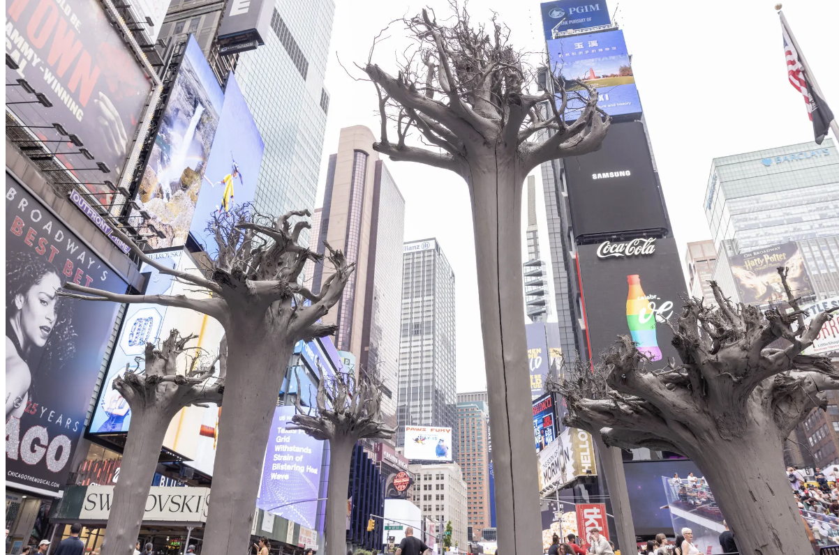
Charles Gaines, The American Manifest: Roots, Times Square, New York City, 2022 - Interactive monument - Recalls the wilderness of pre-colonial America
Notes:
https://www.nytimes.com/2022/10/07/arts/design/charles-gaines-governors-island-public-art-chains.html

Slide 12
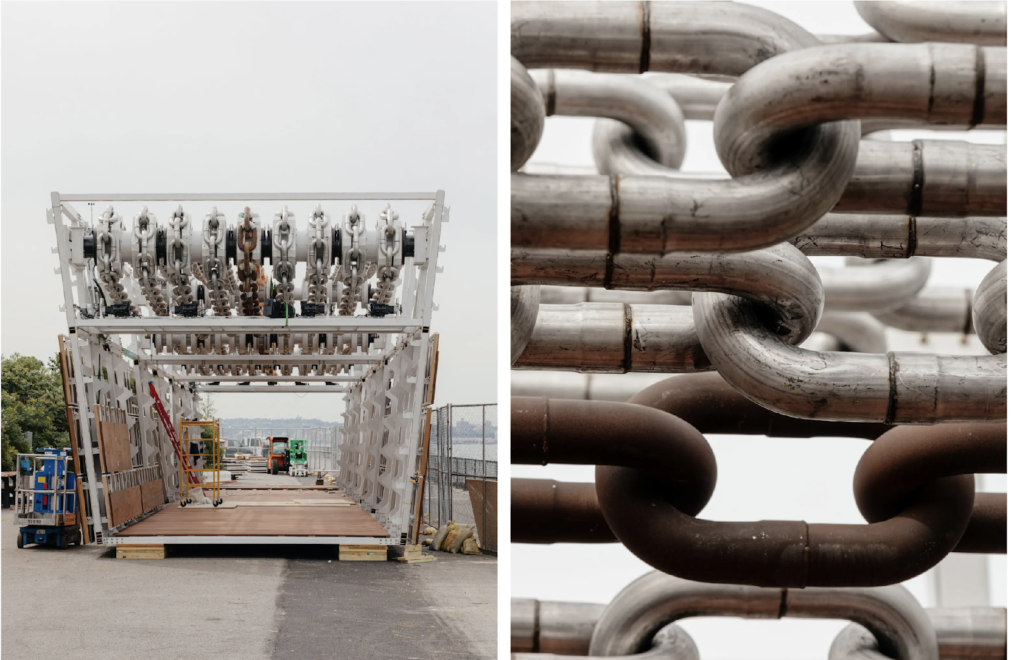
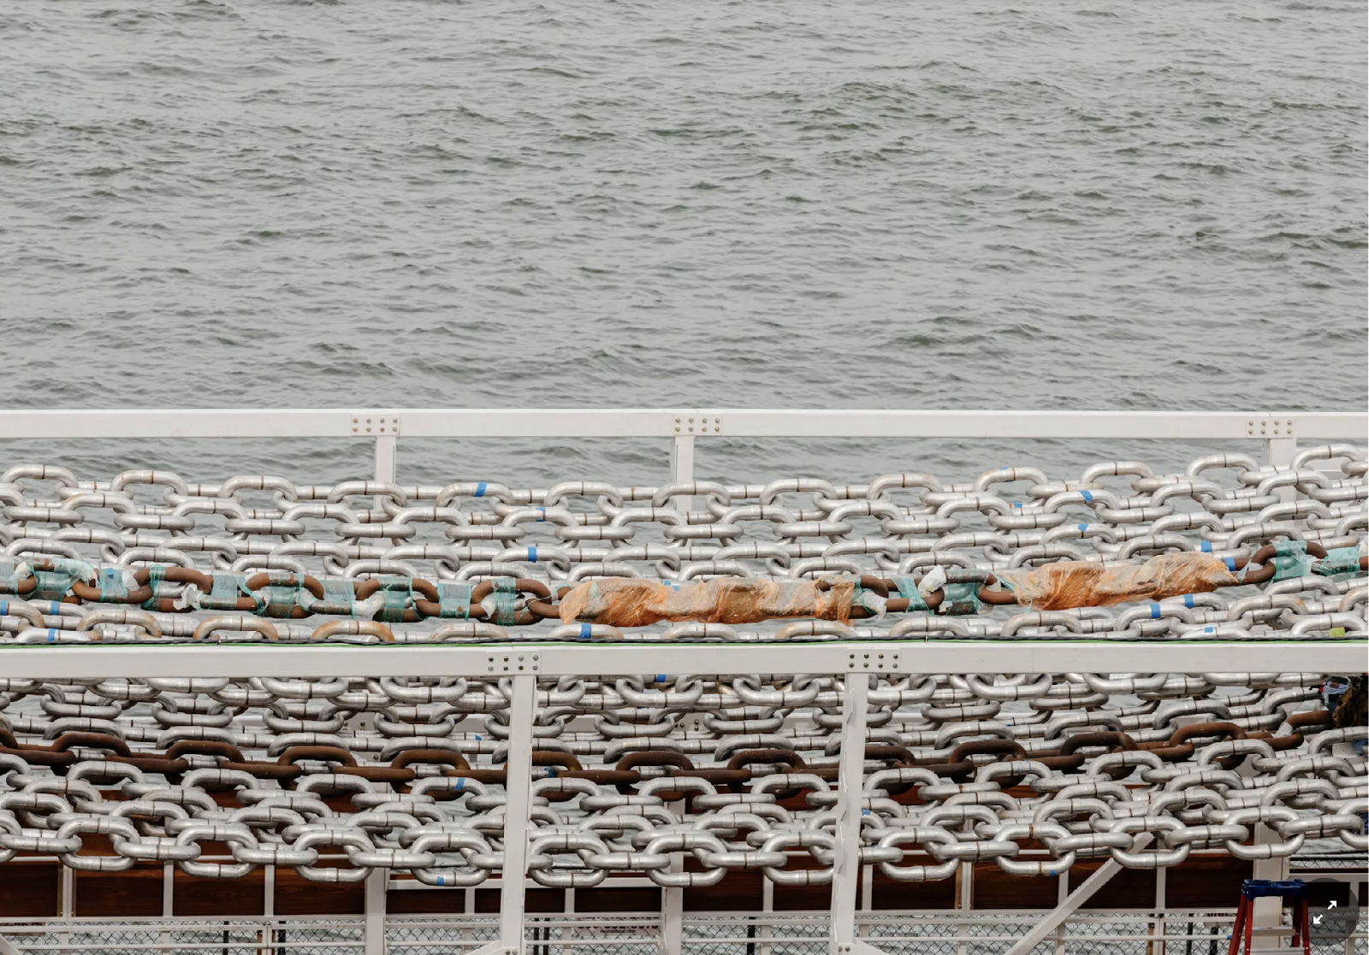
Charles Gaines, The American Manifest: Moving Chains, Governor’s Island, New York, 2022 “The project evokes river transport, industry, territorial expansion — the building of the American economy from conquest.”

Slide 13
“’Art can legitimately inform culture as much as any other discipline, rather than being this sort of pleasure, or way of escaping society.’” Coursing through his projects is a social concern: How can art destabilize the power structures that channel our thinking? “’I’m really invested in the idea of the power of art in relation to the public.’” Charles Gaines

Slide 14
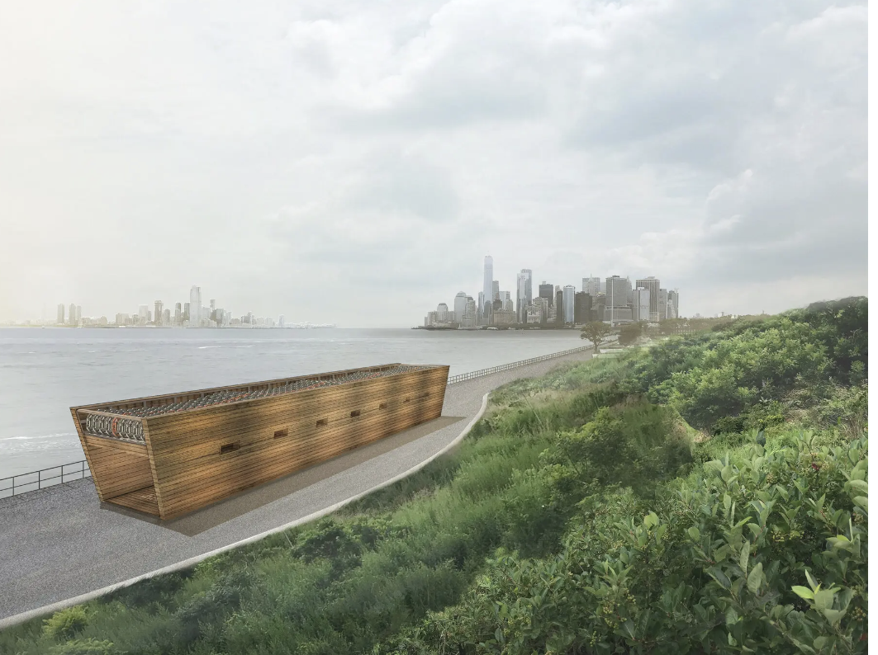
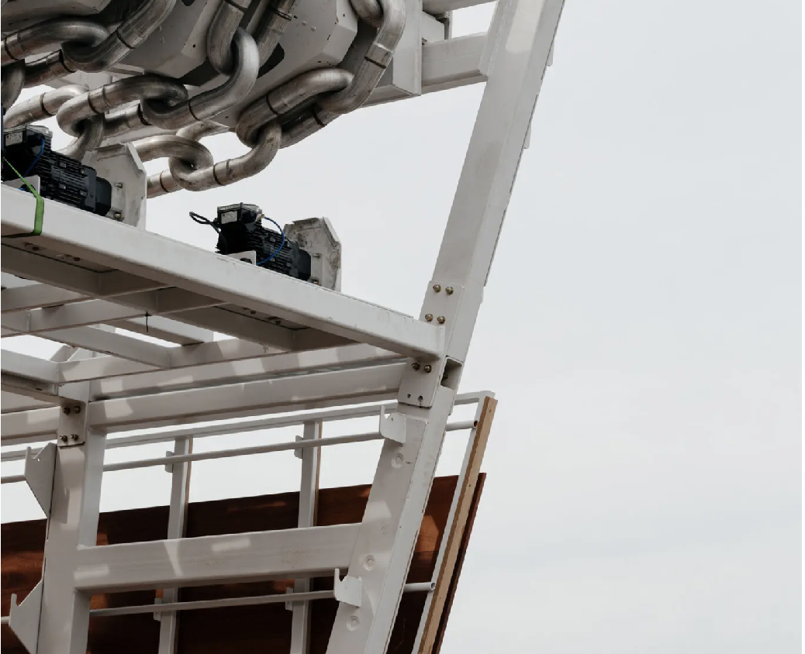
“Visitors can enter the construction, the chains rumbling overhead. The floor and wall cladding are made from sapele, a sustainably harvested African wood. ‘The cladding creates a resonating space,’ Gaines said. ‘You won’t lose your hearing, but hopefully your bones will rattle.’”

Slide 15
Looking Back
Positives about looking back?
Negatives about looking back?

Slide 16
Anselm Kiefer, Lot’s Wife, 1989
Who is Lot’s wife and what is the importance of her story?
Notes:
Artwork: https://www.clevelandart.org/art/1990.8
Additional Information: https://thepostcalvin.com/salt-ash-and-lead-an-artist-and-his-materials/

Slide 17

Lot and his wife were biblical figures who were instructed to leave Sodom and Gomorrah. Additionally, they were not to look back on the cities as they departed. Lot’s wife did look back, however, and was turned into a pillar of salt for doing so.
Anselm Kiefer references this story to address universal themes of regret, consequences, mistakes, looking to the past vs. looking forward, and more.

Slide 18
Anselm Kiefer’s painting Lot’s Wife encourages us to confront tragedies, especially large-scale destruction like the Holocaust, Hiroshima and Nagasaki, tsunamis, hurricanes, earthquakes, etc. As we confront them, his art argues, we must also move forward.
Train tracks, straw, shellac, and lead are often involved in Anselm Kiefer’s works as references to the Holocaust.
Notes:
Examples:
Bohemia Lies by the Sea, 1996: https://www.metmuseum.org/art/collection/search/486996 OR https://www.khanacademy.org/humanities/global-culture/concepts-in-art-1980-to-now/x247213a3:cold-war-germany-and-after/v/the-conservators-eye-anselm-kiefer-bohemia-lies-by-the-sea
Nürnberg, 1982: https://www.thebroad.org/art/anselm-kiefer/n%C3%BCrnberg
Iron Path, 1986: https://www.christies.com/en/lot/lot-5621943 [Auschwitz Concentration Camp]

Slide 19
Make a monument of your choice that relates to your own life or world events.

