Slide 1
Writing for All Levels
Teaching with the Visual Arts

Slide 2
Shorter Exercises

Slide 3
Daily Writing
Suggested artwork:
https://moa.byu.edu/moa-artwork-of-the-week (any)
Sample questions:
82 Questions

Slide 4
Journal Prompts
Suggested artwork:
https://moa.byu.edu/maynard-dixon-searching-for-a-home (any)
https://moa.byu.edu/treasures-from-the-collection (any)

Slide 5
Journal Prompts
One word that describes how I’m feeling right now is _____________________.
Today, the artwork that best demonstrates this word is ____________________.
This artwork demonstrates my word because ____________________.

Slide 6
Journal Prompt Images

Slide 7
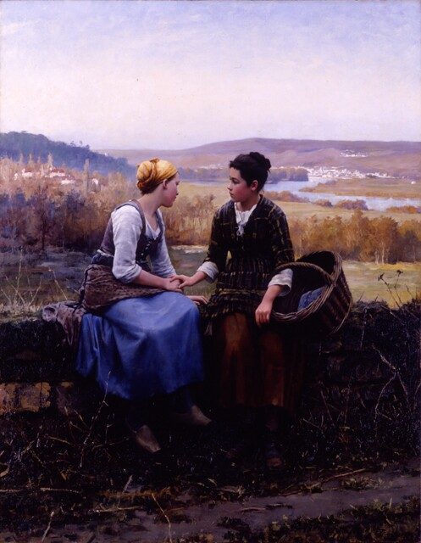
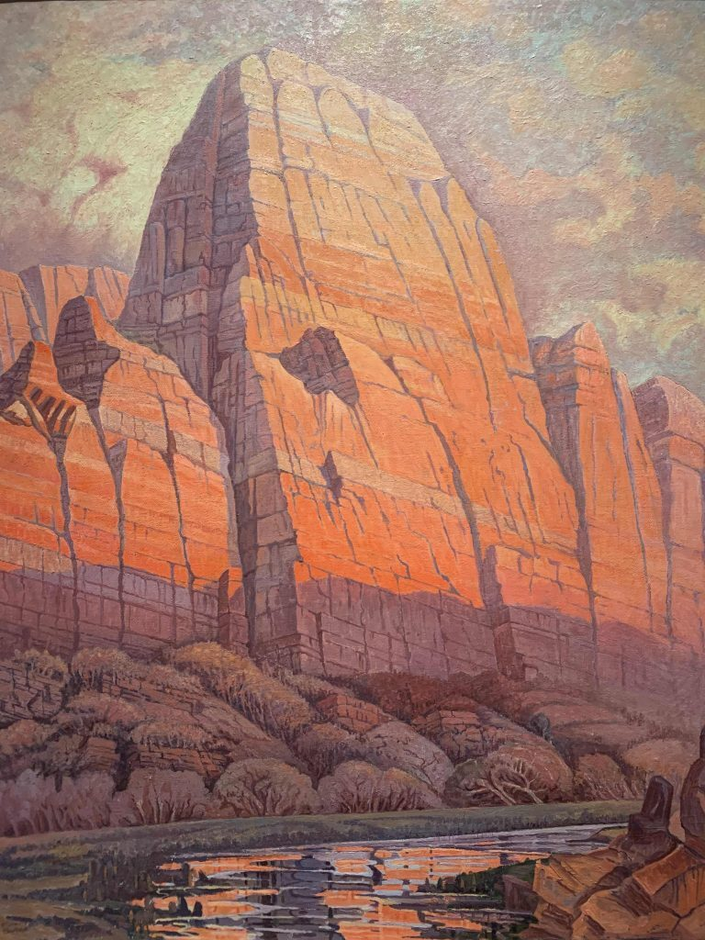
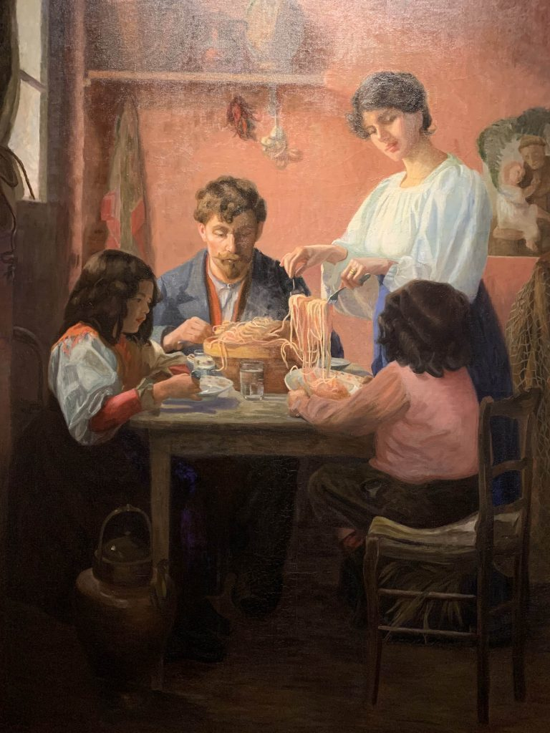
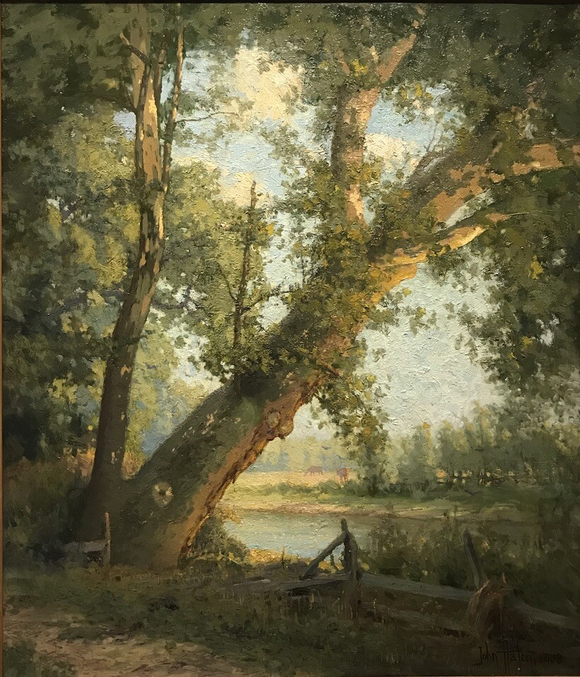
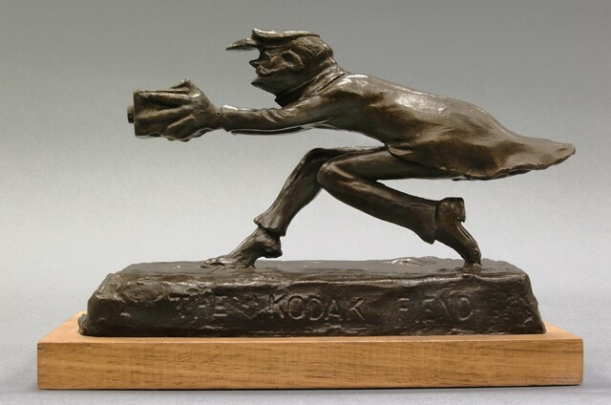
Notes:
Daniel Ridgway Knight (1839-1924), Premier Chagrin, 1892, Oil on Canvas. Brigham Young University Museum of Art, Purchased With Funds Provided By Jack R. And Mary Lois Wheatley, 2000.
Phillip Henry Barkdull (1888-1968), Great White Throne, C.1930, Oil on Canvas, 41 3/8 X 33 ½ Inches. Brigham Young University Museum of Art, Gift Of Mrs. Phillip H. Barkdull, 1968.
Rose Hartwell (1861-1917), The Frugal Meal, 1903, Oil on Canvas. Brigham Young University Museum of Art, 1941.
John Hafen (1856-1910), The Sycamore Tree, 1908, Oil on Canvas. Brigham Young University Museum of Art, Gift Of J. William Knight.
John Septimus Sears (1875-1969), The Kodak Fiend (1/30), 20th Century. Brigham Young University Museum of Art, Purchase/Gift of The Mahonri M. Young Estate, 1959.

Slide 8
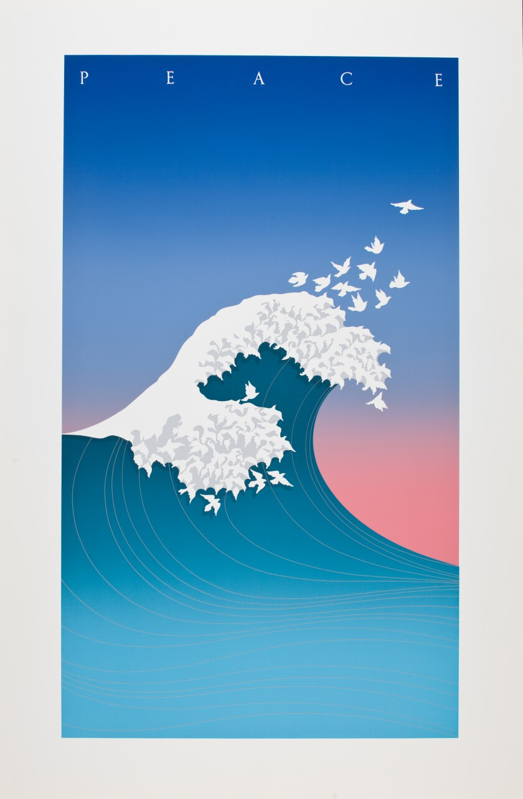
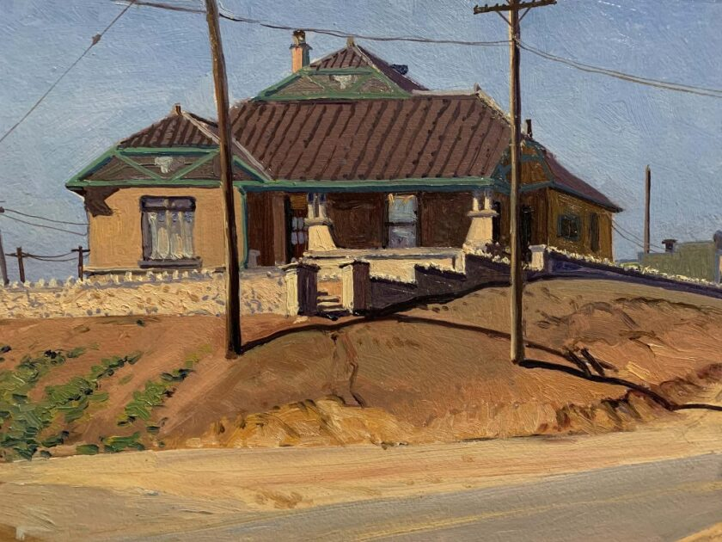
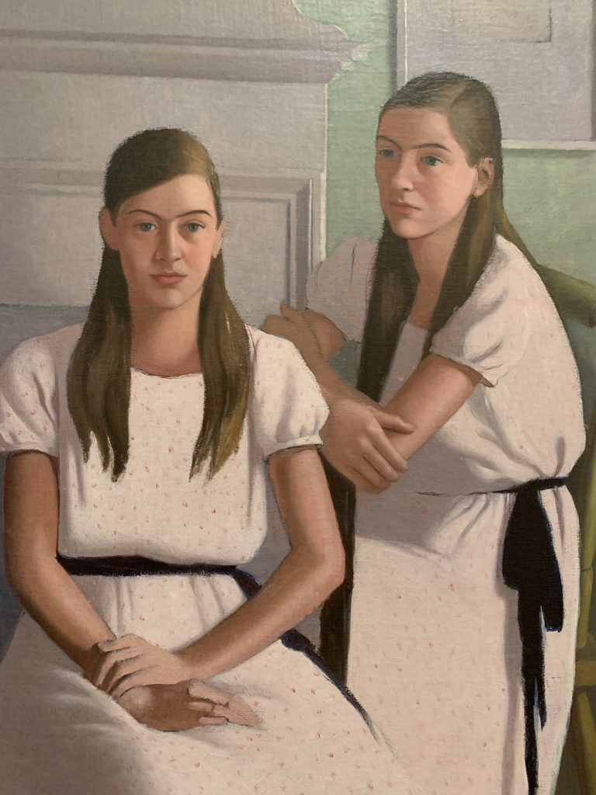
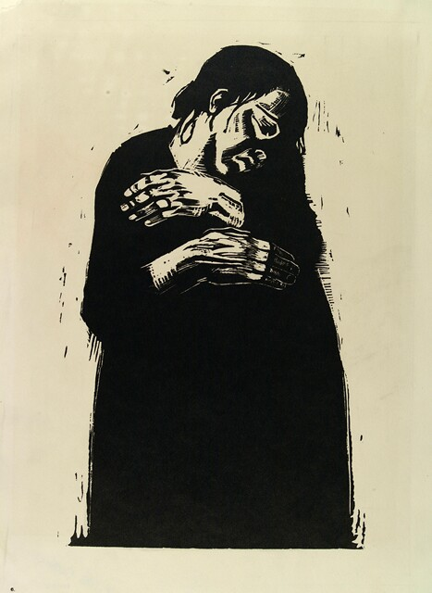
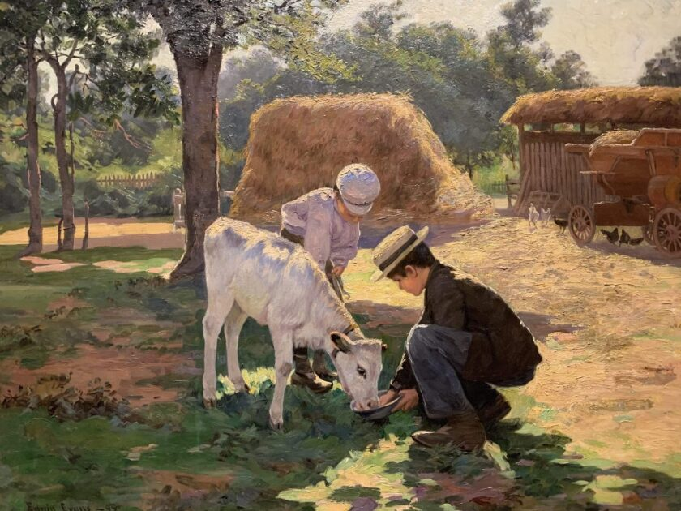
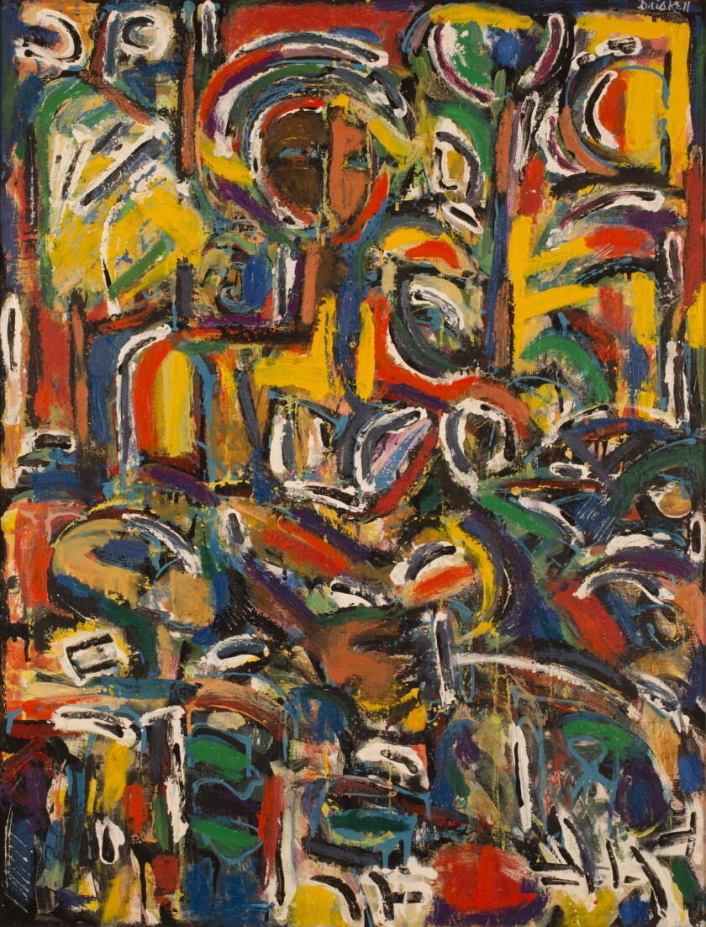
Notes:
Mcray Magleby (B.1941), Peace Wave, 1985, 1985, Silk Screen Print, 33 5/8 X 19 1/2 Inches. Brigham Young University Museum of Art, 2012.
Leconte Stewart (1891-1990), Western Gingerbread, 1937, Oil on Board. Brigham Young University Museum of Art, 1978.
Dorothy Weir Young (1890-1947), Twin Girls, C.1930, Oil on Canvas, 38 X 29 Inches. Brigham Young University Museum of Art, Purchase/Gift Of The Mahonri M. Estate, 1959.
Käthe Kollwitz (1867-1945), The Widow I, 1923, Woodcut, 18 1/8 X 12 13/16 Inches. Brigham Young University Museum of Art, Gift of Donald Goodwall.
Edwin Evans (1860-1941), The Calf, 1899, Oil on Canvas. Brigham Young University Museum of Art, Gift pf Maria Winder, Before 1928.
David Driskell (1931-2020), Lady In Waiting, 1992, Oil and Encaustic on Canvas, 44 ½ X 34 ½ Inches. Brigham Young University Museum of Art, Gift of The John M. And Pauline N. Fife Collection of African American Art, 2014. © The Estate of David C. Driskell. Courtesy of DC Moore Gallery, New York.

Slide 9
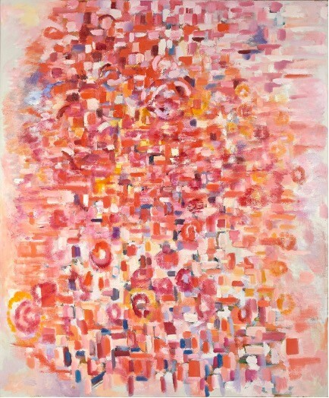
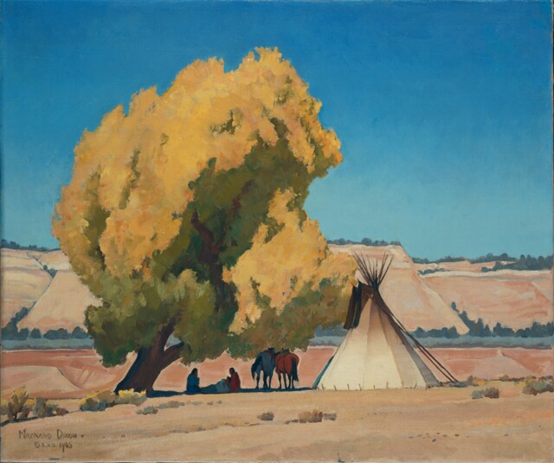
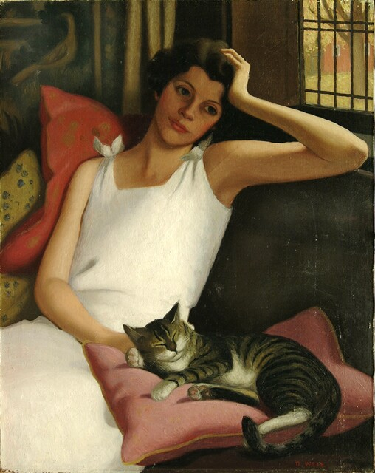
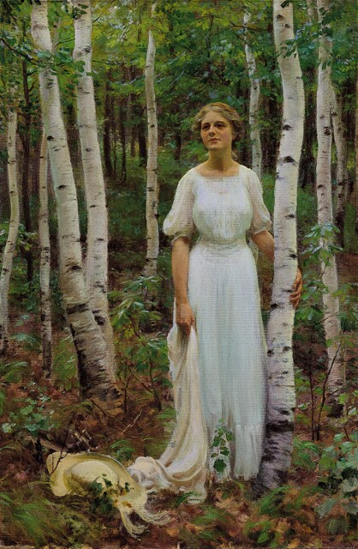
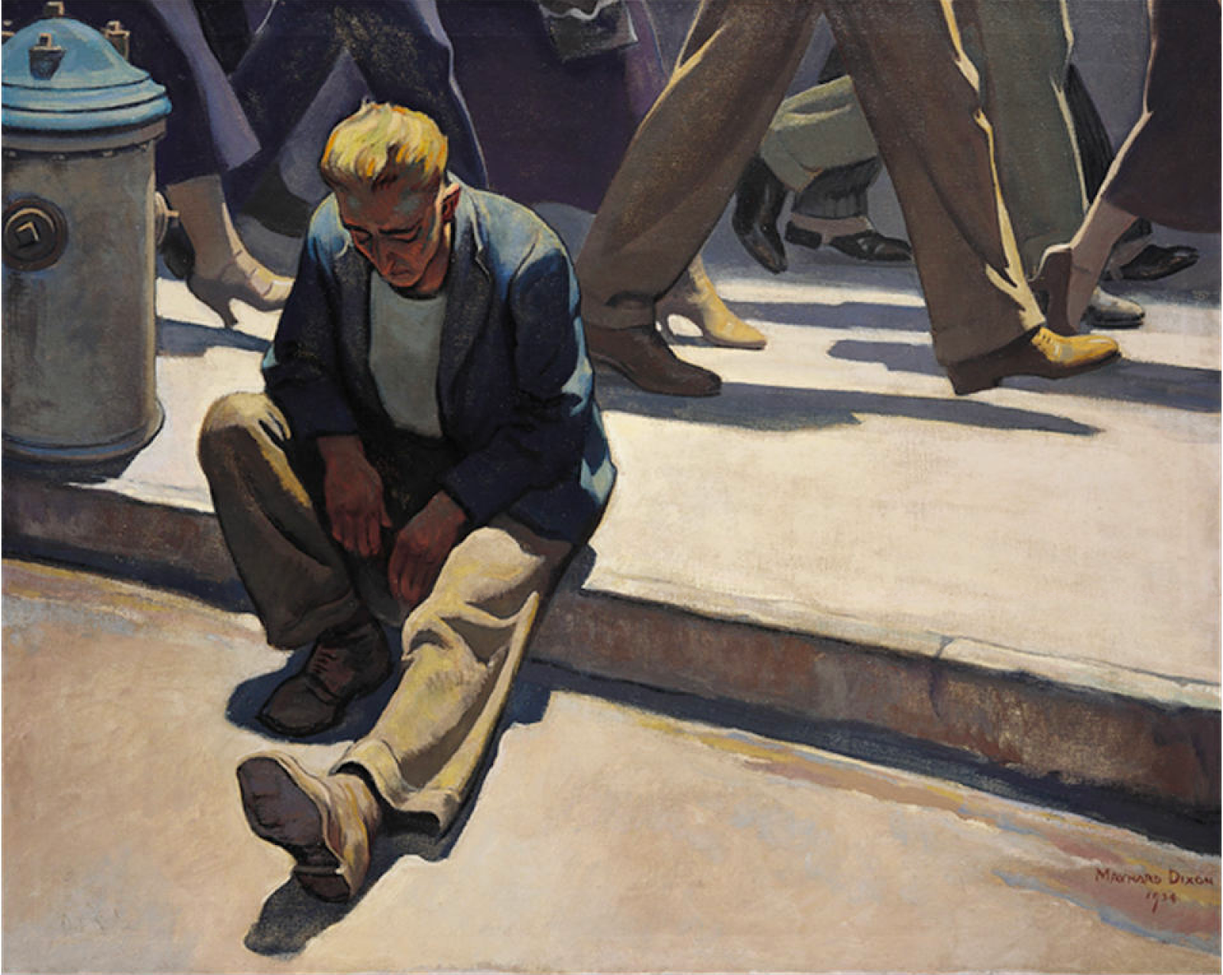
Notes:
Mari Lyons (1935-2016), Abstract In Pink, No Date, Oil on Canvas, 72 1.8 X 59 ¾ Inches. Brigham Young University Museum of Art, 2022.
Maynard Dixon (1875-1946), Lazy Autumn, 1943, Oil on Canvas. Brigham Young University Museum of Art, Gift of Gene L. Jones and Hazel Anna Smith.
Dorothy Weir Young (1890-1947), Theresa And Tommy, C.1932, Oil on Canvas, 27 1/8 X 34 1/8 Inches. Brigham Young University Museum of Art, Purchase/Gift of The Mahonri M. Young Estate, 1959.
Charles Courtney Curran (1861-1942), Woodland Solitude, 1913, Oil on Canvas. Brigham Young University Museum of Art, Gift of The A. Merlin Steed and Alice W. Steed Collection.
Maynard Dixon, Forgotten Man, 1934-1936, Oil on Canvas, Brigham Young University Museum of Art.

Slide 10
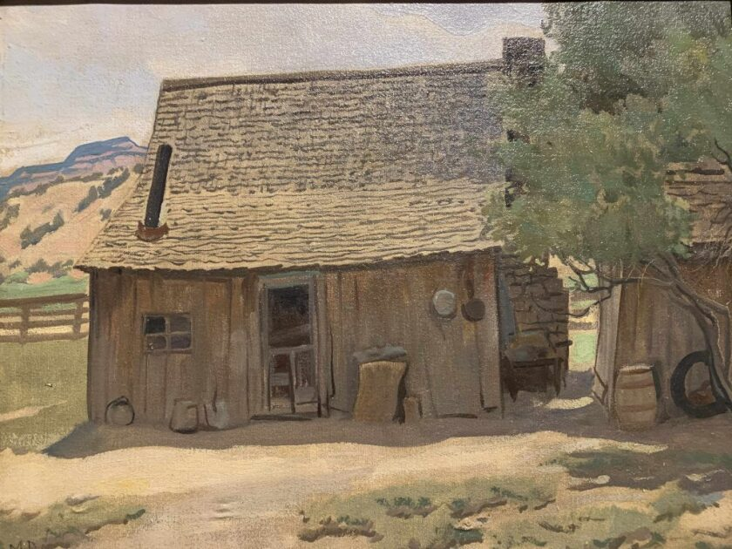
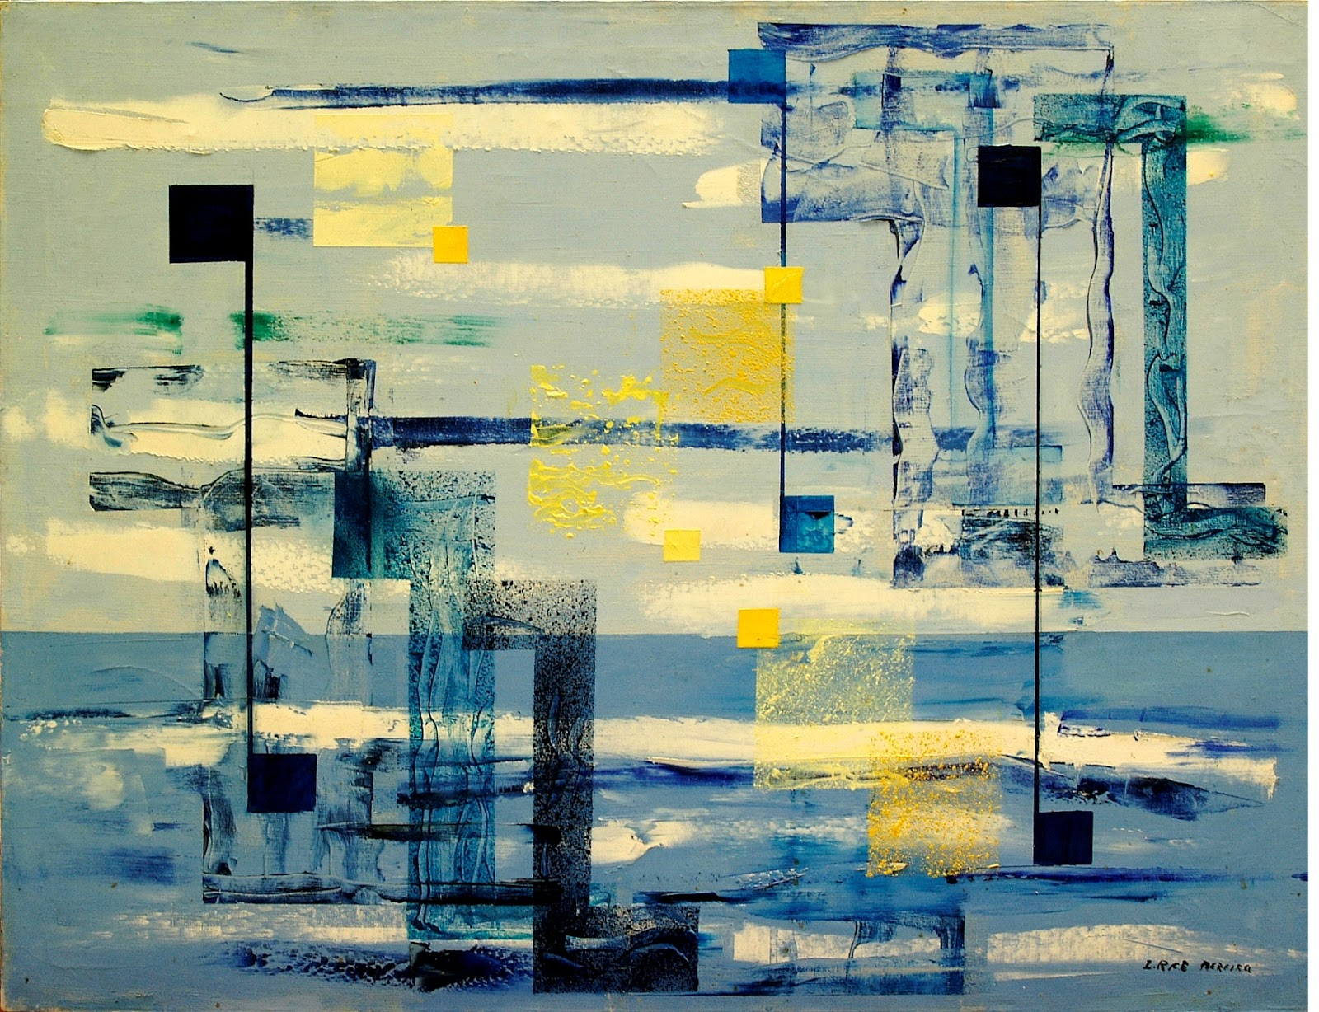
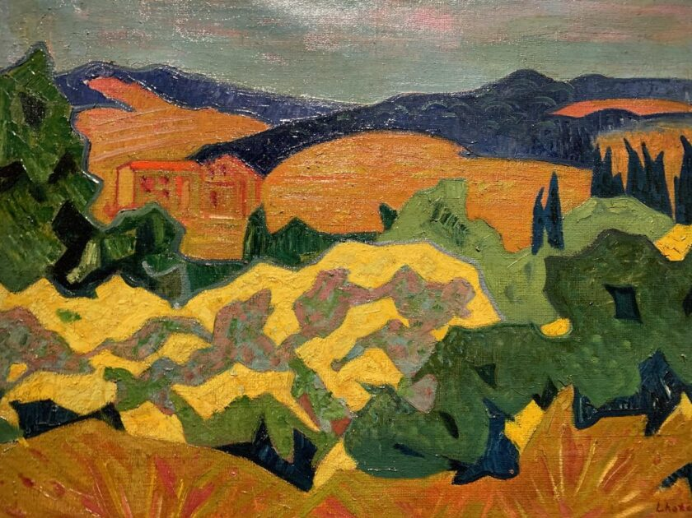
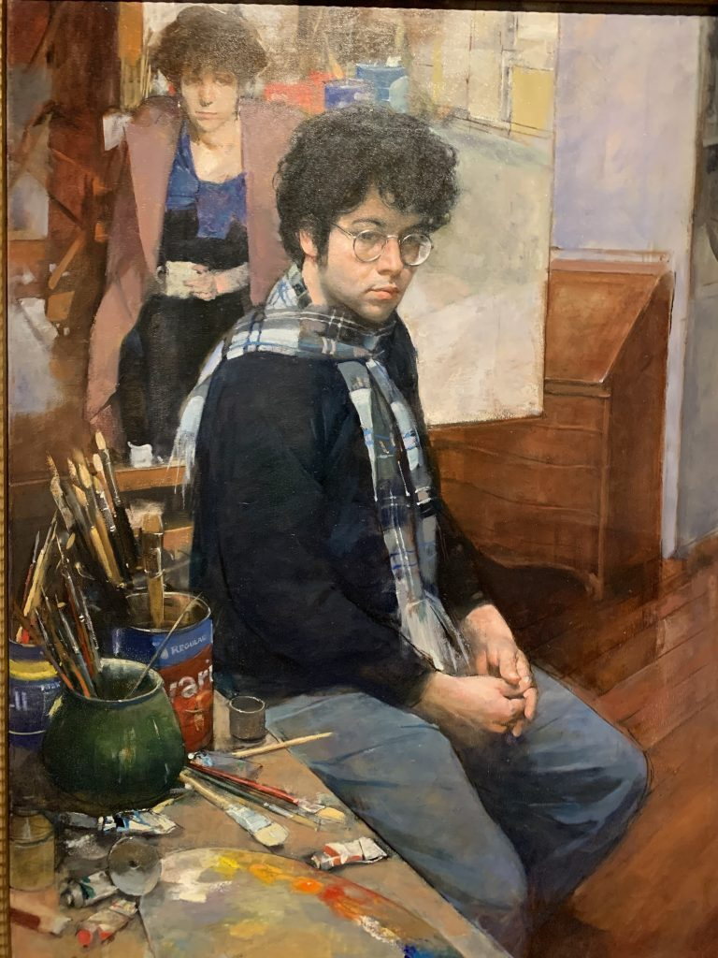
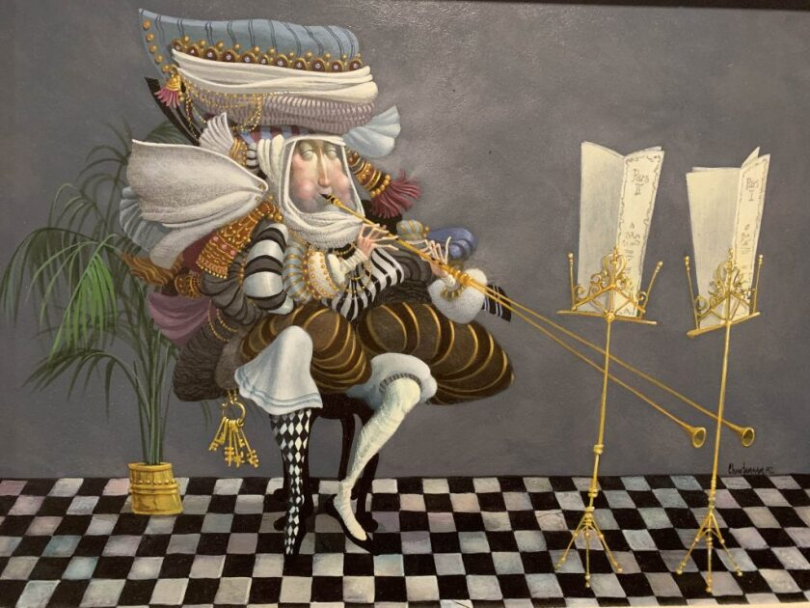
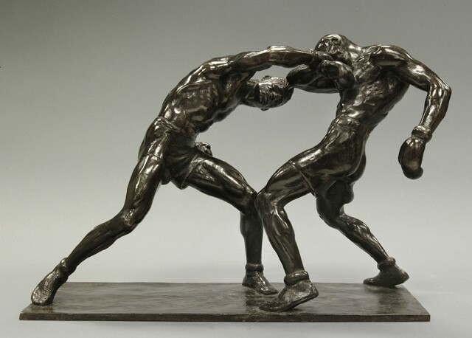
Notes:
Maynard Dixon (1875-1946), Dad Walker’s House, 1933, Oil on Canvas. Brigham Young University Museum of Art, 1937.
Irene Rice Pereira, The Spirit Of Unity, Acrylic on Canvas, 32 1/8 X 42“, Brigham Young University Museum of Art, Gift of Richard L. and Marian N. Warner.
Andre Lhote (1885-1962), Maritime Alps (Landscape), 1935, Oil on Canvas. Brigham Young University Museum of Art, Gift of Lynn J. Dowden, 1970s.
Burton Silverman (B.1928), Passage, 1993, Oil on Linen. Brigham Young University Museum of Art, 1999.
James C. Christensen (1942-2017), Duet For Single Musician, 1982, Acrylic on Board. Brigham Young University Museum of Art, 1994.
Mahonri M. Young (1877-1957), Right To The Jaw, 1926, Bronze. Brigham Young University Museum of Art, Purchase/Gift of The Mahonri M. Young Estate, 1959.

Slide 11
Collaborative Poetry
Suggested artwork
https://moa.byu.edu/recent-acquisitions
Family on Horse Drawn Cart, Joseph Paul Vorst (scroll to 15 of 25)
https://moa.byu.edu/recent-acquisitions
Abstract in Pink, Mari Lyons (scroll to 2 of 25)
https://moa.byu.edu/00000181-ac35-d0f9-a7bd-bfb7c64b0001/i-spy-zentangles (Trifloria, Jeanne Leighton-Lundberg Clarke)
https://moa.byu.edu/00000184-154f-d2de-abb7-557f34ea0001/arizona-teaching-poster (Arizona, Nat Leeb)
https://moa.byu.edu/artwork-of-the-week/artwork-of-the-week-february-6-2023 (Lady in Waiting, David Driskell)
https://moa.byu.edu/maynard-dixon-searching-for-a-home (any image)

Slide 12
Character Developments or Journal Entries
Suggested artwork
https://moa.byu.edu/00000184-161a-d2ff-a7b6-1f9fa0f70001/first-grief-teaching-poster (Premier Chagrin (First Grief), Daniel Ridgway Knight)
https://moa.byu.edu/00000181-ac36-d9e0-a789-be367df70000/a-letter-home-one-point-perspective (Immigrants to New York City (Jewish Refugees), Minerva Teichert)
https://moa.byu.edu/from-the-vault-guide (In the Beginning, Ernie Barnes, scroll half-way down)

Slide 13
Character Developments or Journal Entries
Consider the following questions (all responses must be based on what can be found in the painting):
How old do you think the individual is?
What is their social status? How can you tell?
What types of things do you think are important to them?
Based on their body language and facial expression, how does the individual feel right now? Why might they feel that way?
What do they like to do for fun?
How would their friends describe them?
What other information can students infer about the individual?

Slide 14
Longer Exercises

Slide 15
Verbal Descriptions
Suggested artwork (postcard images available upon request. Email liz_donakey@byu.edu)
Against the Sky, Robert Reid; Boy with Peonies, Robert Reid; In the Sun, Julian Alden Weir
Grain Fields, Edwin Evans; Off the Maine Coast, Samuel Colman; Mountain Landscape, John Frederick Kensett; Lake Scene, Sanford Robinson Gifford

Slide 16
Tips for Writing Verbal Descriptions
Start with the big picture
Establish perspective
Clarify size and scale of objects within the image
Give information in relation to other details (use prepositions)
Refer to samples
Notes:
Resources:
http://www.artbeyondsight.org/mei/verbal-description-training/writing-verbal-description-for-audio-guides/#:~:text=Art%20Beyond%20Sight%20uses%20the,uses%20the%20term%20audio%20description.
https://www.cooperhewitt.org/cooper-hewitt-guidelines-for-image-description/

Slide 17
Verbal Descriptions Samples

Slide 18
Silver Chalice with Roses, Julian Alden Weir
This still life painting is 12” x 9”, roughly the size of a piece of paper, and was created as a birthday gift from the artist to his fiancée. It features floral arrangements in a bowl and vase (the vase behind the bowl), and a covered silver chalice behind both the bowl and the vase. The chalice is just right from center, but left of the vase. The still life is placed in front of a warm orange-brown background, which gradually becomes darker in color towards the bottom left corner.
The bottom half of the chalice is hidden from view by the roses in the foreground, but the upper half, which is visible, is created with detailed texture. From what is visible of the middle third of the chalice, grooves cross both vertically and diagonally to create a diamond-like pattern. As we move up the chalice, it begins to widen and the diamond-like pattern softens to reflect the shape of a rose petal. The widest point of the chalice is reached about 3/4th of the way up then, the chalice abruptly narrows again to a thin decorative finial at the top.
In front and slightly right of the chalice is an indistinct indication of a vase filled with three roses. The two roses on the left are a cooler white color, and the third on the right is a much warmer yellow. At their height, the roses reach the widest point of the chalice.
In the foreground in front of all of this, there is a shallow bowl in the center of the painting filled with roses and other small flowers. In the bowl are two roses on the left side, one which is more of a peachy pink, and one which is more yellow, close in color to the rose in the vase on the right side. The roses in the bowl are about double the size of the roses in the vase and have fully opened. In the right side of the bowl are small yellow flowers. At their highest point, the flowers in the bowl reach about halfway up the vase between the bowl and the chalice.
Scattered on the surface that the bowl sits on are some small flowers still attached to a stem, as well as a few rose petals. Slightly behind the bowl to the left is a pink rose with some small white flowers. Weir painted each of these flowers in a loose, impressionist brushstroke, despite his prior opposition to the style.

Slide 19
Family on Horse Drawn Cart, Joseph Paul Vorst
Family on Horse Drawn Cart by Joseph Paul Vorst is a painting that measures about 32 inches square. Vorst depicts a black family headed up a hill to church on a wooden cart with metal wheels drawn by a single horse. The cart and the family fill the majority of the piece, headed away from the viewer along a country road that curves along the right side of the painting. The road winds toward a church in the distance in the far upper right corner with a large tree shading the church’s courtyard. The parents are seated in the front of the cart (mother on the left, father on the right), facing away from the viewer, while their four children slouch in the back. In the scene, the parents have stopped the cart to talk with a woman walking by, although the woman is mostly obscured by the cart and the mother’s arm as she reaches up to touch her white hat. The mother is also wearing a white scarf around her neck and a yellow dress. The father is wearing a wide-brimmed gray hat, with a white shirt and white pants. His right leg dangles over the outside of the cart, showing part of his bare lower leg and a brown boot. Their three daughters and one son all sitting in the back of the cart look as though the ride to the church is longer than they would have liked. On the left the cart bed, one of the older daughters and the youngest daughter look off to the right, over the shoulder of the viewer. While they seem to be looking at the same thing, it holds no interest for either of them. The older daughter sits at the edge of the cart, her legs dangling over the back. She is wearing a white sleeveless dress with a wide, flowing collar; a white hat with a small brim, angled to sit lower over her right ear; white high-heeled shoes; and is holding a couple of small red rosebuds in her hands as she leans against the side of the wagon. The youngest daughter sits in the back of the wagon, and is wearing a pink dress with a white pillbox hat with several braids hanging down, one of which rests on her forehead. The third daughter and the son sit on the right side of the cart, facing down at something in the center of the wagon bed, equally disinterested. The daughter’s legs hang off the back of the cart like the first, and her face is turned away, letting the viewer see her head graced with a white ribbon that encircles intricate braids running horizontally across the back of her head. She is also wearing a white sleeveless dress with white high-heeled shoes, and her stockings have rolled down her legs and gathered about her ankles. The son is wearing a tan newsboy cap: rounded in the back with a small stiff brim in front. He is also wearing a white shirt with red suspenders. Along the left side of the lane, a small storefront is nestled between two small trees, with two more trees running along the road toward the church. Outside the building are two gas pumps from the 1930s or 1940s, indicating the popularity of automobiles at the time. Though the family may not be able to afford a car, it is evident that they dress nicely for church. The gas pumps, like the trees, figures, and entire painting, are stylized, or painted without extreme naturalism. Behind the building on the left, running along the upper part of the painting, is a small hill, tracing along a cloudy blue sky.

Slide 20
Fallen Monarchs, William Bliss Baker
Fallen Monarchs by William Bliss Baker is a landscape painting that measures about 30 inches tall by about 40 inches wide. Baker places the viewer within a forest scene with predominantly grayed trees, showing a hint of morning sunlight filtering through some of the more distant trees. Yellow and brown autumn leaves cling to the mostly bare tree branches and litter the forest floor. While most of the trees in the painting are relatively young, on the right, there is a large, weathered tree, which has fallen to the ground towards the viewer. To the left of this fallen tree, starting in roughly the center of the canvas, a small river approaches the viewer, splitting off to both sides of the canvas. The still river is mostly brown from the reflection of the trees and the leaves floating atop it. In the center of the canvas where the river is first visible, a second fallen tree is found. This tree spans the river, creating a bridge over the water. On the left side, there are two tall trees, one about twice as wide as the other, whose tops cannot be seen in view. Despite the weather edging toward winter, Baker’s use of gold, particularly in the fall leaves, and the lush, green moss on several tree trunks adds a feeling of warmth to the scene. The tall, slender trees standing vertically throughout the painting also lend a feeling of majesty to the overall view. The ornate, gilded frame, covered in leaves and flowers, and the inscription in the bottom center of the frame furthers this thought. It says, “These lofty trees wave not less proudly that their ancestors moulder beneath them.”

Slide 21
Mrs. Edward Goetz, John Singer Sargent
Mrs. Edward Goetz by John Singer Sargent is a painting that measures about 58 inches tall and 42 inches wide. This portrait of Mrs. Goetz shows the subject seated in a chair with decorative wood trim and white velvet fabric, decorated with an occasional red and blue flower pattern. Both Mrs. Edward Goetz and the chair she sits in are angled slightly toward the right side of the image, but Mrs. Goetz turns her head to look straight at the viewer. Mrs. Goetz is an older white woman with close set gray eyes, a long slender nose, and slightly pursed red lips. Although she does not have a lot of wrinkles, her soft skin and gray hair give away her age. Her hair is pulled up and pinned decoratively on her head, and she sits with her back straight, her left hand resting on the chair’s armrest, and her right hand resting in her lap. Her stately and stiff posture contrast the kind and peaceful expression on her face. Mrs. Goetz is clothed in a black long-sleeved gown and a chiffon shawl embellished with lace atop of it, gathered and knotted in front just above her waist, but trailing off to her right side under her forearm. She also wears a black choker necklace. She appears to be a woman of some wealth, based on the opulent dress, the rings adorning one of her fingers on each hand, and her pearl earrings. Behind her, the light wall is mostly bare, but features wooden trim and a border of a delicate gold vine with leaves, twining around a thin, straight gold line. This border runs behind her chair and then up the edges of the canvas on the left and the right. The largely blank background serves to focus the viewer’s attention back on Mrs. Goetz. Sargent’s bold yet loose brushstrokes suggest more detail than they actually depict.

Slide 22
Premier Chagrin (First Grief), Daniel Ridgway Knight
Premier Chagrin by Daniel Ridgway Knight is a portrait-oriented painting that measures about 60 inches tall by about 47 inches wide. The title, Premier Chagrin, translates from French as “first grief.” In this quiet countryside scene, two young white women sit on a low stone wall. The moss-covered wall is on the side of a road, though only the edge of the dirt road and dying plant life are visible. The clothing these women wear indicate they are French peasants from the 19th century. The first (the woman on the viewer’s left) sits fully on the wall, her body turned partially in towards the woman on the viewer’s right, but her face turned so far that even a profile is barely visible. The first woman’s legs and feet (covered in dark gray stockings and light brown wooden clogs) dangle just above the ground. Her hair is pulled up in a bun with a yellow scarf wrapped tightly around her head, leaving only the edges of her dark hair visible. The long sleeves of her white shirt are rolled up toward her elbows, and a dark brown bodice laced up in the front holds the shirt close to her body. The bodice is the top of an overdress, the skirt of which is pulled up around her waist. The overdress features a subtle rusty red polka-dotted pattern, and the ankle-length underskirt is a soft azure blue. This skirt, along with her yellow headscarf, are the two brightest colors in the painting, drawing the viewer’s attention to this first woman. Though her face is turned away from the viewer, the red color in her cheeks is clearly visible. With her left hand, she braces the top of the rock wall, and her right hand rests on her left leg. She leans in toward the woman on the right, indicating trust.
The woman on the viewer’s right sits on the edge of the wall, supported both by the wall beneath her and her feet on the ground. She looks at the first woman, as if waiting for her companion to speak. The young woman on the viewer’s right has dark hair, which is gathered up into a bun at the crown of her head. Her white long-sleeved shirt peeks out from under a midnight blue overcoat with a mustard yellow plaid pattern. The half-sleeve overcoat reaches her mid-thigh, and is cinched at the waist. She also wears a cotton skirt, the color of light brown leather, as well as tan stockings and worn black boots with brown tips. A thick wicker basket rests against the side of her leg, with the basket’s handle in the crook of the woman’s left arm. This arm is relaxed, resting against the edge of the basket. The basket is tipped slightly forward, revealing a blue fabric in the bottom which matches the first woman’s skirt. Her right hand reaches out and rests on the first woman’s right hand as if to console or give comfort to her after what she has just shared. While the two faces seem relatively still, there is a peaceful quality to the scene as two women connect over a shared pain. Behind them, a countryside stretches out to meet the light sky across the top fourth of the painting. A light blue river flows across the background, weaving back and forth on the right side of the painting. Both to the left of and behind the river are some hills covered with periodic groves of trees, their yellow autumn leaves getting ready to fall. The landscape elements in the background are painted in a looser brushstroke, in contrast to the precise detail of the women in the foreground and wall on which they sit.

Slide 23
Ladies at Dinner, Dorothy Weir Young
Ladies at Dinner, by Dorothy Weir Young, is nearly square, measuring at about 30” tall and 27” wide. The painting depicts five white women gathered around a square dining room table made of dark wood. The table is angled, as if the viewer stands at the corner. One lady sits in a mismatched chair on each side of the table: Though their designs differ, these tall chairs are each wooden with upholstered seats and backs. The fifth woman stands at the corner opposite the viewer, holding a bowl as the seated woman to the viewer’s left serves herself. The early 1900s setting is established through the furniture and clothing. At each place setting, the low bowls with wide rims are still empty, the silverware untouched, but the napkins have been unfolded across the ladies’ laps. A porcelain bowl in the center of the wooden table holds a colorful arrangement not intended for eating.
Around the table, the women are as follows, moving clockwise from left to right:
First, we see a young woman in a long tan dress; pink flowers adorn the elbow-sleeved outfit. She is seated mostly facing away from the viewer, with her legs are crossed at the ankles, just above the black heels on her feet. Her right elbow rests on the wooden arm of the chair, and her hand on the table; her light brown hair is pulled into a small bun at the nape of her neck, and she looks at the woman on her right (who will be the fifth woman described).
To the first lady’s left is the woman who serves herself from the proffered serving bowl. She wears a light blue short-sleeved dress. Her dirty blond hair is also pulled back. Additional details are not visible from this vantage point.
The third woman stands, holding the serving bowl for the second lady in her left hand, with her right hand down at her side. She wears a white collared blouse and white skirt. Her graying hair is also pulled back.
To the third woman’s left is the woman with the darkest hair. She wears a rich teal top, long black skirt, and heels. It is not clear how long her sleeves are with her hands in her lap. She looks to her left at the fifth woman, who is on the viewer’s right.
The fifth lady sits up straight in her long plum dress with full-length sleeves and a mauve collar. She wears her dark hair short, and folds both hands in her lap. Unlike the first lady, at whom she looks, her chair does not have any armrests.
The dining room features brown carpet and rosy pink walls on which hang multiple paintings by the artist’s father: J. Alden Weir. The left wall features a full-length portrait on the left, with a small landscape next to it. The portrait is of Dorothy’s mother Anna in a black dress with a lace bodice and cuffs. The right wall shows an open doorway on the left, leading to another room where an armoire and additional paintings are visible. To the right of the doorway features a portrait of Dorothy’s paternal grandfather, Robert Walter Weir, seated and wearing a dark suit and bowtie.

Slide 24
In the Beginning, Ernie Barnes
In the Beginning by Ernie Barnes is a landscape-oriented painting measuring 23” tall and 29” wide, which he painted around 1970. In the left foreground of this painting is a young man who faces the viewer’s right side of the canvas, but is also turned away towards a basketball hoop farther in the distance. This young man with medium-dark skin wears a red baseball cap, white t-shirt tucked into his light wash blue jeans, and white sneakers. His figure is elongated, and his hips are exaggeratedly shifted due to his weight being on his left leg while his right knee is bent. The concave arch in his back pushes his chest forward. His arms stretch over his head, following through on the basketball he has just shot, but it is evident that he has pushed off with both hands equally, rather than following through with his non-dominant hand. The basketball lingers in midair, just right of center of the canvas, almost to the hoop. The hoop, in the right third of the frame, is a worn homemade hoop with wooden slats for the backboard. In the background of the painting is a wooden house, which is the only other evidence of life in the scene. A few windows and covered porch are visible. Tall yellow grass grows on the ground the young man stands on, and it waves in a gentle breeze as indicated by its diagonal direction, and further emphasized by the loose, feathery brushstrokes. Soft grey clouds overtake the sky, though it does not look as though it will storm, and the entire piece is framed in worn wood.
The worn wooden frame pays homage to the white picket fence that once surrounded the home of the artist’s parents. When Ernie Barnes was preparing for his first solo exhibit, he received the news that his father had suffered a stroke. He drove across the country to be with his parents, and while there, he finished preparing for his exhibition. One day he noticed the fence his father had always taken such good care of had begun to look a bit worn. He took a painting and leaned it against the fence. He then said, “I was startled at the marriage between the old wood fence and the painting. It was perfect. In tribute, Daddy’s fence would hug all my paintings in a prestigious New York gallery. That would have made him smile.”

Slide 25
Additional Resources
Additional lesson plans that incorporate English Language Arts can be found with the MOA Teacher Resources:
https://moa.byu.edu/00000184-155b-d2de-abb7-557bd9b90001/riding-the-girder-teaching-poster
https://moa.byu.edu/00000186-7a4f-da16-a7ef-ffdf645b0001/converting-maynard-dixon-paintings-into-poetry-lance-larsen98-pdf

