Slide 1
Tissue Paper Quilts
By Tina Hollingshead

Slide 2
What do you think of when you think of quilts or quilting?

Slide 3
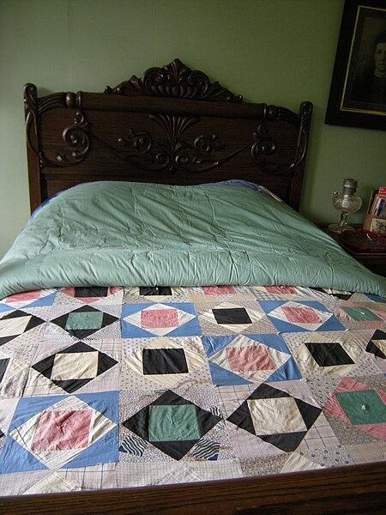
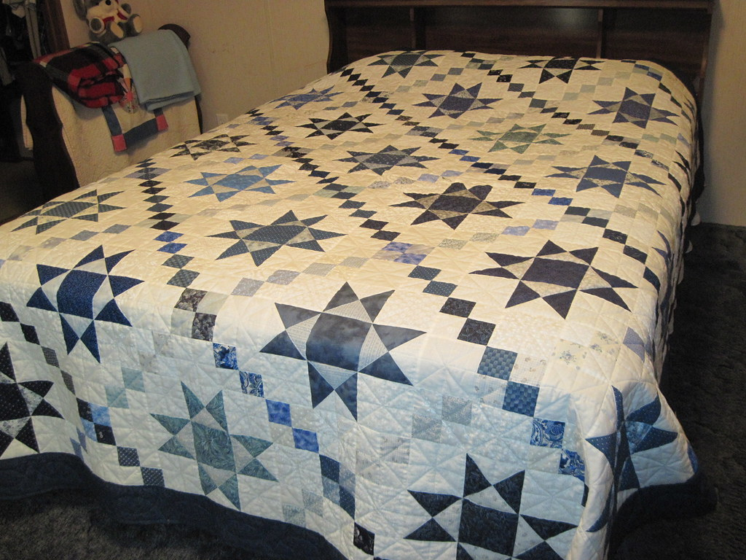
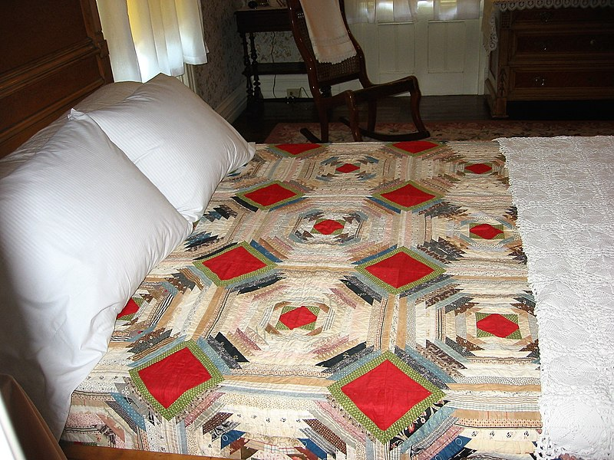
Did you know quilting is an art form?
What materials do you need when quilting?

Slide 4
Primal Forces: Earth
These quilts reference the forces that shape the earth’s surface, including:
Erosion, volcanic activity, earthquakes, and different weather patterns.
What do you see in each of these quilts? What colors are used? What patterns do you see?
These artists used a variety of materials in creating these pieces. The quilts are not on beds but hanging in a museum.

Slide 5
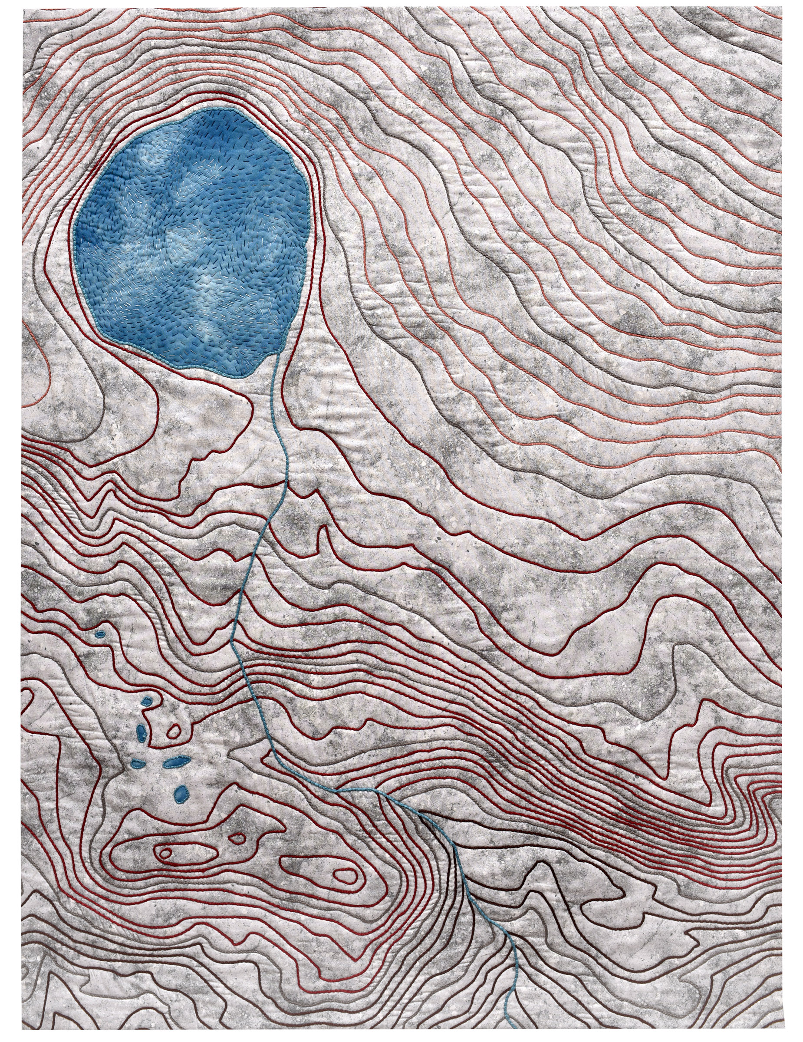
Desolation Relief, 2020
Holly Brackmann
Ukiah, California
USA
Notes:
Desolation Relief portrays a small portion of the topography of the Desolation Wilderness in the Sierra Nevada. Depicting the earth’s contours with couched yarns, discovering the water’s path from Gilmore Lake, and learning to recognize the slopes and the escarpments, were all part of the creation quest that brought back memories of walking up the steep trail past fields of scree, granite cliffs, and hidden meadows. It had never occurred to me that quilting would lead me to a deeper appreciation of this granitic landscape, where I made my first backpacking trip years ago. Fiber has played a central role in my life, so it is fitting that threads create the structure for abstract earth shapes.
Materials: Cotton
Techniques: Hand and machine couched, hand dyed, hand embroidered, machine stitched

Slide 6
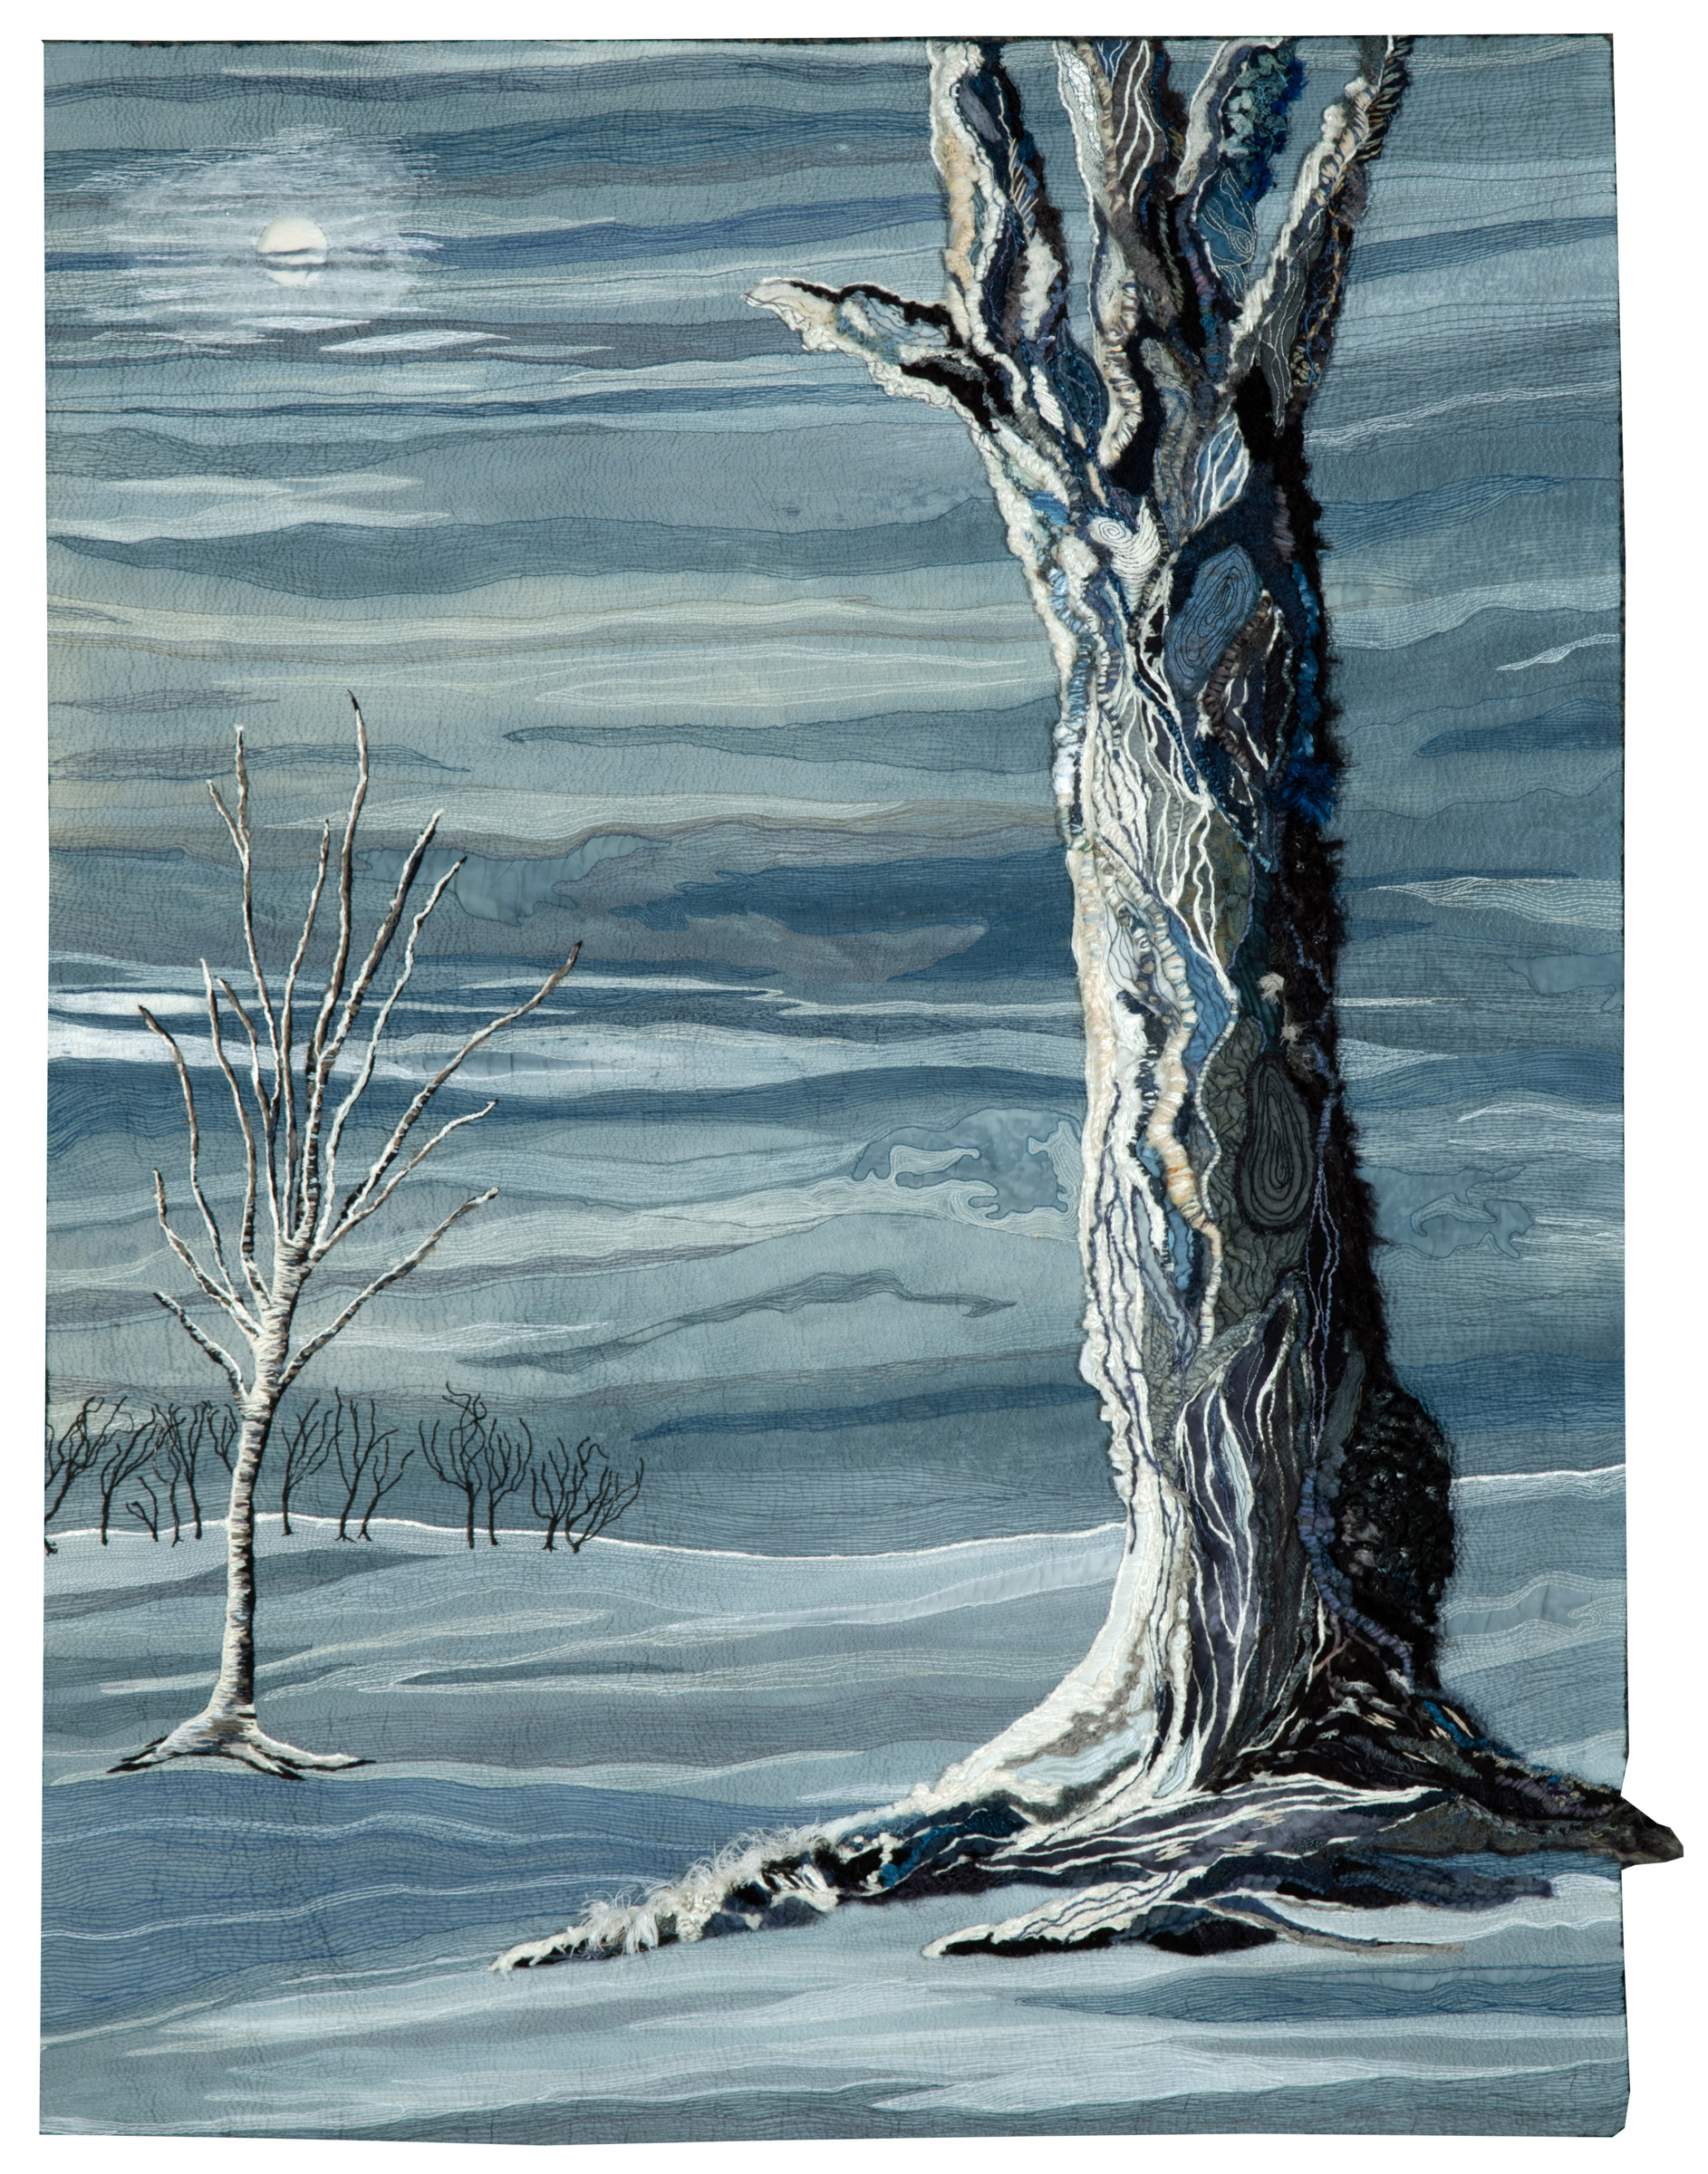
After the Warming—Permanent Winter, 2017
Jean Sredl
Shawano, Wisconsin
USA
Notes:
Our glorious Earth—after global warming particulate pollution has blocked the sun, plunging the earth into an ice age.
Materials: Cotton, wool, silk, recycled wool ties, deconstructed sweaters, tencel, fabric paint, wire, hair, heated activated stiffener
Techniques: Hand sewn, machine quilted, hand embroidered, dyed, manipulated

Slide 7
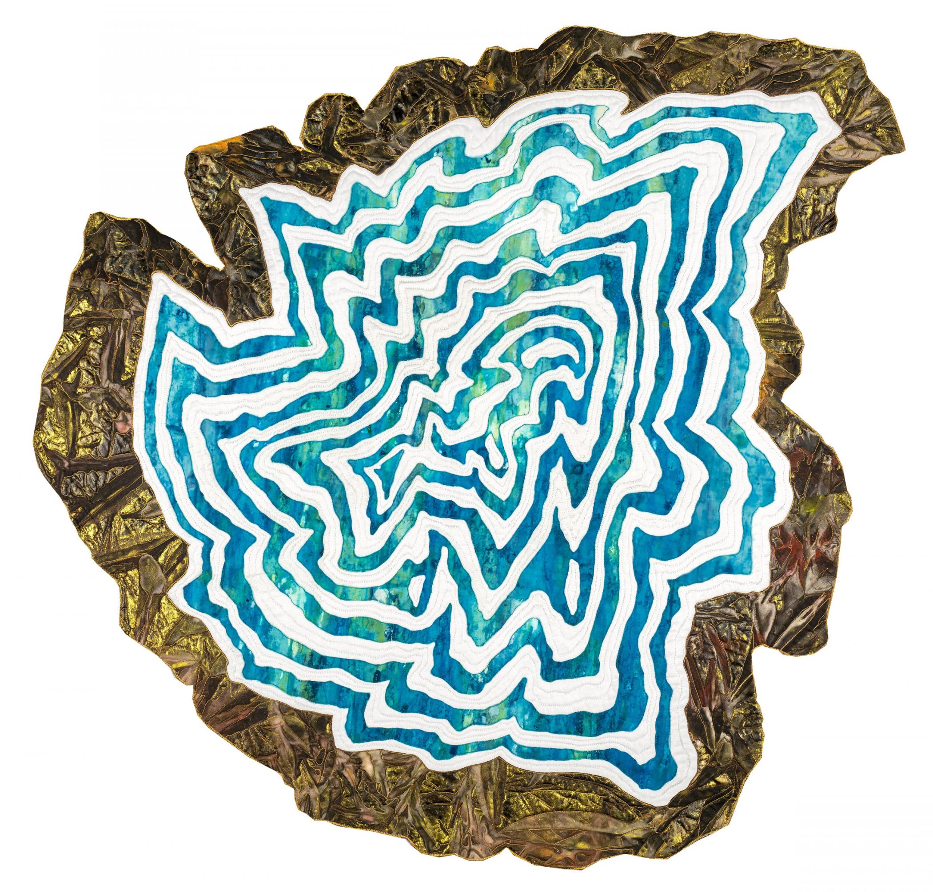
Cerulean Lake, 2018
Anne Severn
Loveland, Colorado
USA
Notes:
Cerulean Lake is inspired by glacial cirque lakes. Resulting from past glacial erosion, these lakes are found in the high country of most mountain ranges. Pristine and clear, they are most often a beautiful shade of azure blue, fed by melting snow and surrounded by shores of crystalline rock.
Materials: Fabric, hand painted silk
Techniques: Dyed, hand painted, raw edge appliquéd, stitched

Slide 8
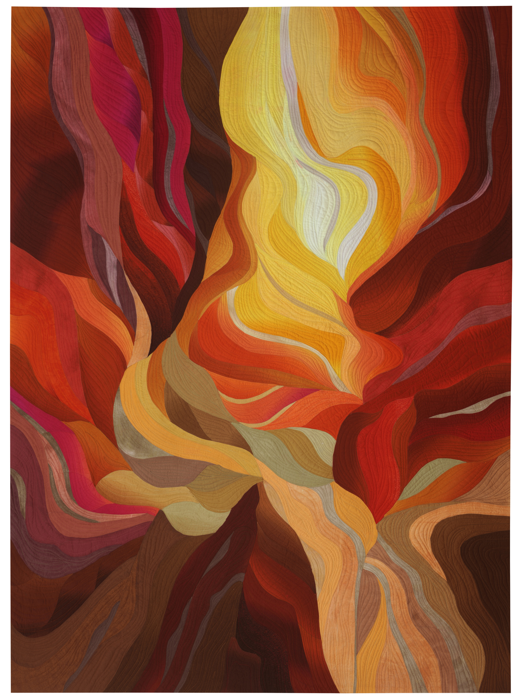
Slot Canyon #6, 2020
Vicki Conley
Ruidoso Downs, New Mexico
USA
Notes:
After visiting Antelope Canyon in northern Arizona, I was drawn to create a series of works based on the exquisite geology and the play of light through the rocks. These unique canyons are created by violent flash floods and are formed only when geological and environmental circumstances are just right.
Human activity is constantly transforming the surface of our planet, very often in ways that are detrimental. As increased greenhouse gases lead to warming, weather and storm patterns shift. Increased agriculture and population leads to damming of rivers and rerouting of runoff. Human interest in natural wonders can lead to over-visitation and erosion or damage to irreplaceable formations. Let us always act with thoughtfulness and with the goal of conserving our resources for the future.
Materials: Cotton
Techniques: Applipieced, free-motion machine quilted

Slide 9
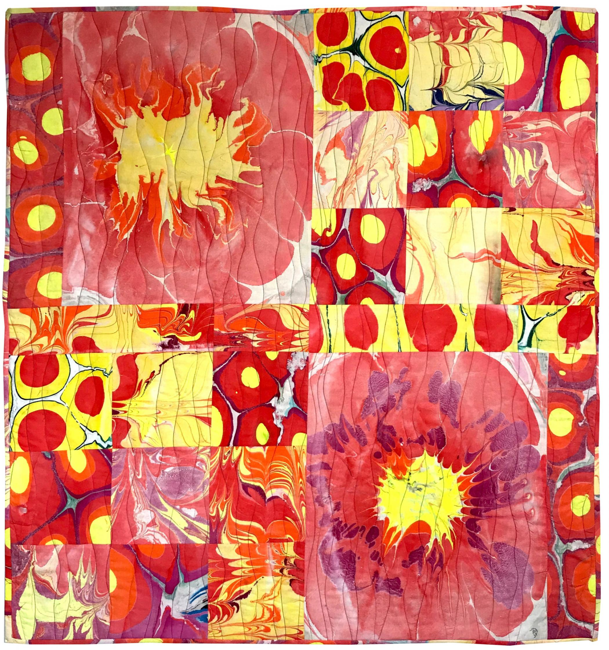
Oozing Heat, 2020
Lynn Woll
Austin, Texas
USA
Notes:
Global warming is real. Hot summer days are getting even hotter. Oozing heat is symbolized with hand-marbled fabrics.
Materials: Fabric
Techniques: Hand-marbled, machine quilted

Slide 10
For more images from the collection, please see here.

