Slide 1
Making Sewn Rocks
By Tara Carpenter Estrada

Slide 2
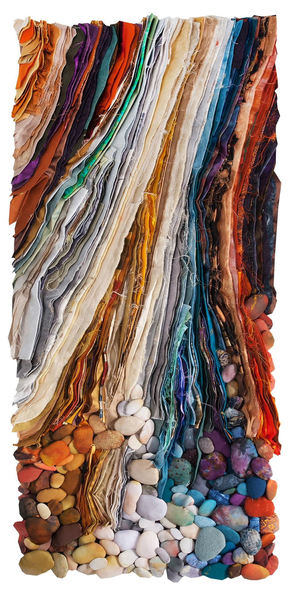
Janet Windsor, “Crumbling” (full piece)
Notes:
https://www.saqa.com/art/browse-collection/crumbling

Slide 3
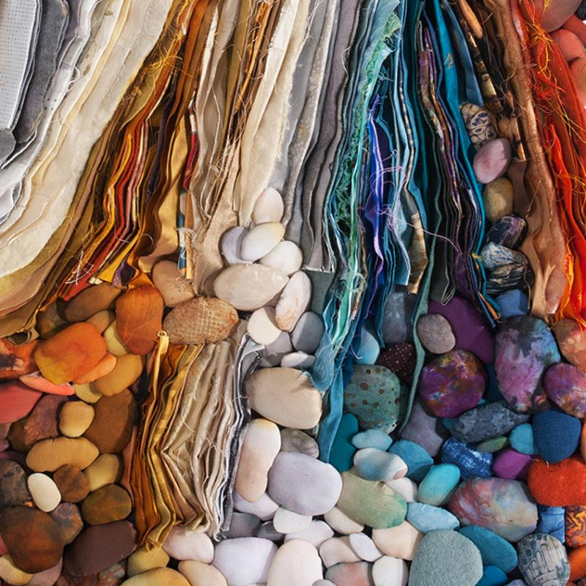
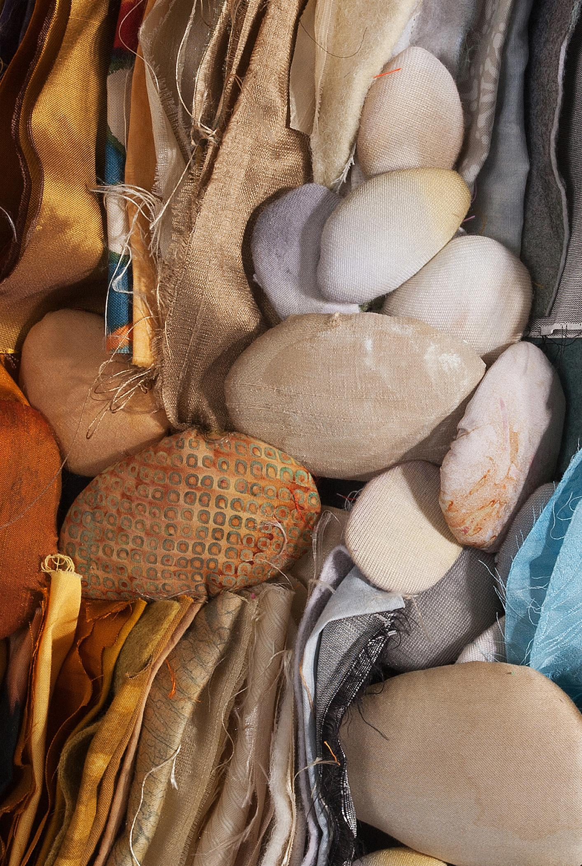
Up close pictures
Notes:
https://www.saqa.com/art/browse-collection/crumbling

Slide 4
“As the edges of the cliffs tumble into the ocean, the sea tosses them about and returns them to us as beautiful pebbles.”

Slide 5
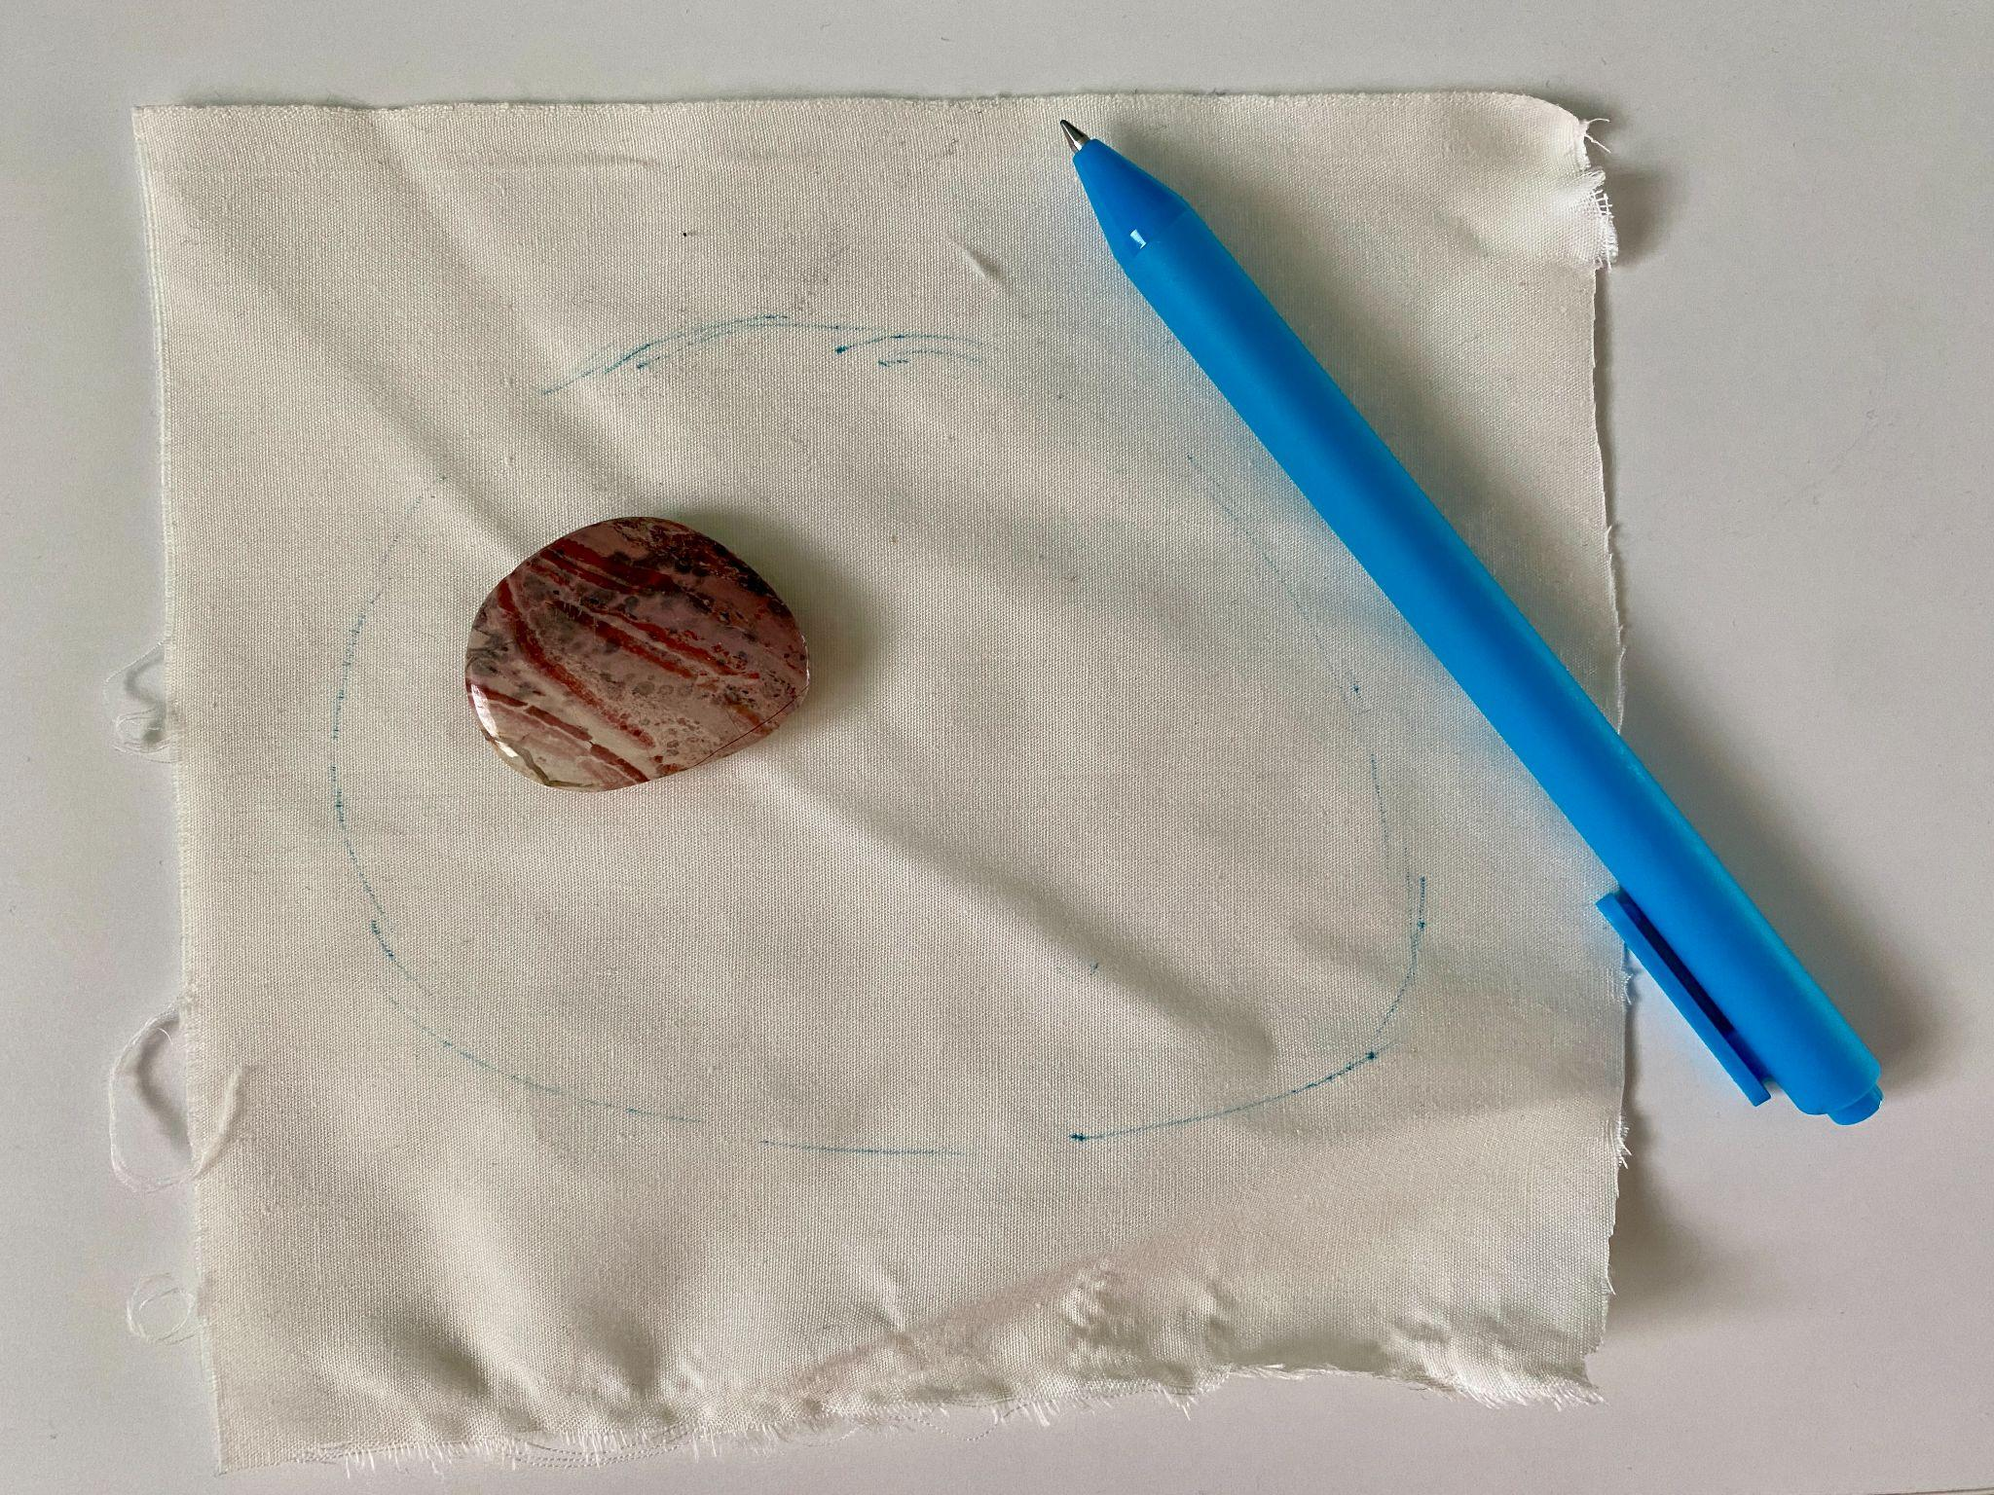
Draw a rough outline of the rock shape

Slide 6
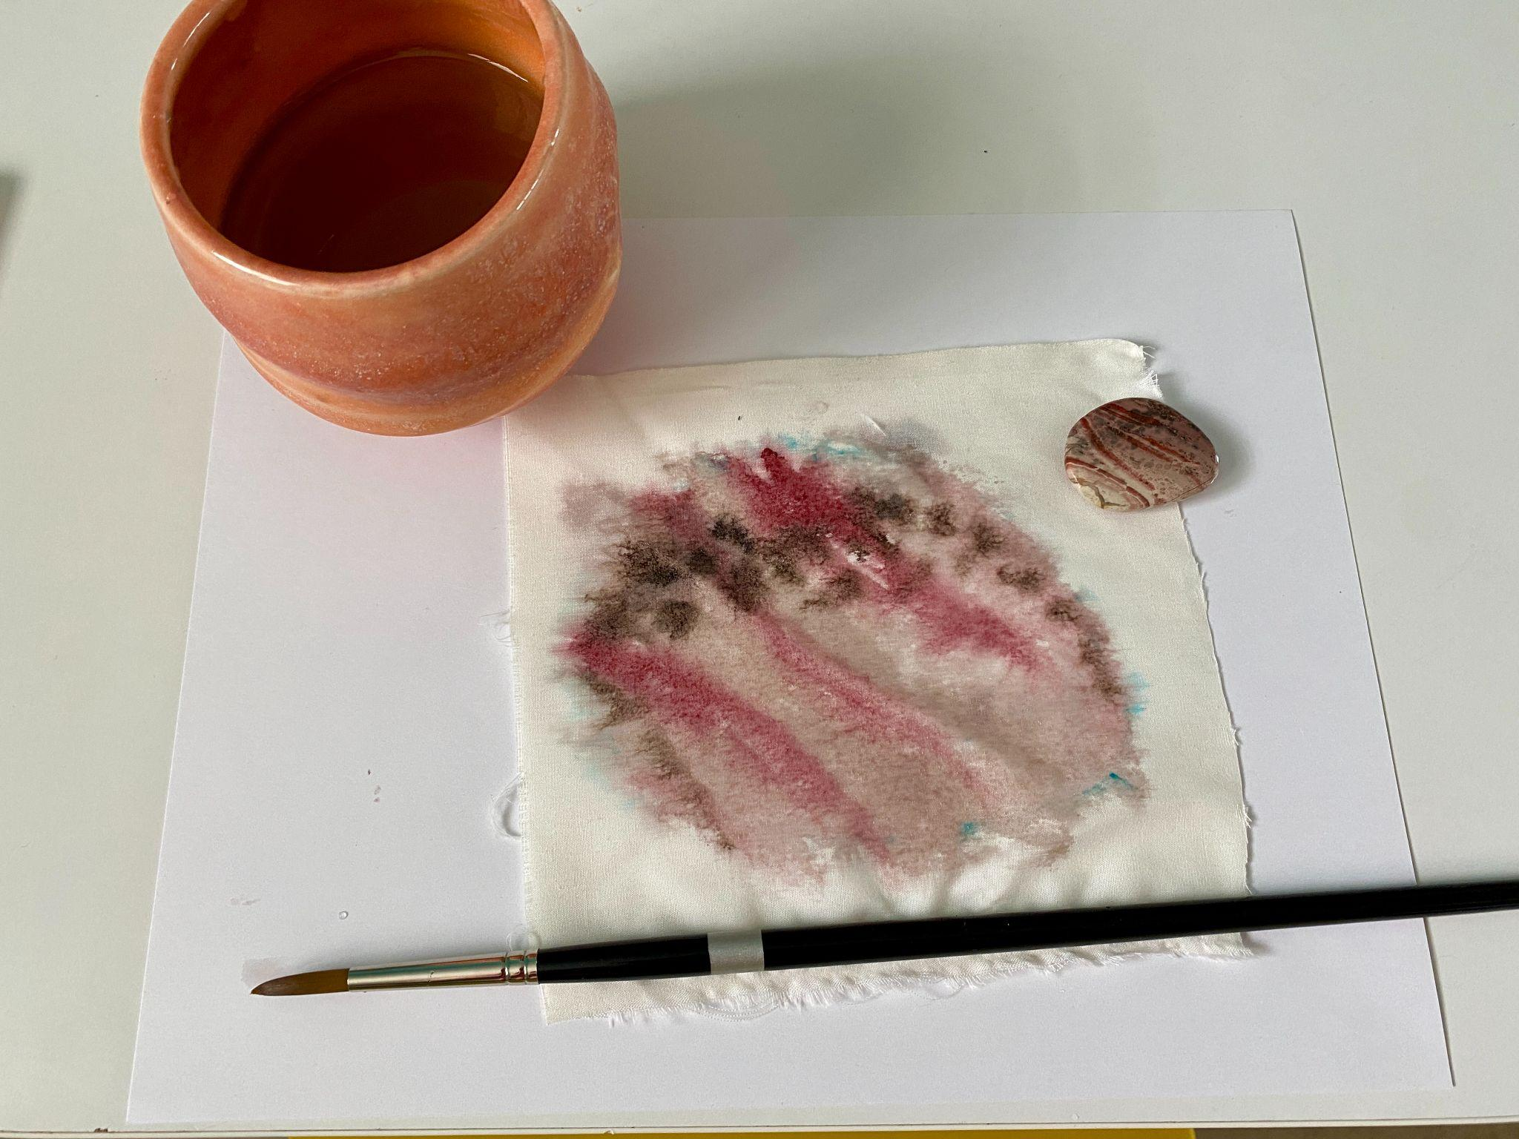
Using watercolors, paint in the colors and textures that you observe in the rock.

Slide 7
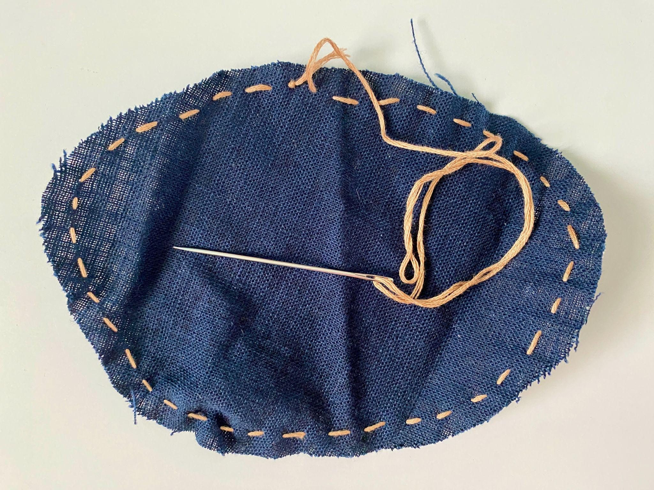
Practice sewing a rock while your fabric dries.
Stitch at least ¼” from the edge around the whole shape.

Slide 8
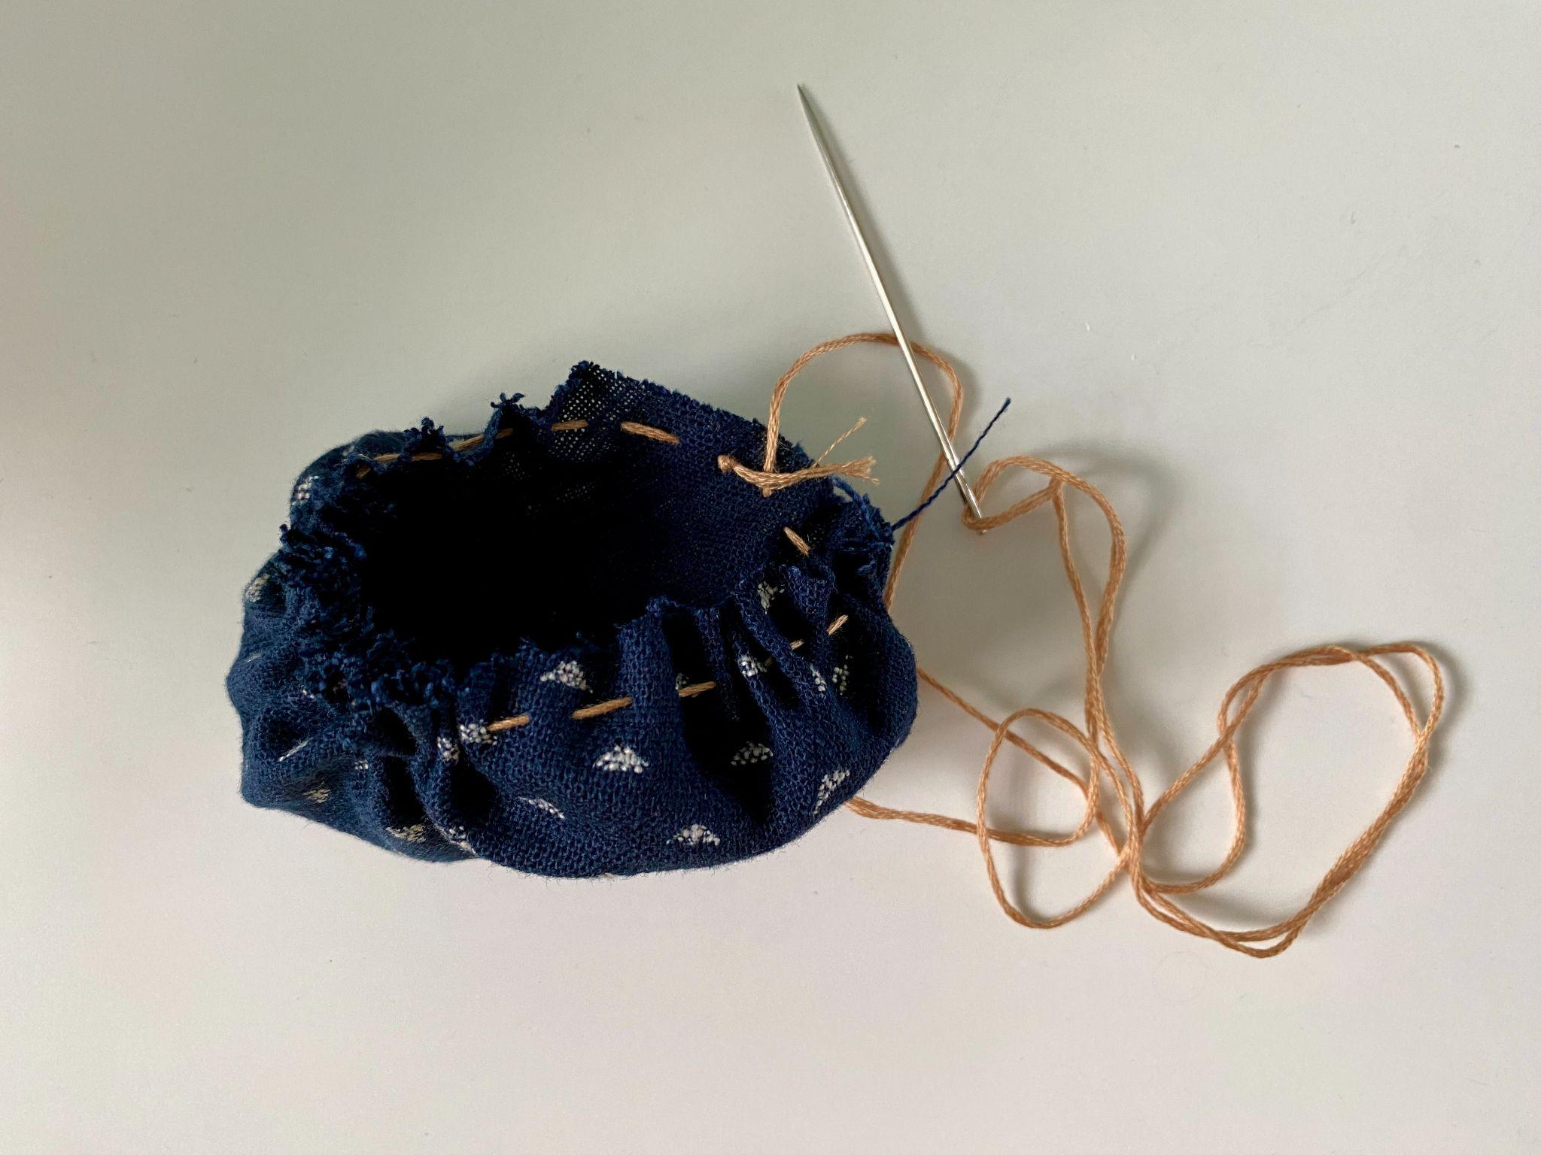
Gently pull on the open end of the thread.

Slide 9
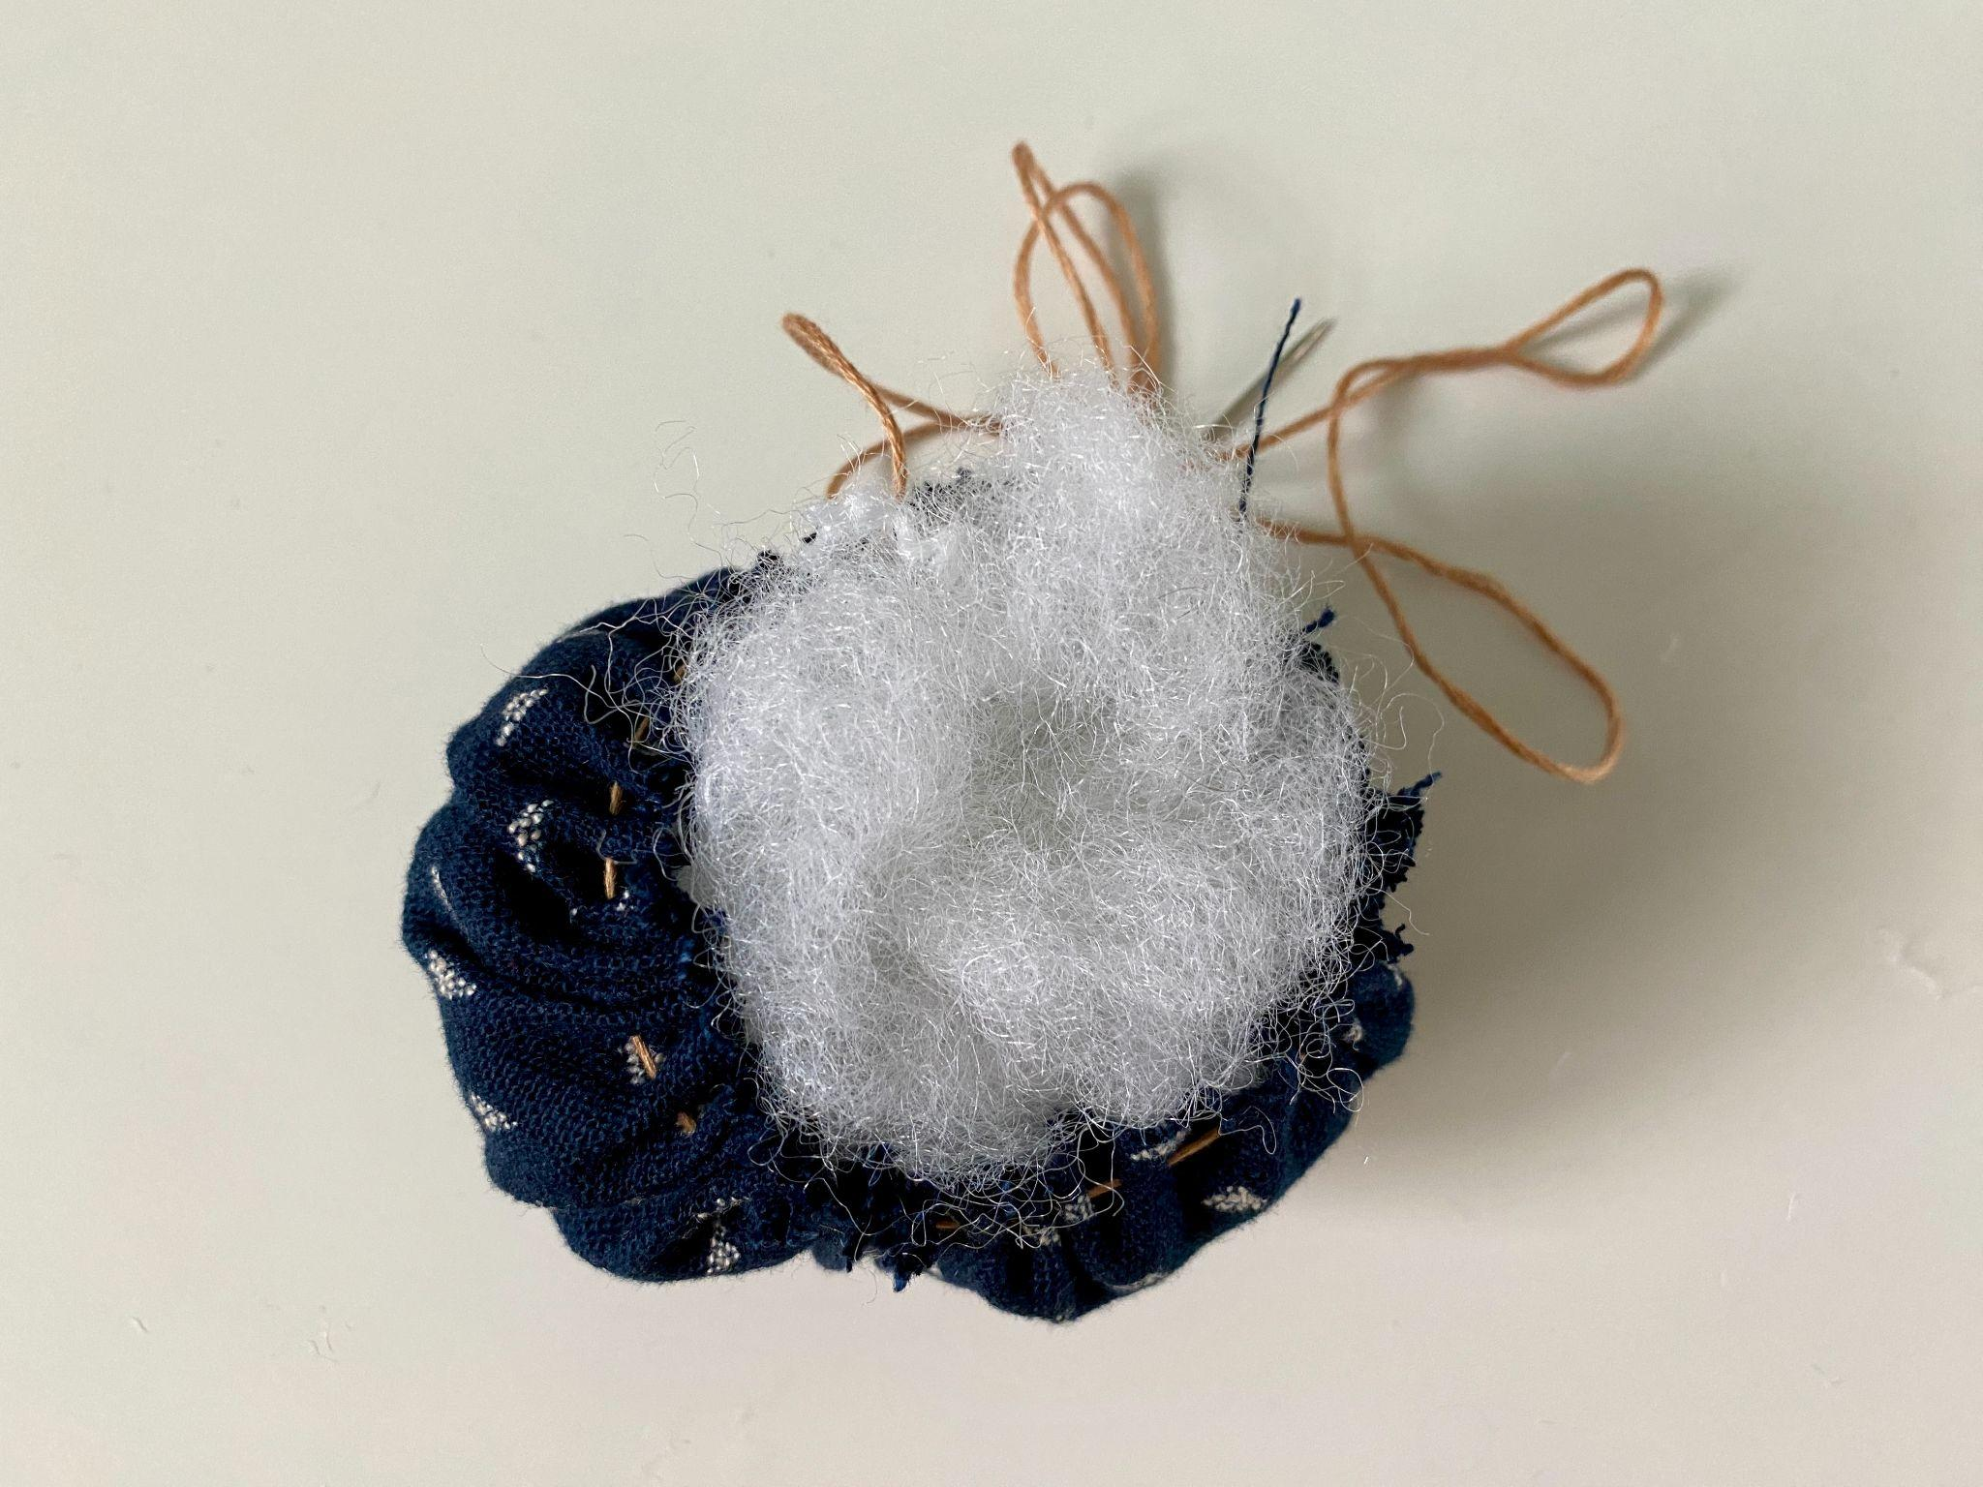
Stuff in some fiber fill

Slide 10
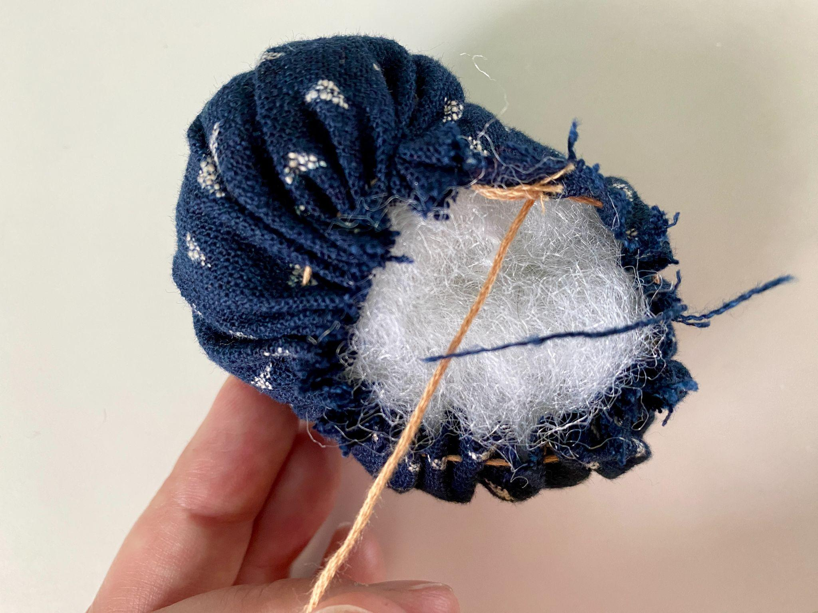
Continue to pull on the thread to cinch the form around the fill.

Slide 11
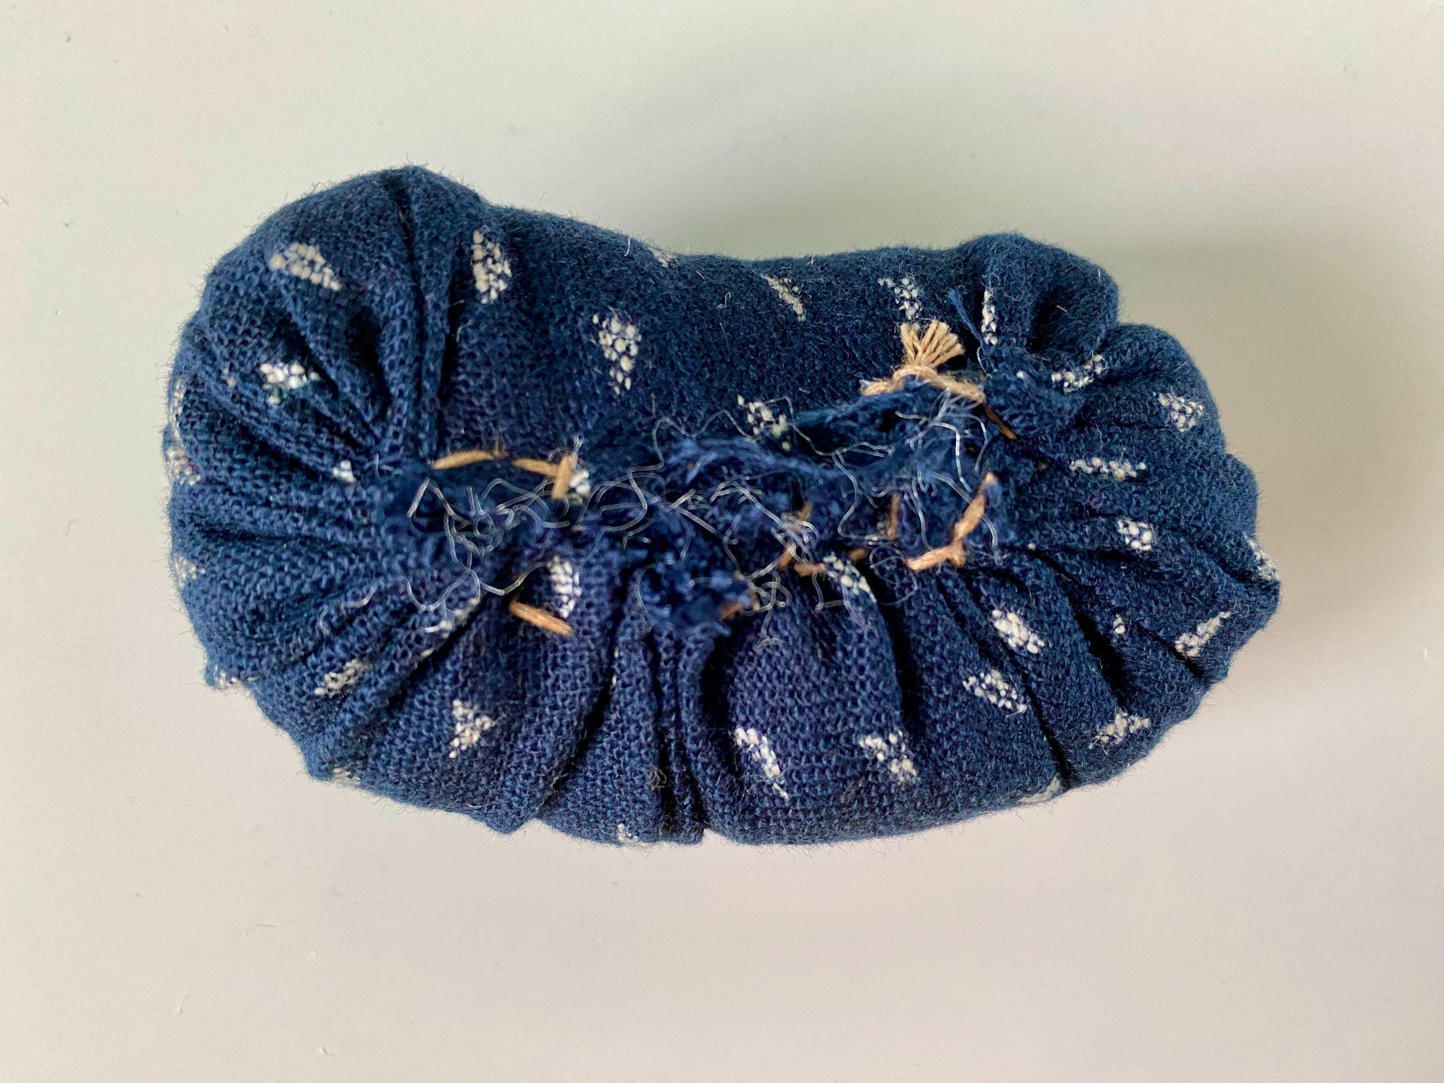
When the form is fully closed, make a couple stitches back and forth across the seam. When finished tie of the thread with a knot.

Slide 12
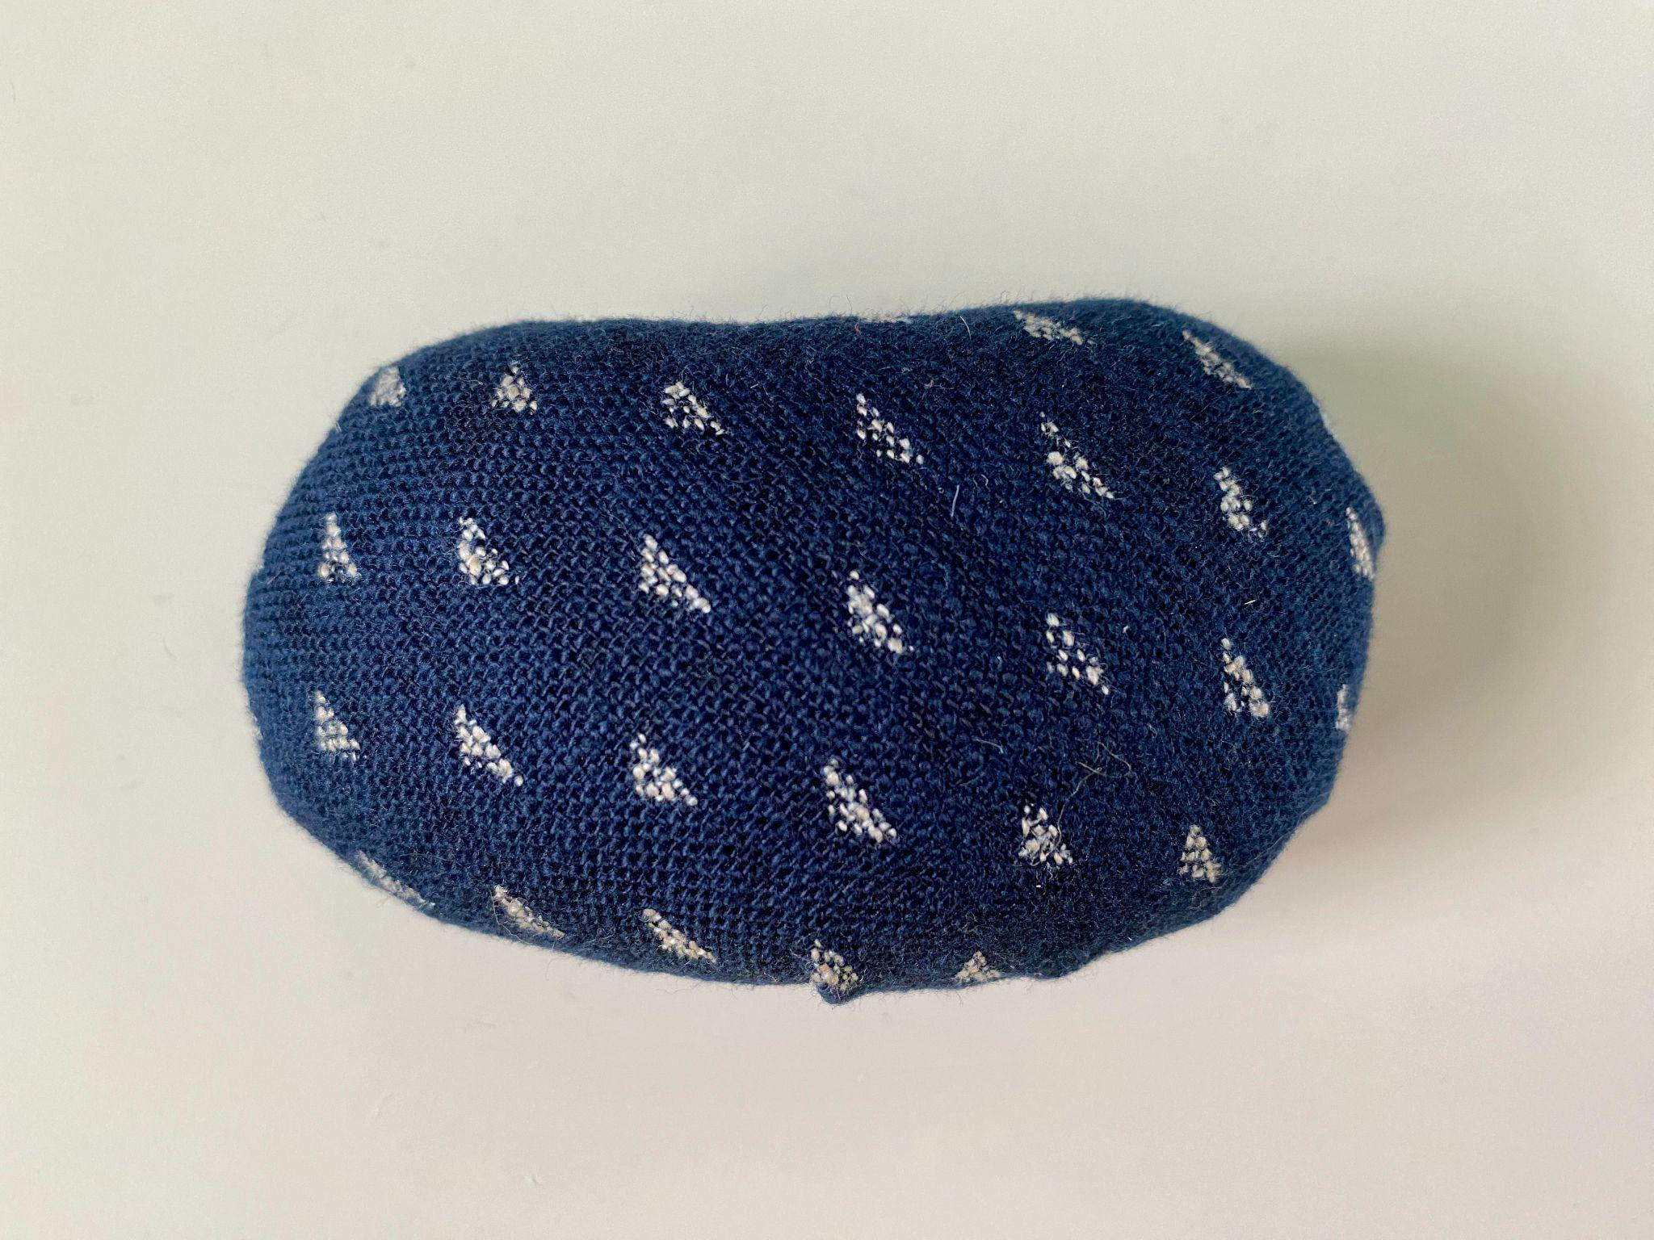
Repeat this whole process with your water-colored fabric.

Slide 13
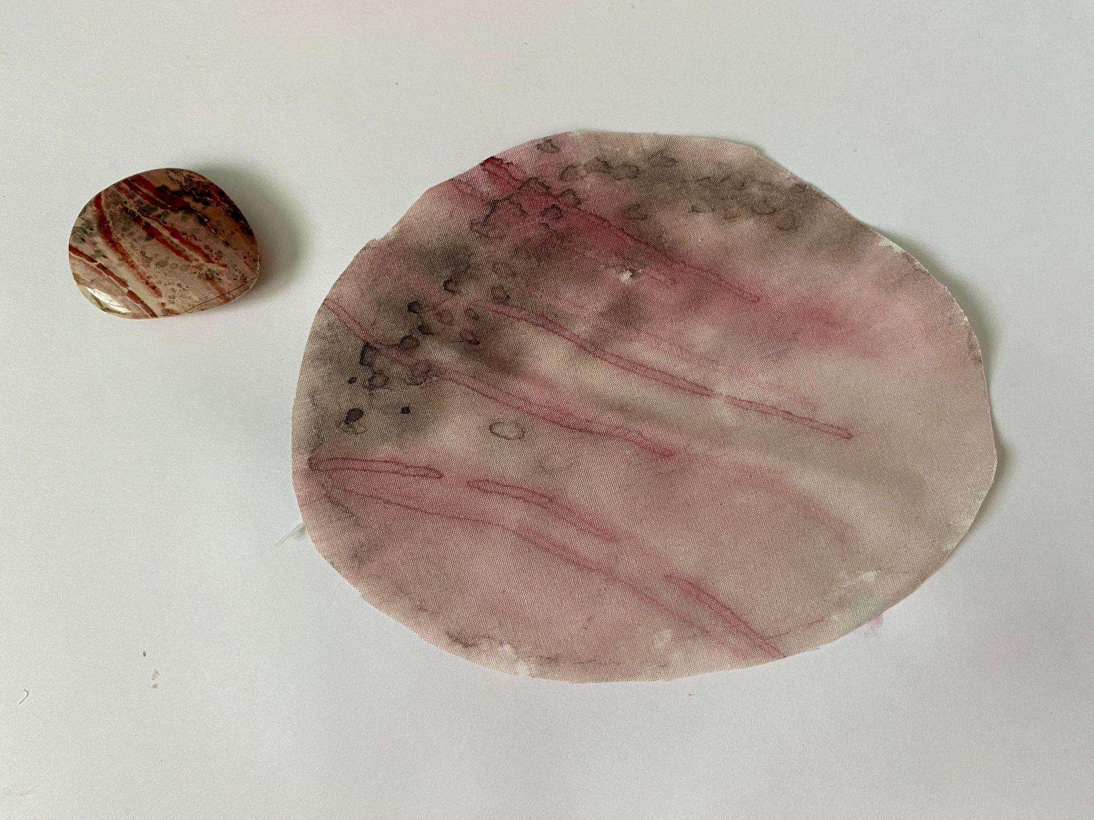

Slide 14
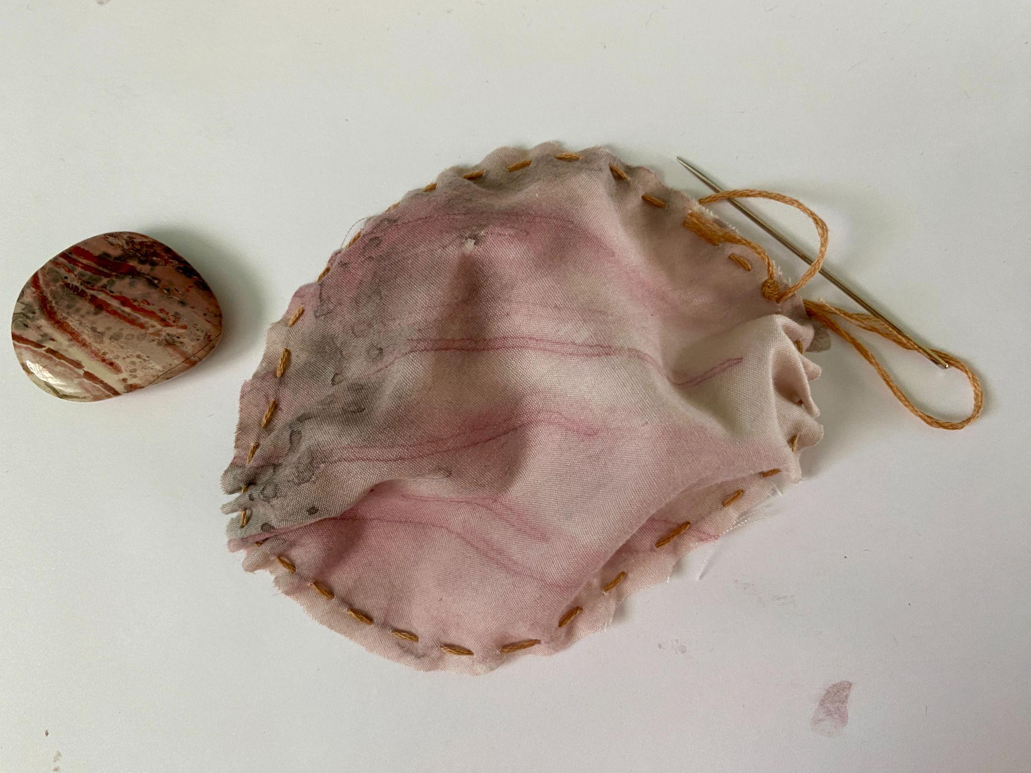

Slide 15
