Slide 1
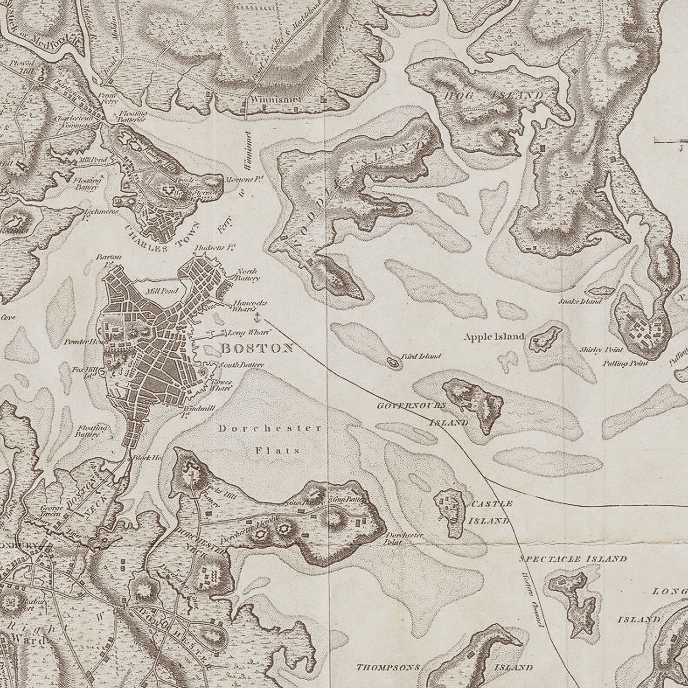

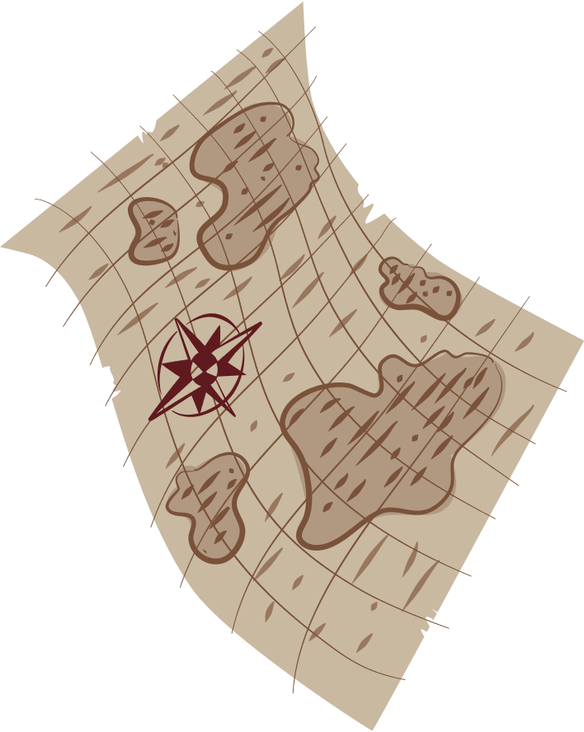
Personal Geography
3 Visual Arts Projects using maps
by Charlotte Hawkins

Slide 2

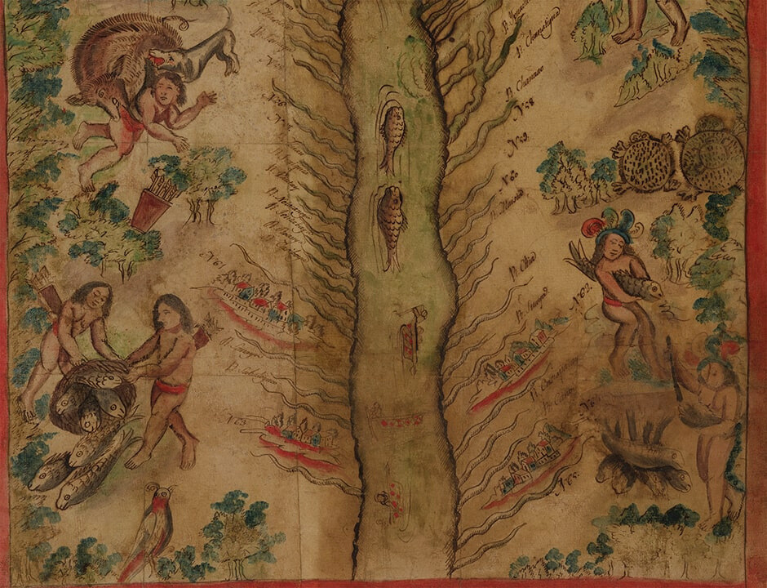

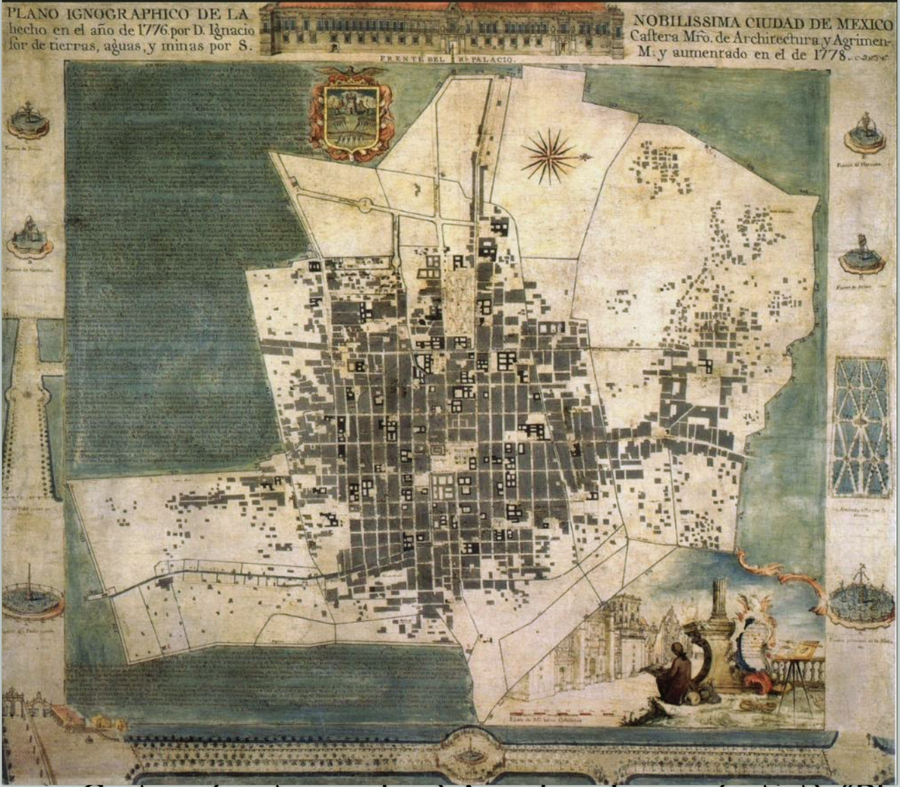
Introduction
People have been making maps - the art of cartography since ancient times. One of the oldest maps in the world dates back to the caves in Lascaux, France 14,500 BCE.
While we often view maps as representational, they are often subjective views of the world.
The BYU Museum of Art has a collection of maps and art from the Hispanic Society Museum and Library on display. Let’s look at how maps tell stories and create a story of our own.

Slide 3
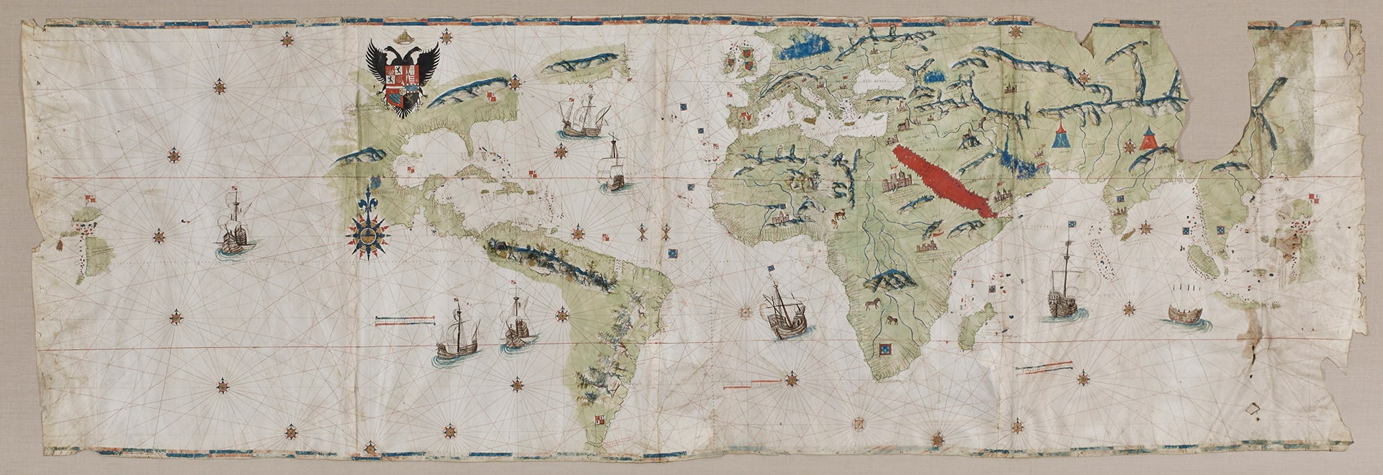
See, think, wonder.
Giovanni Vespucci, Florence, Italy, 1486 - after 1527

Slide 4
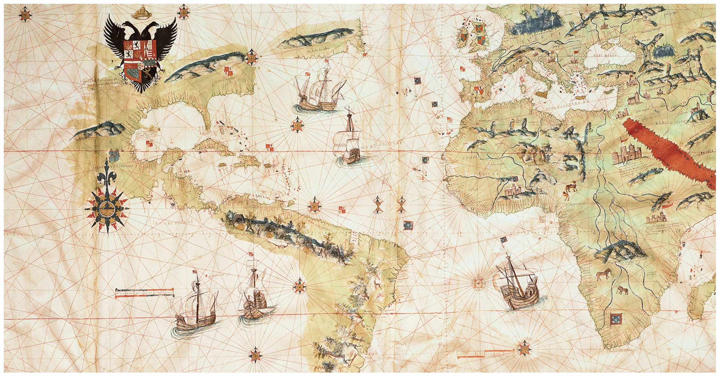

Slide 5
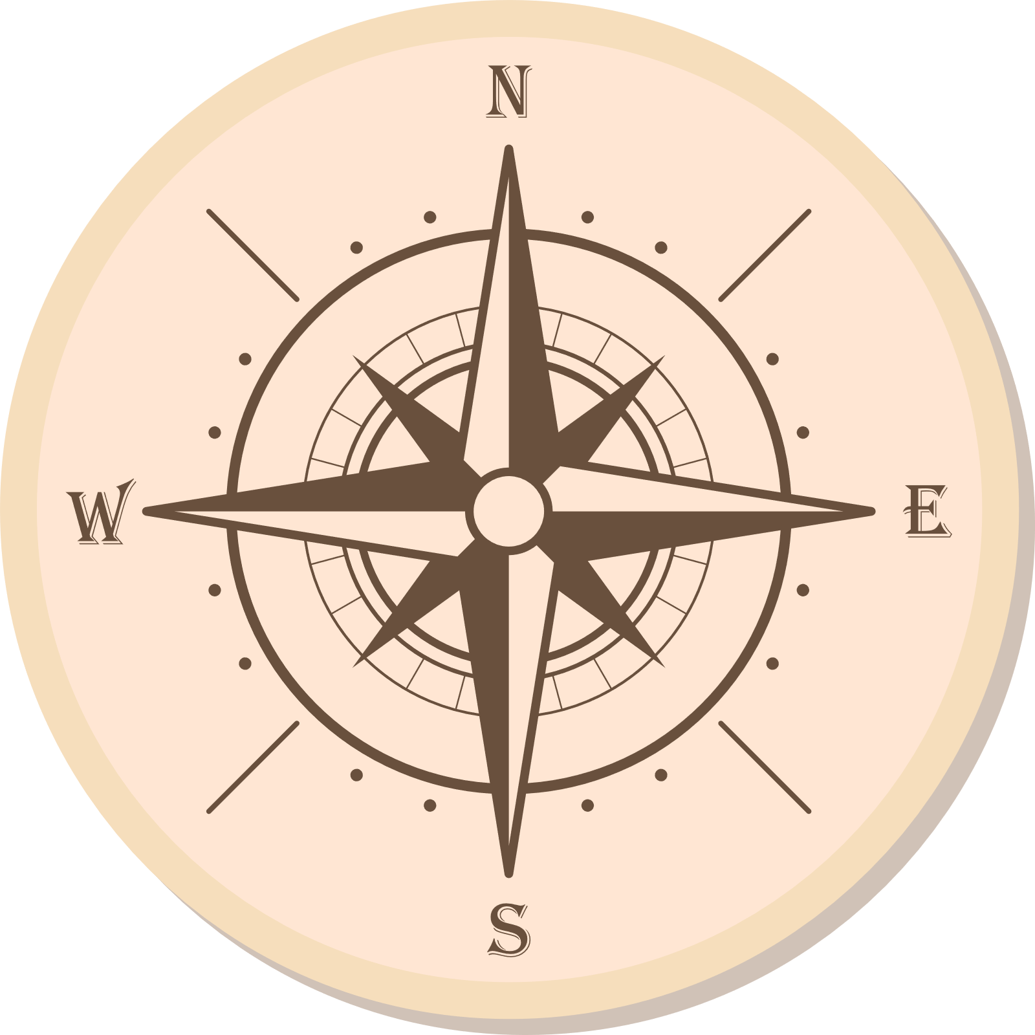
First Grade Map Project
Using shape to represent a place we know

Slide 6
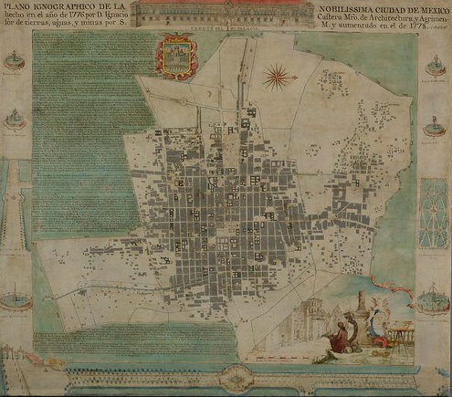
A bird’s eye view
Castera & Lopez, Iconographic Map of the very noble city of Mexico, 1778

Slide 7
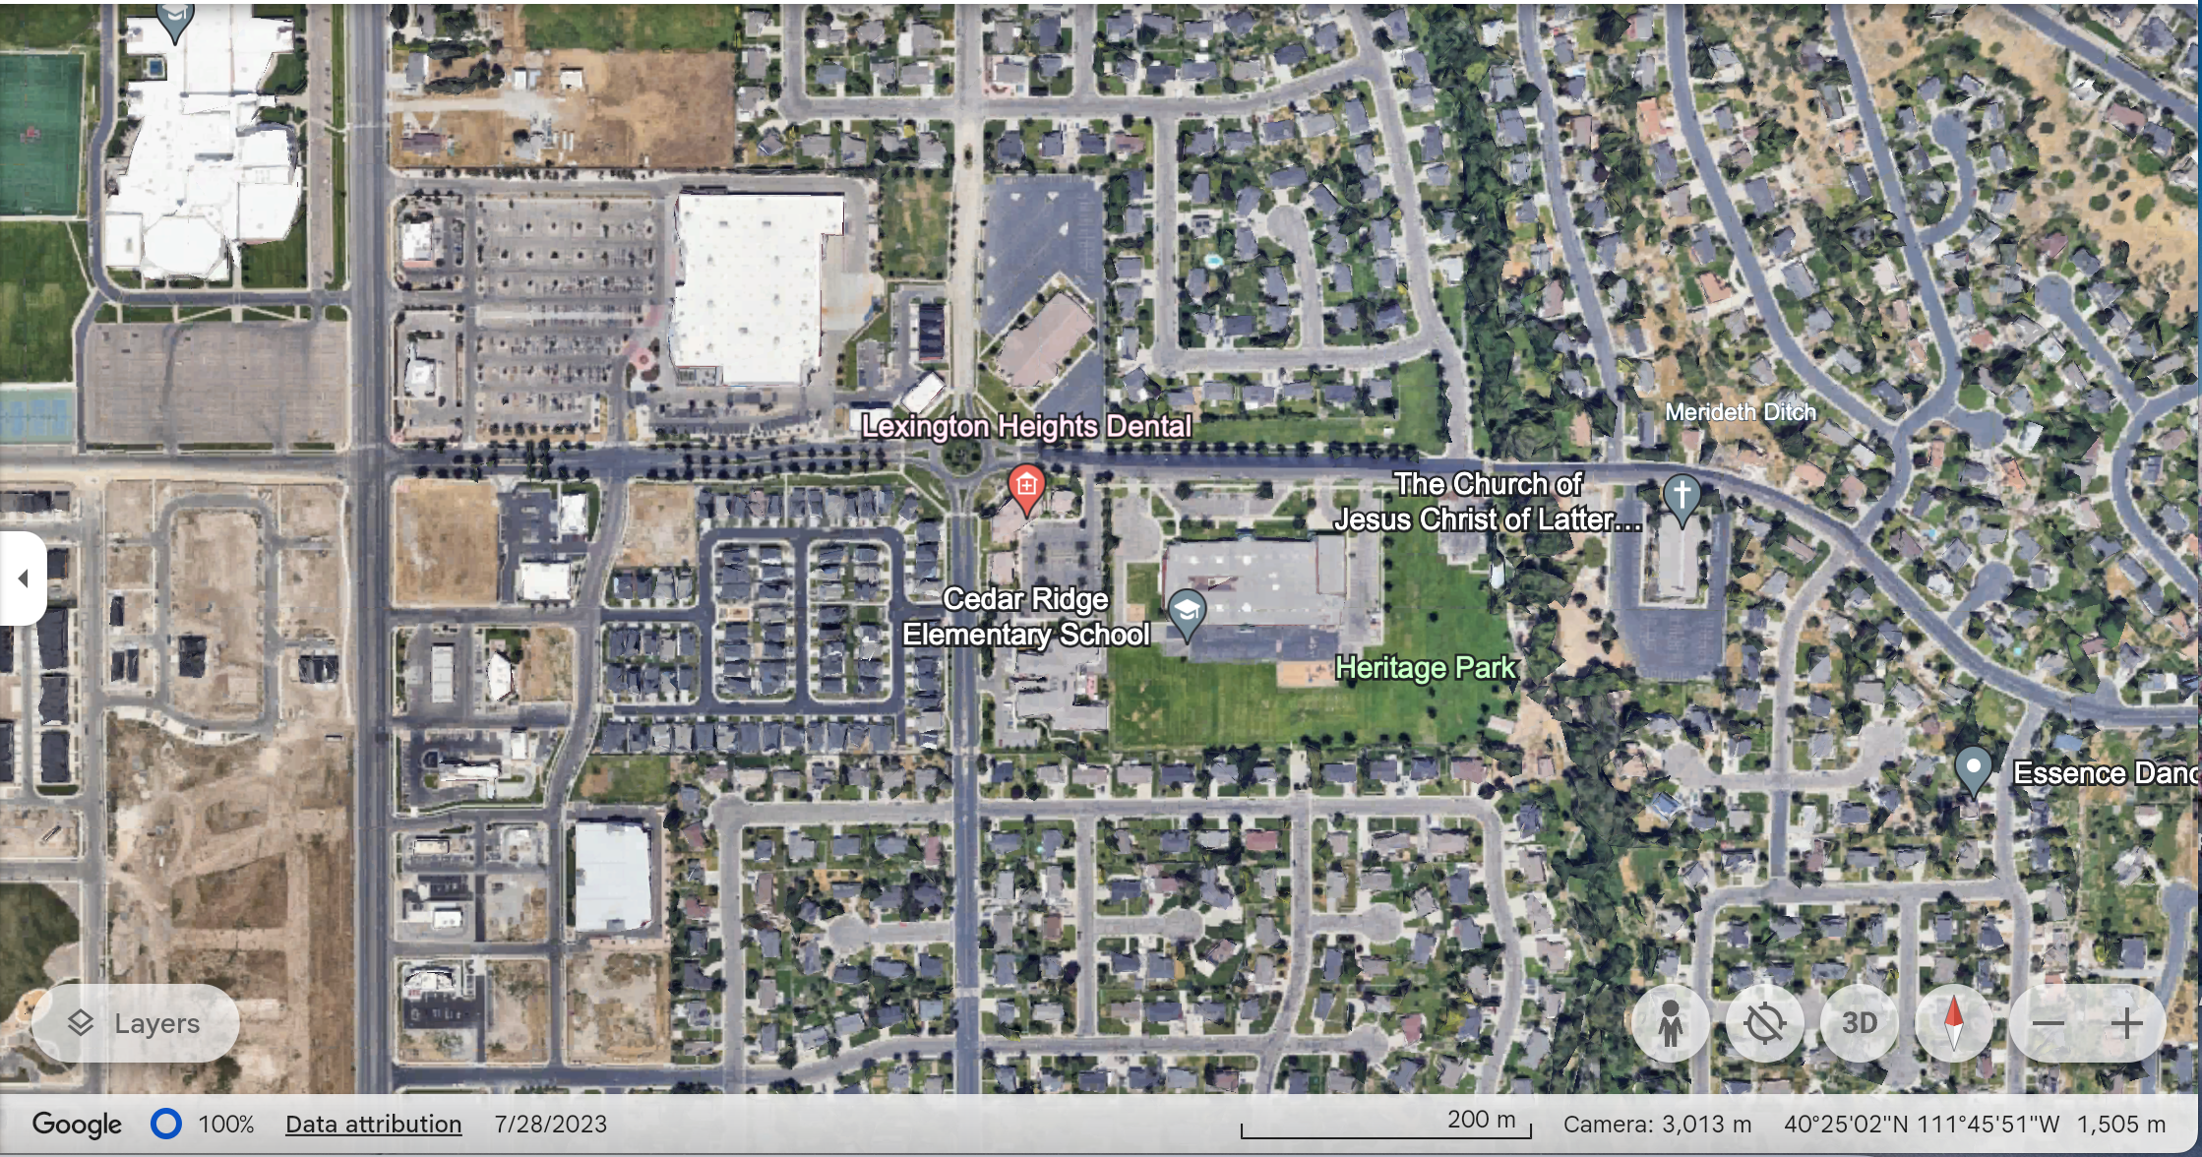

Slide 8
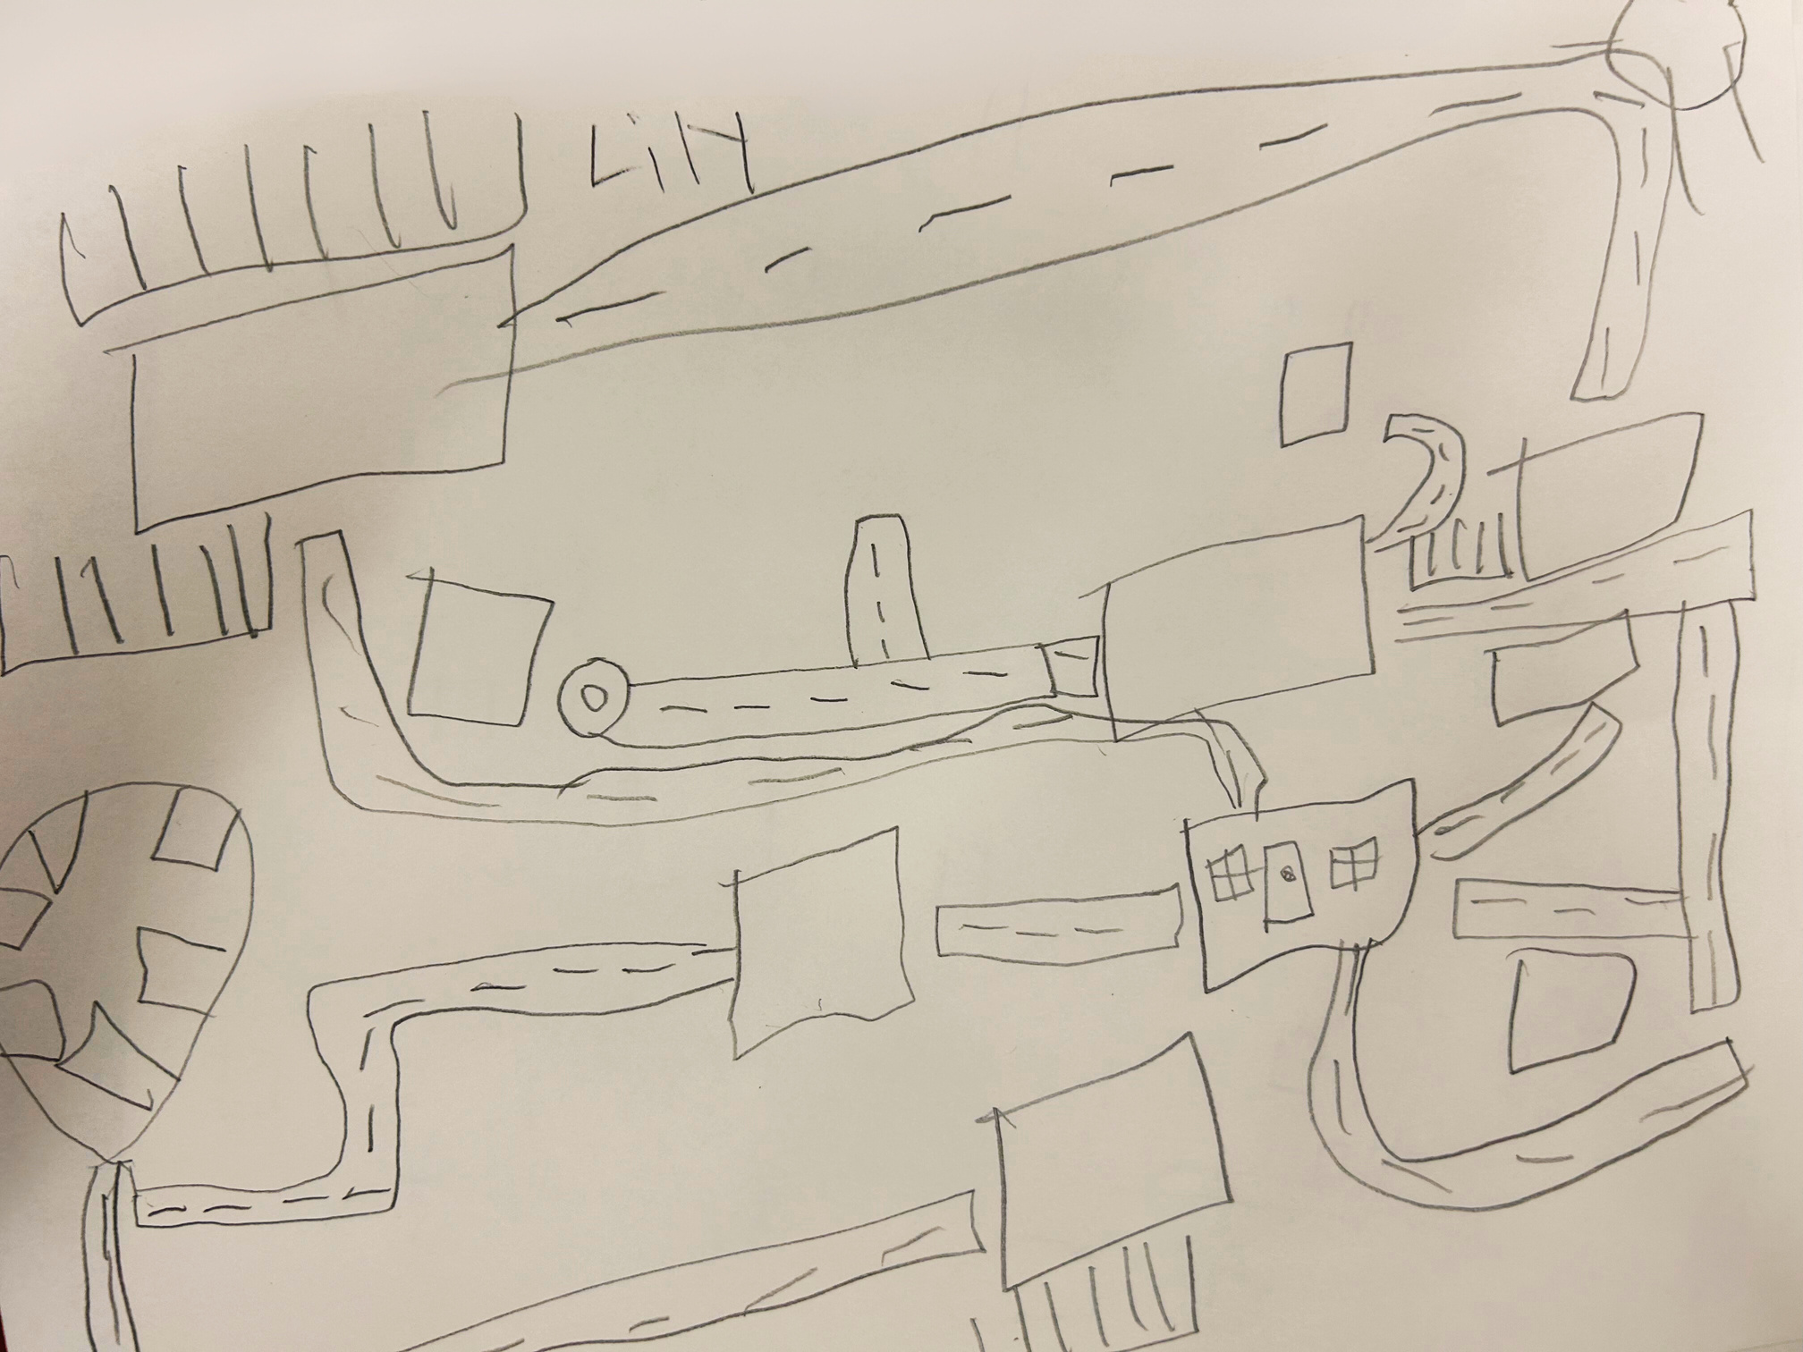
The way I see it...

Slide 9

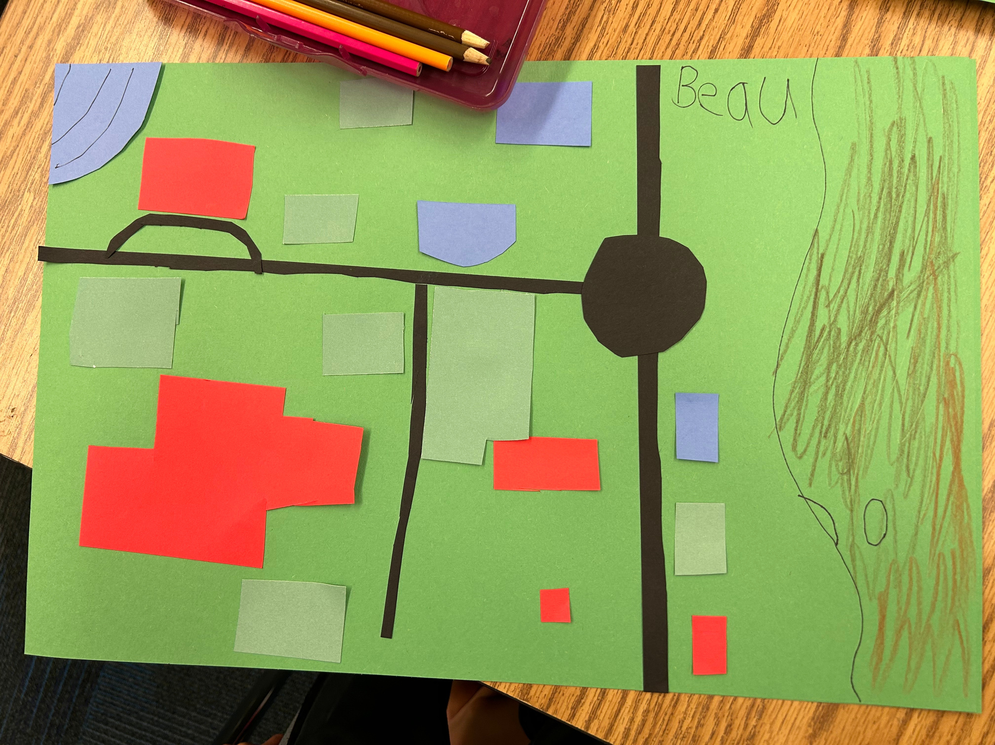

Slide 10
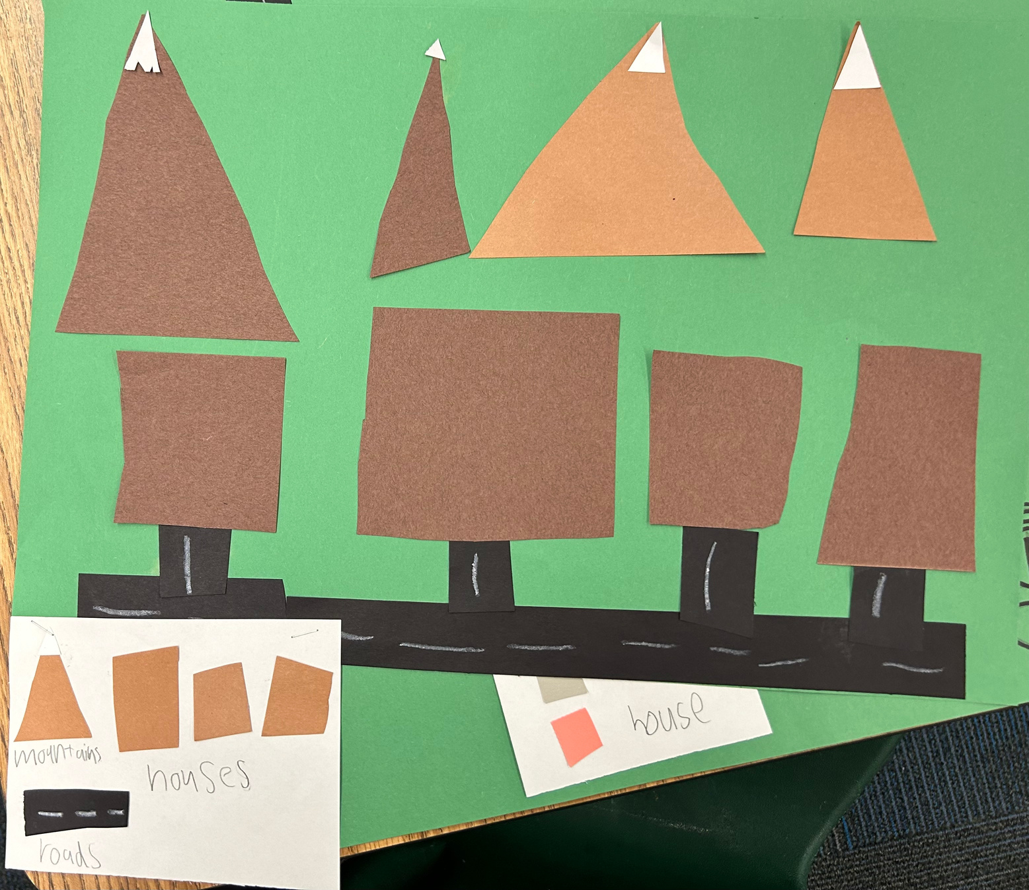
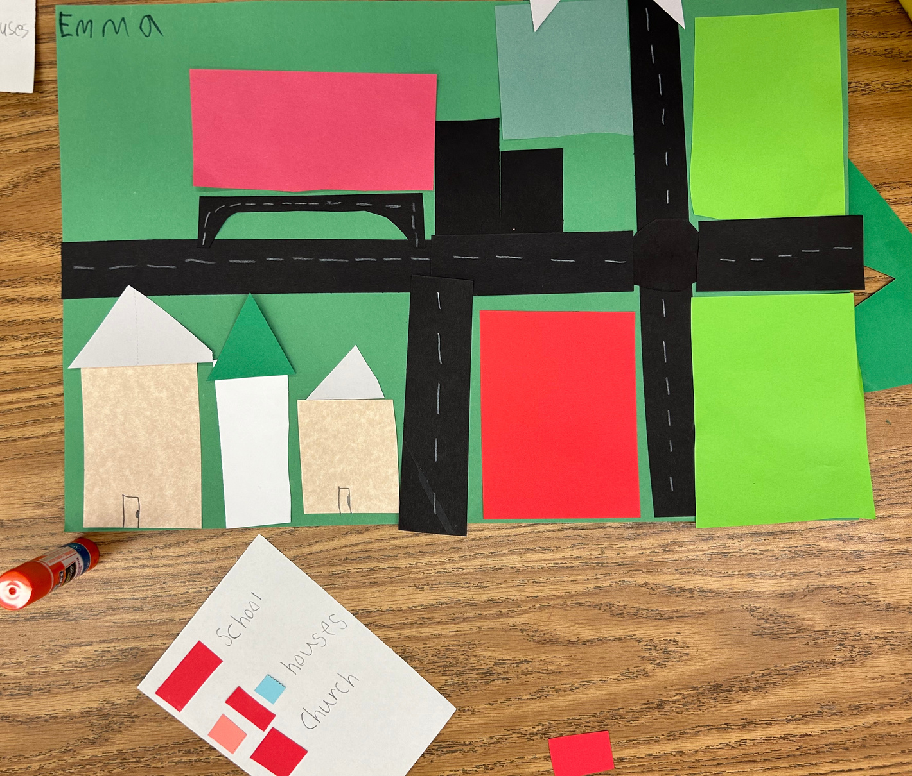
Clark, 1st grade
Emma, 1st grade
The key to understanding

Slide 11
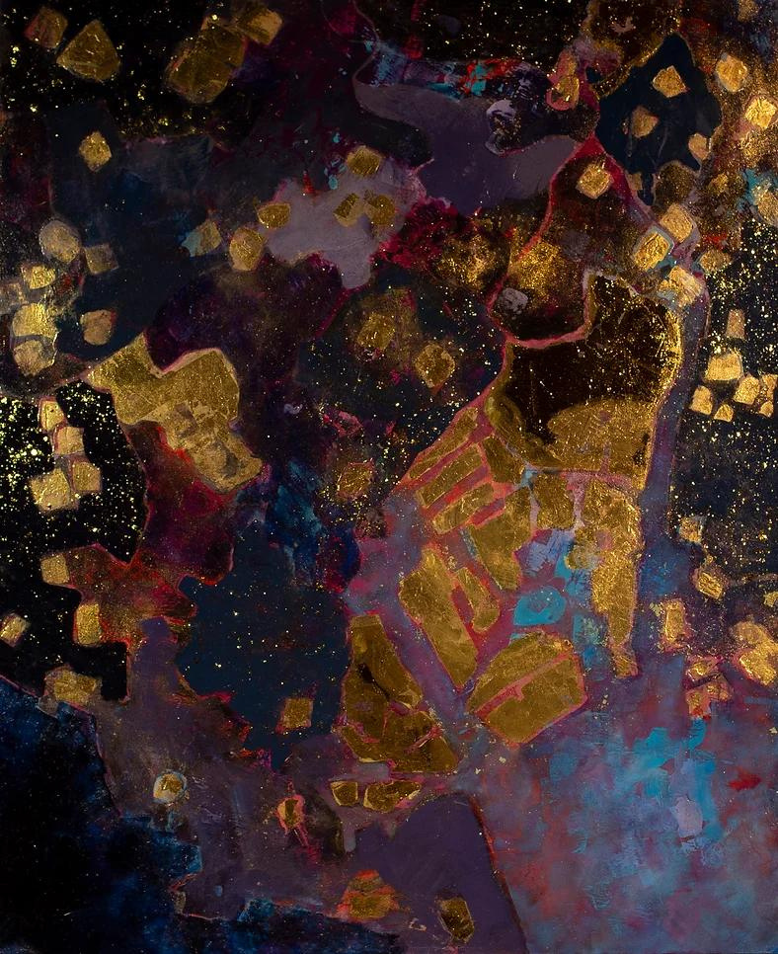
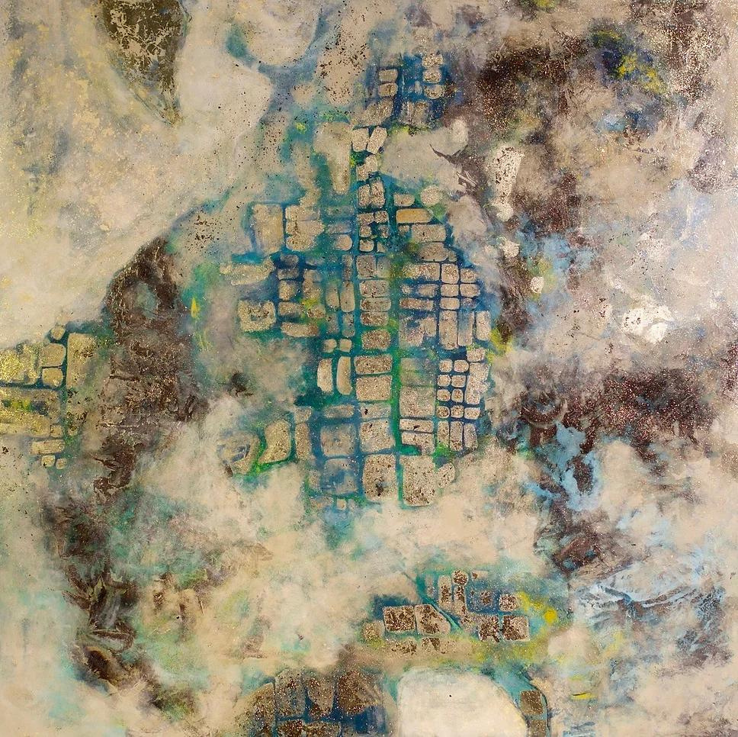
Emilia Wing, Tokyo & Utah
Notes:
https://www.emiliawingart.com/

Slide 12







4th Grade Map
Project
combining geography
with flora and fauna

Slide 13
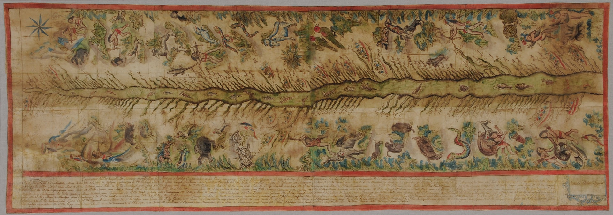
Map of the Ucayali River, Peru 1808-1812

Slide 14
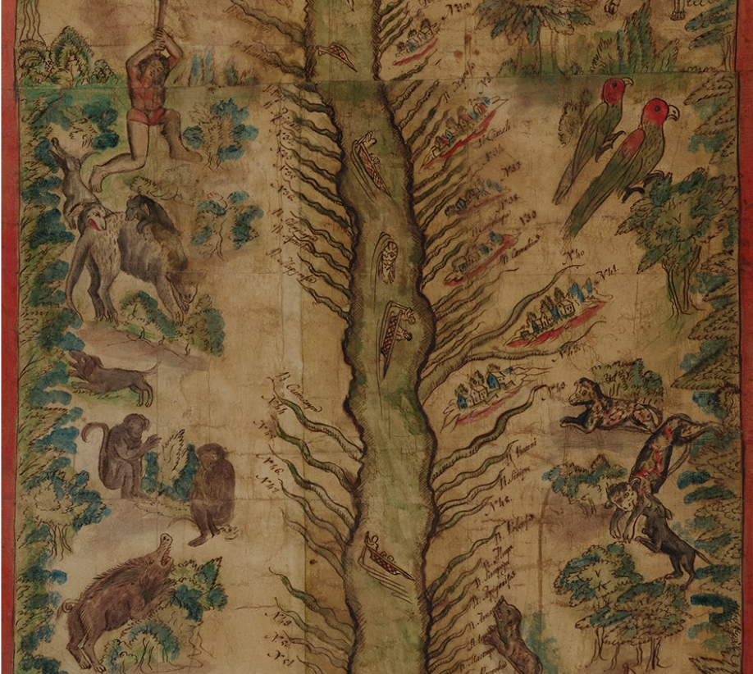


A place to explore
Detail of the Ucayali River Map

Slide 15

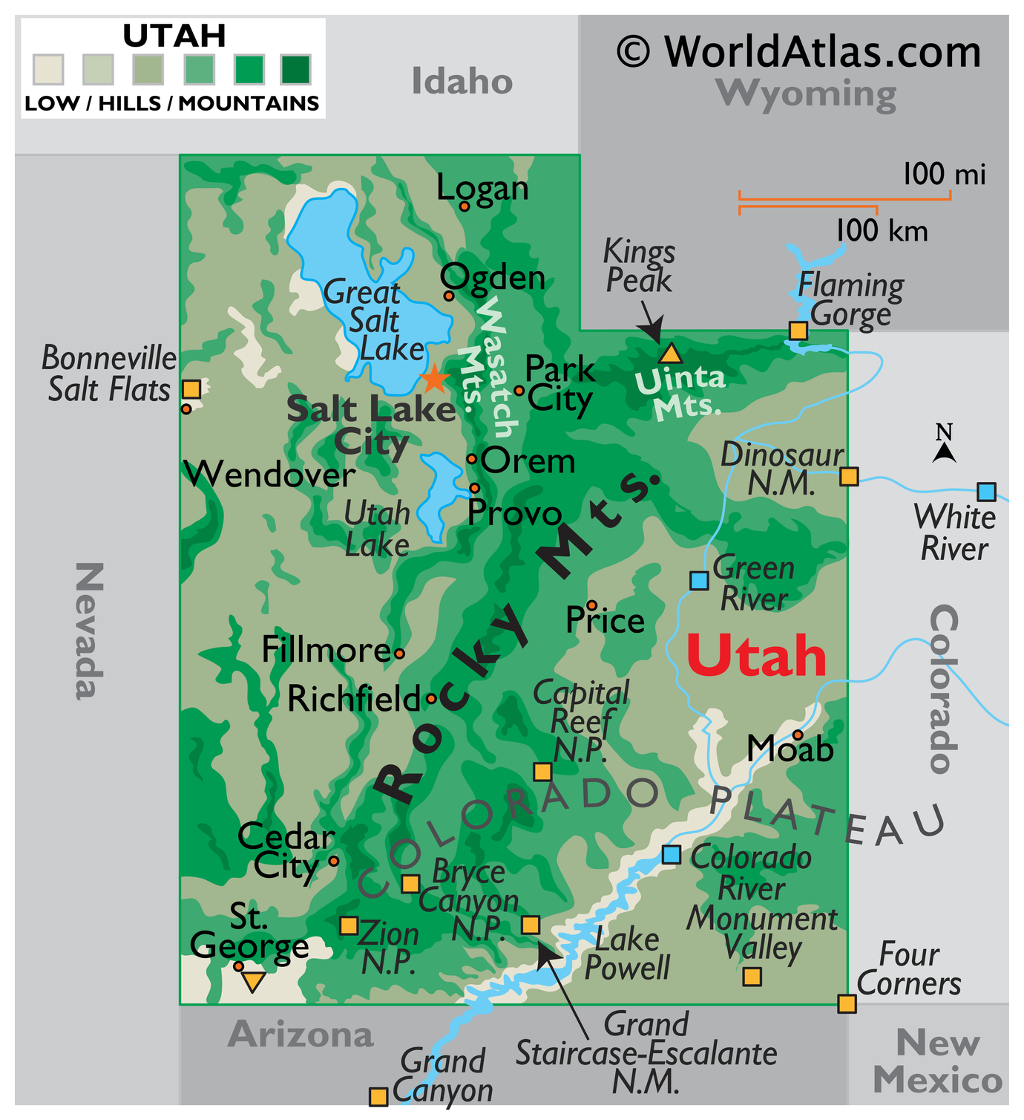



Create a map of Utah
Using 4 geographic references & 4 flora and fauna symbols

Slide 16
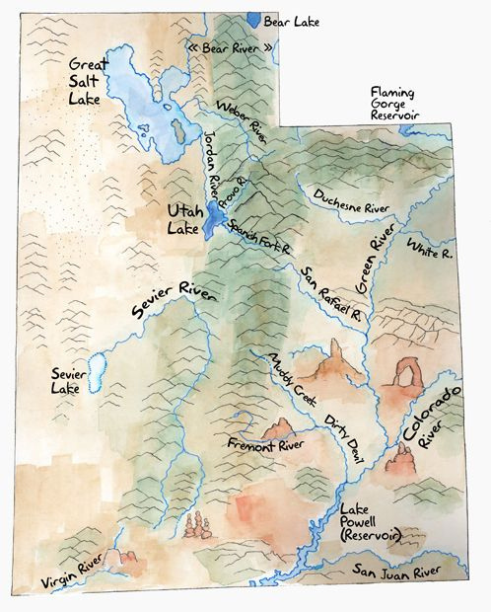
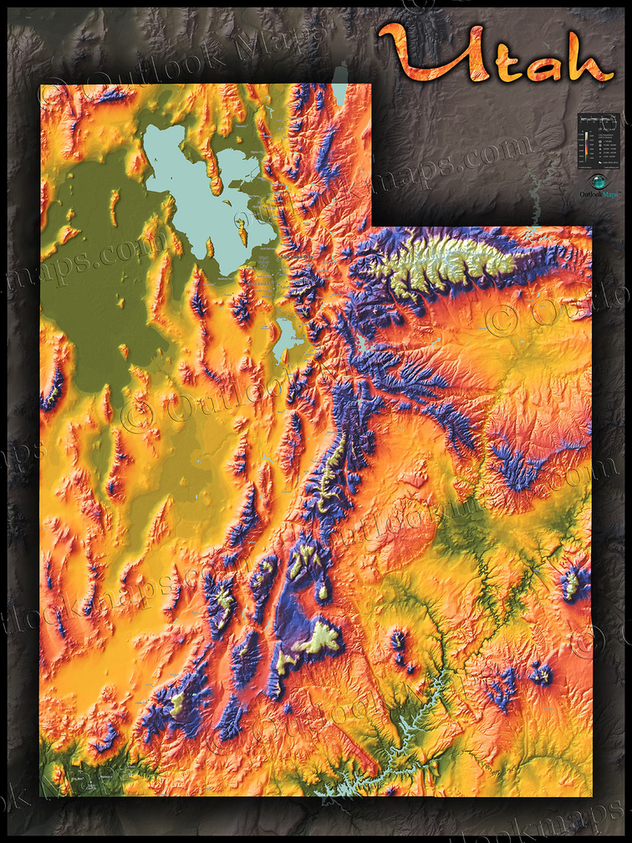
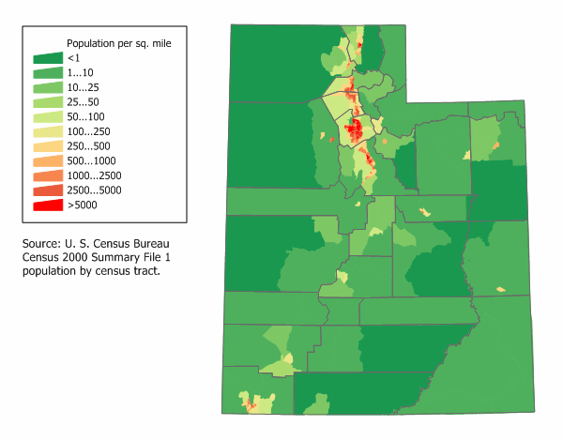


More than just a pretty place
Terrain
Elevation
Population

Slide 17

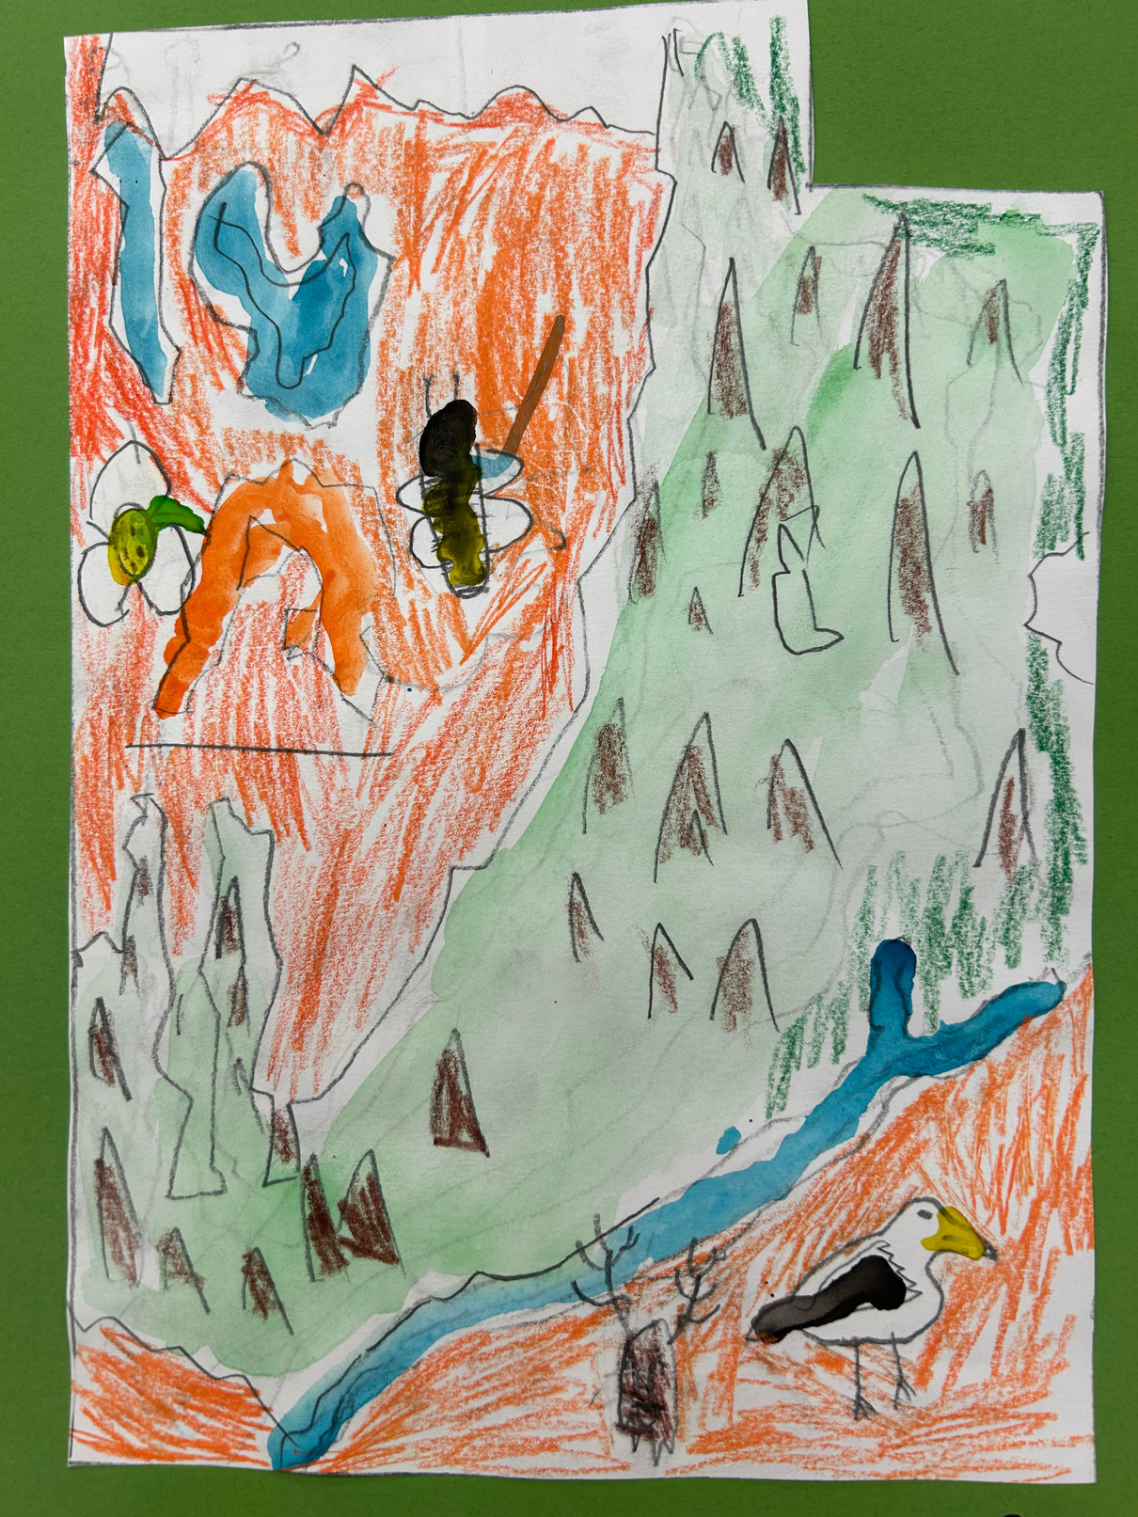
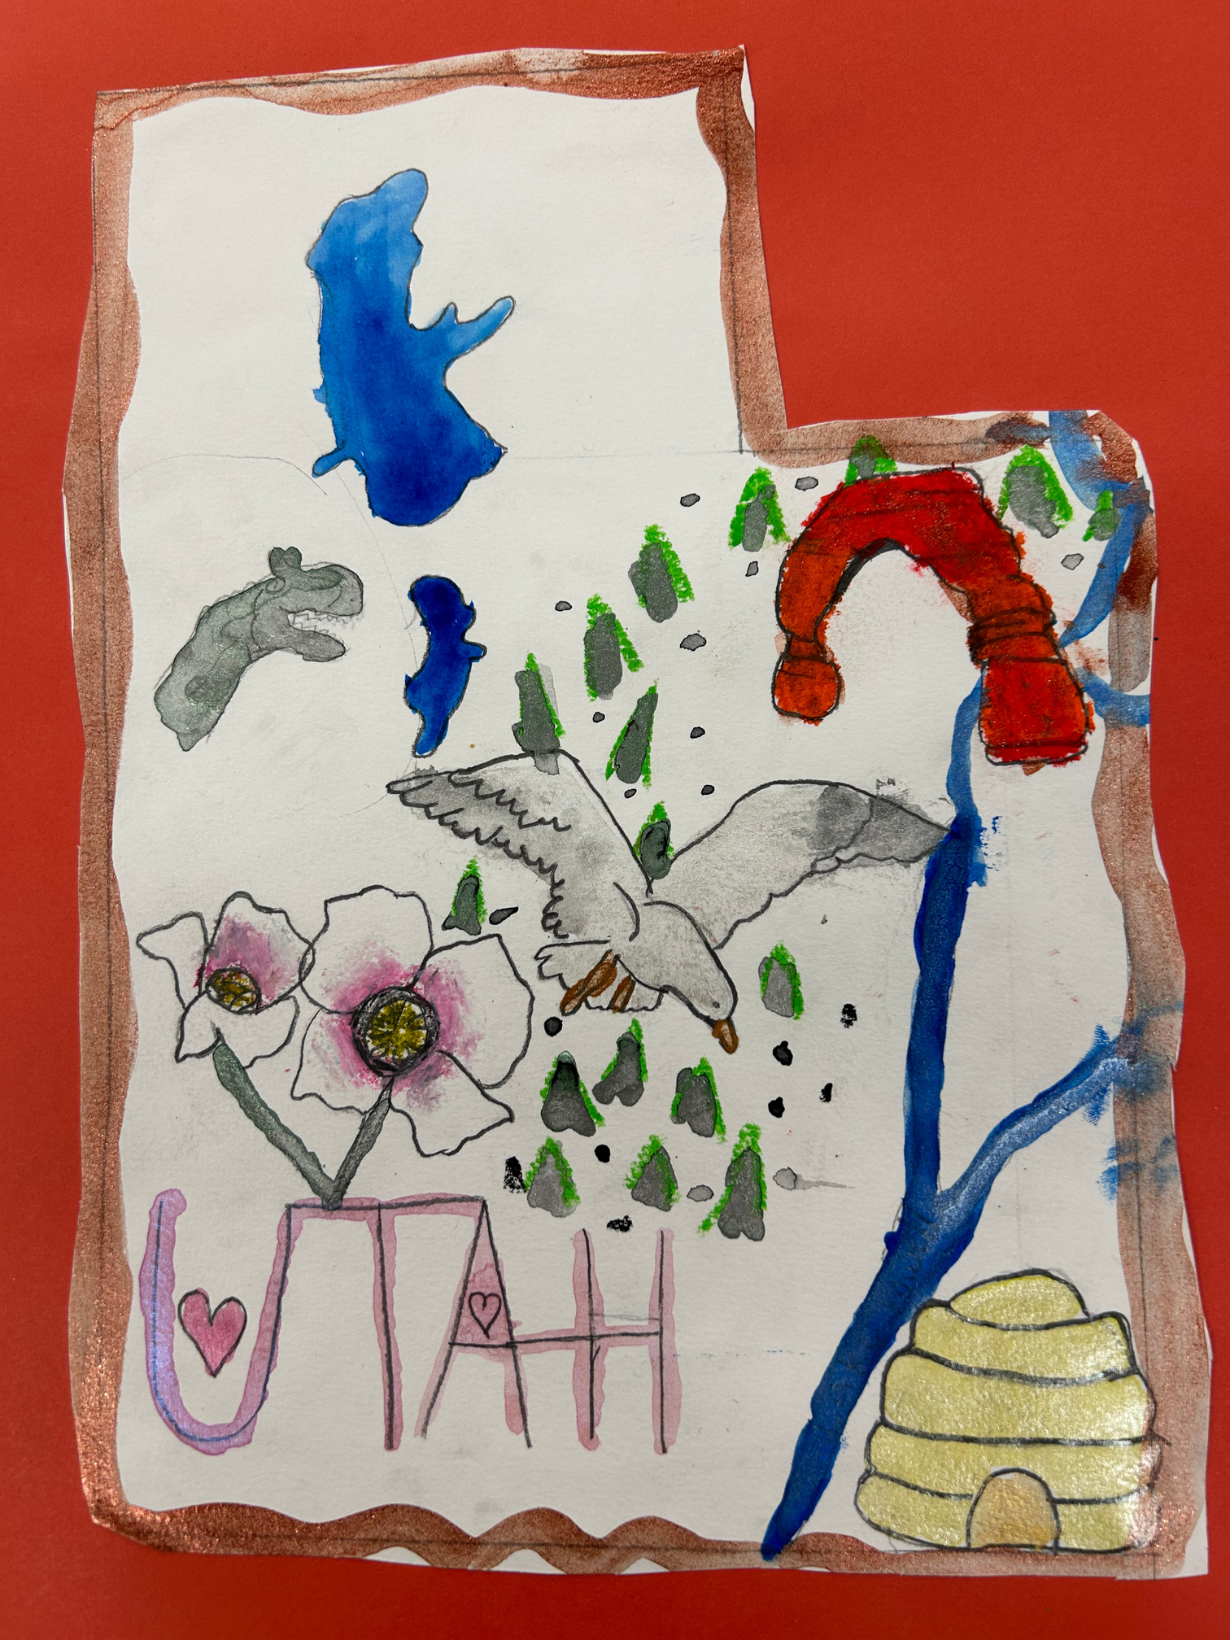
by Crew, 4th grade
by Sofia, 4th grade

Slide 18

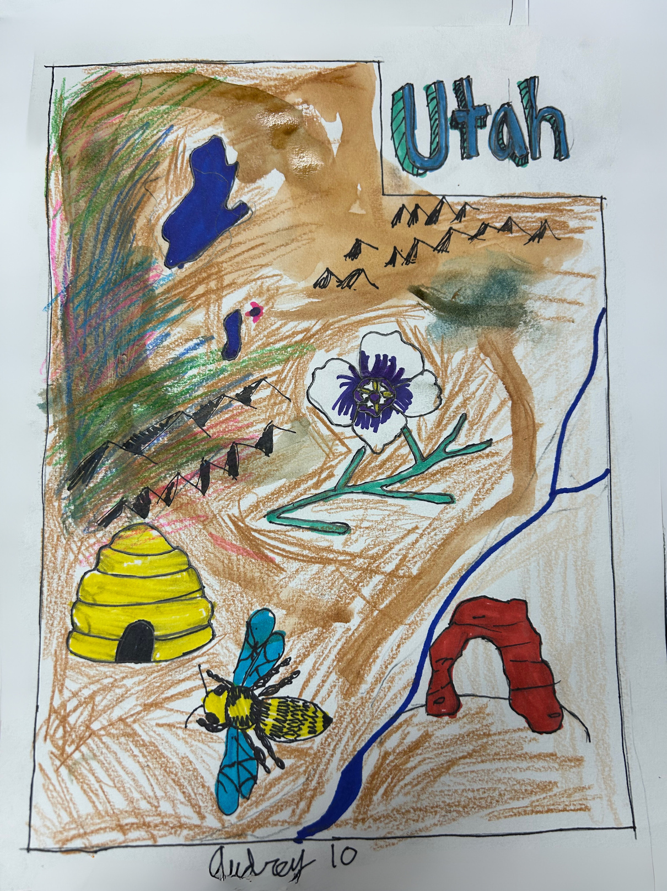



this is my place
by Audrey 4th grade

Slide 19

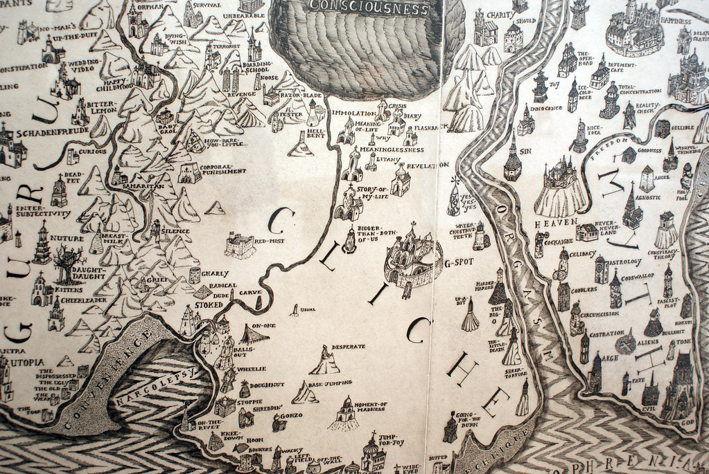
Grayson Perry
Map of an Englishman, 2004
“A lot of people think it’s generally like an Englishman,” the artist has said. “It is an Englishman. It is me.”
Grayson Perry. Map of an Englishman (detail) 2004

Slide 20
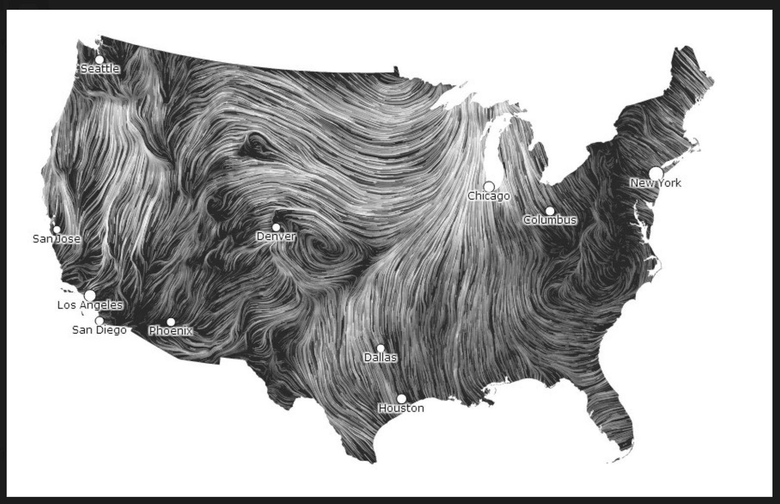
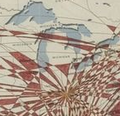
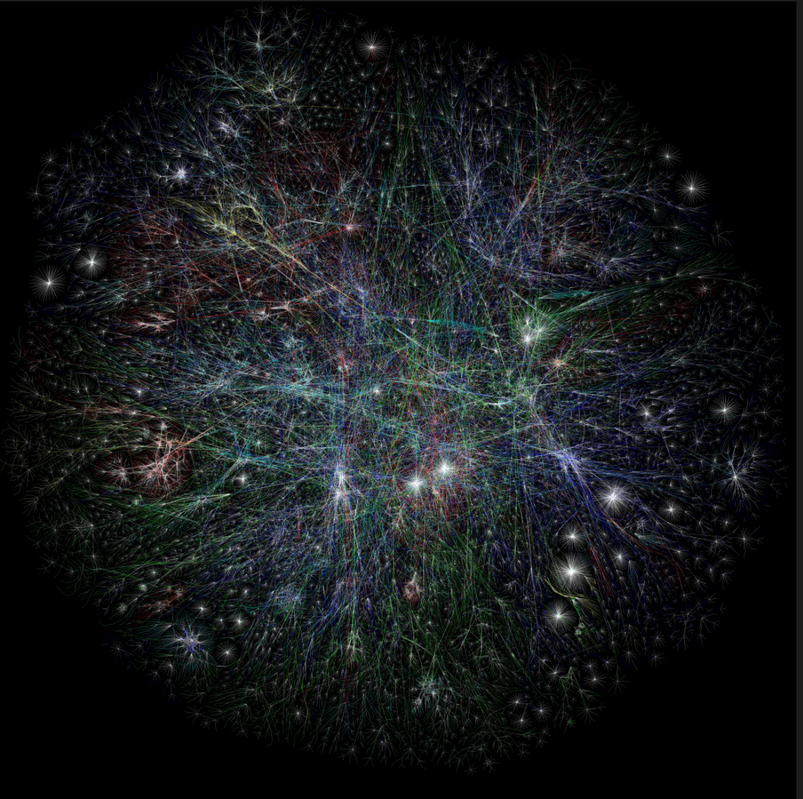
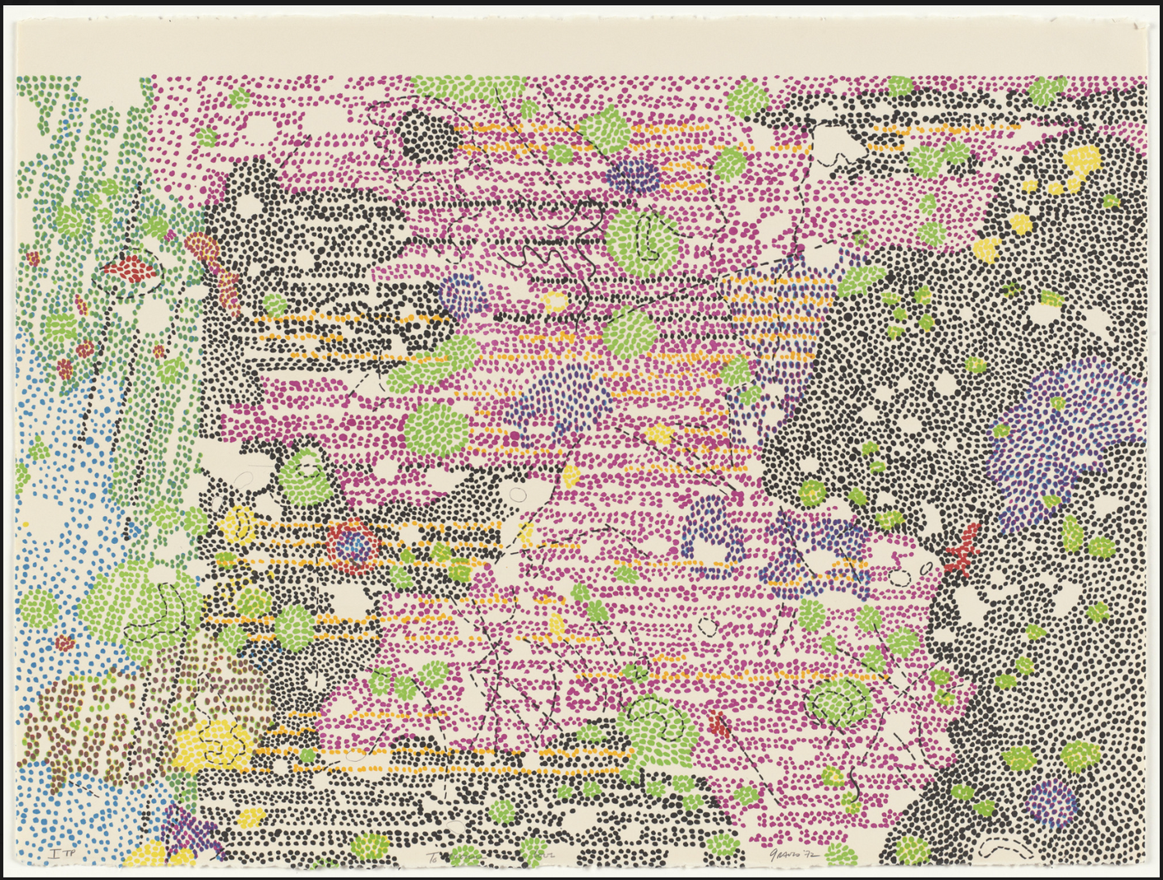
Maps and data collection
Using statistics and geography
Fernanda Bertini Viégas, Martin Wattenberg, Wind Map (detail), 2012
Mona Hatoum, Routes II (detail), 2002
Barrett Lyon, Mapping the Internet from The Opte Project (detail), 2002
Nancy Grave, Part of Sabine D Region, Southwest Mare Tranquilitatis from Lithographs Based on Geologic Maps of Lunar Orbiter and Apollo Landing Sites (detail), 1972
Notes:
Note to teachers: due to copyright, full images are not included on this slide. To see full images, please use the links provided.

Slide 21
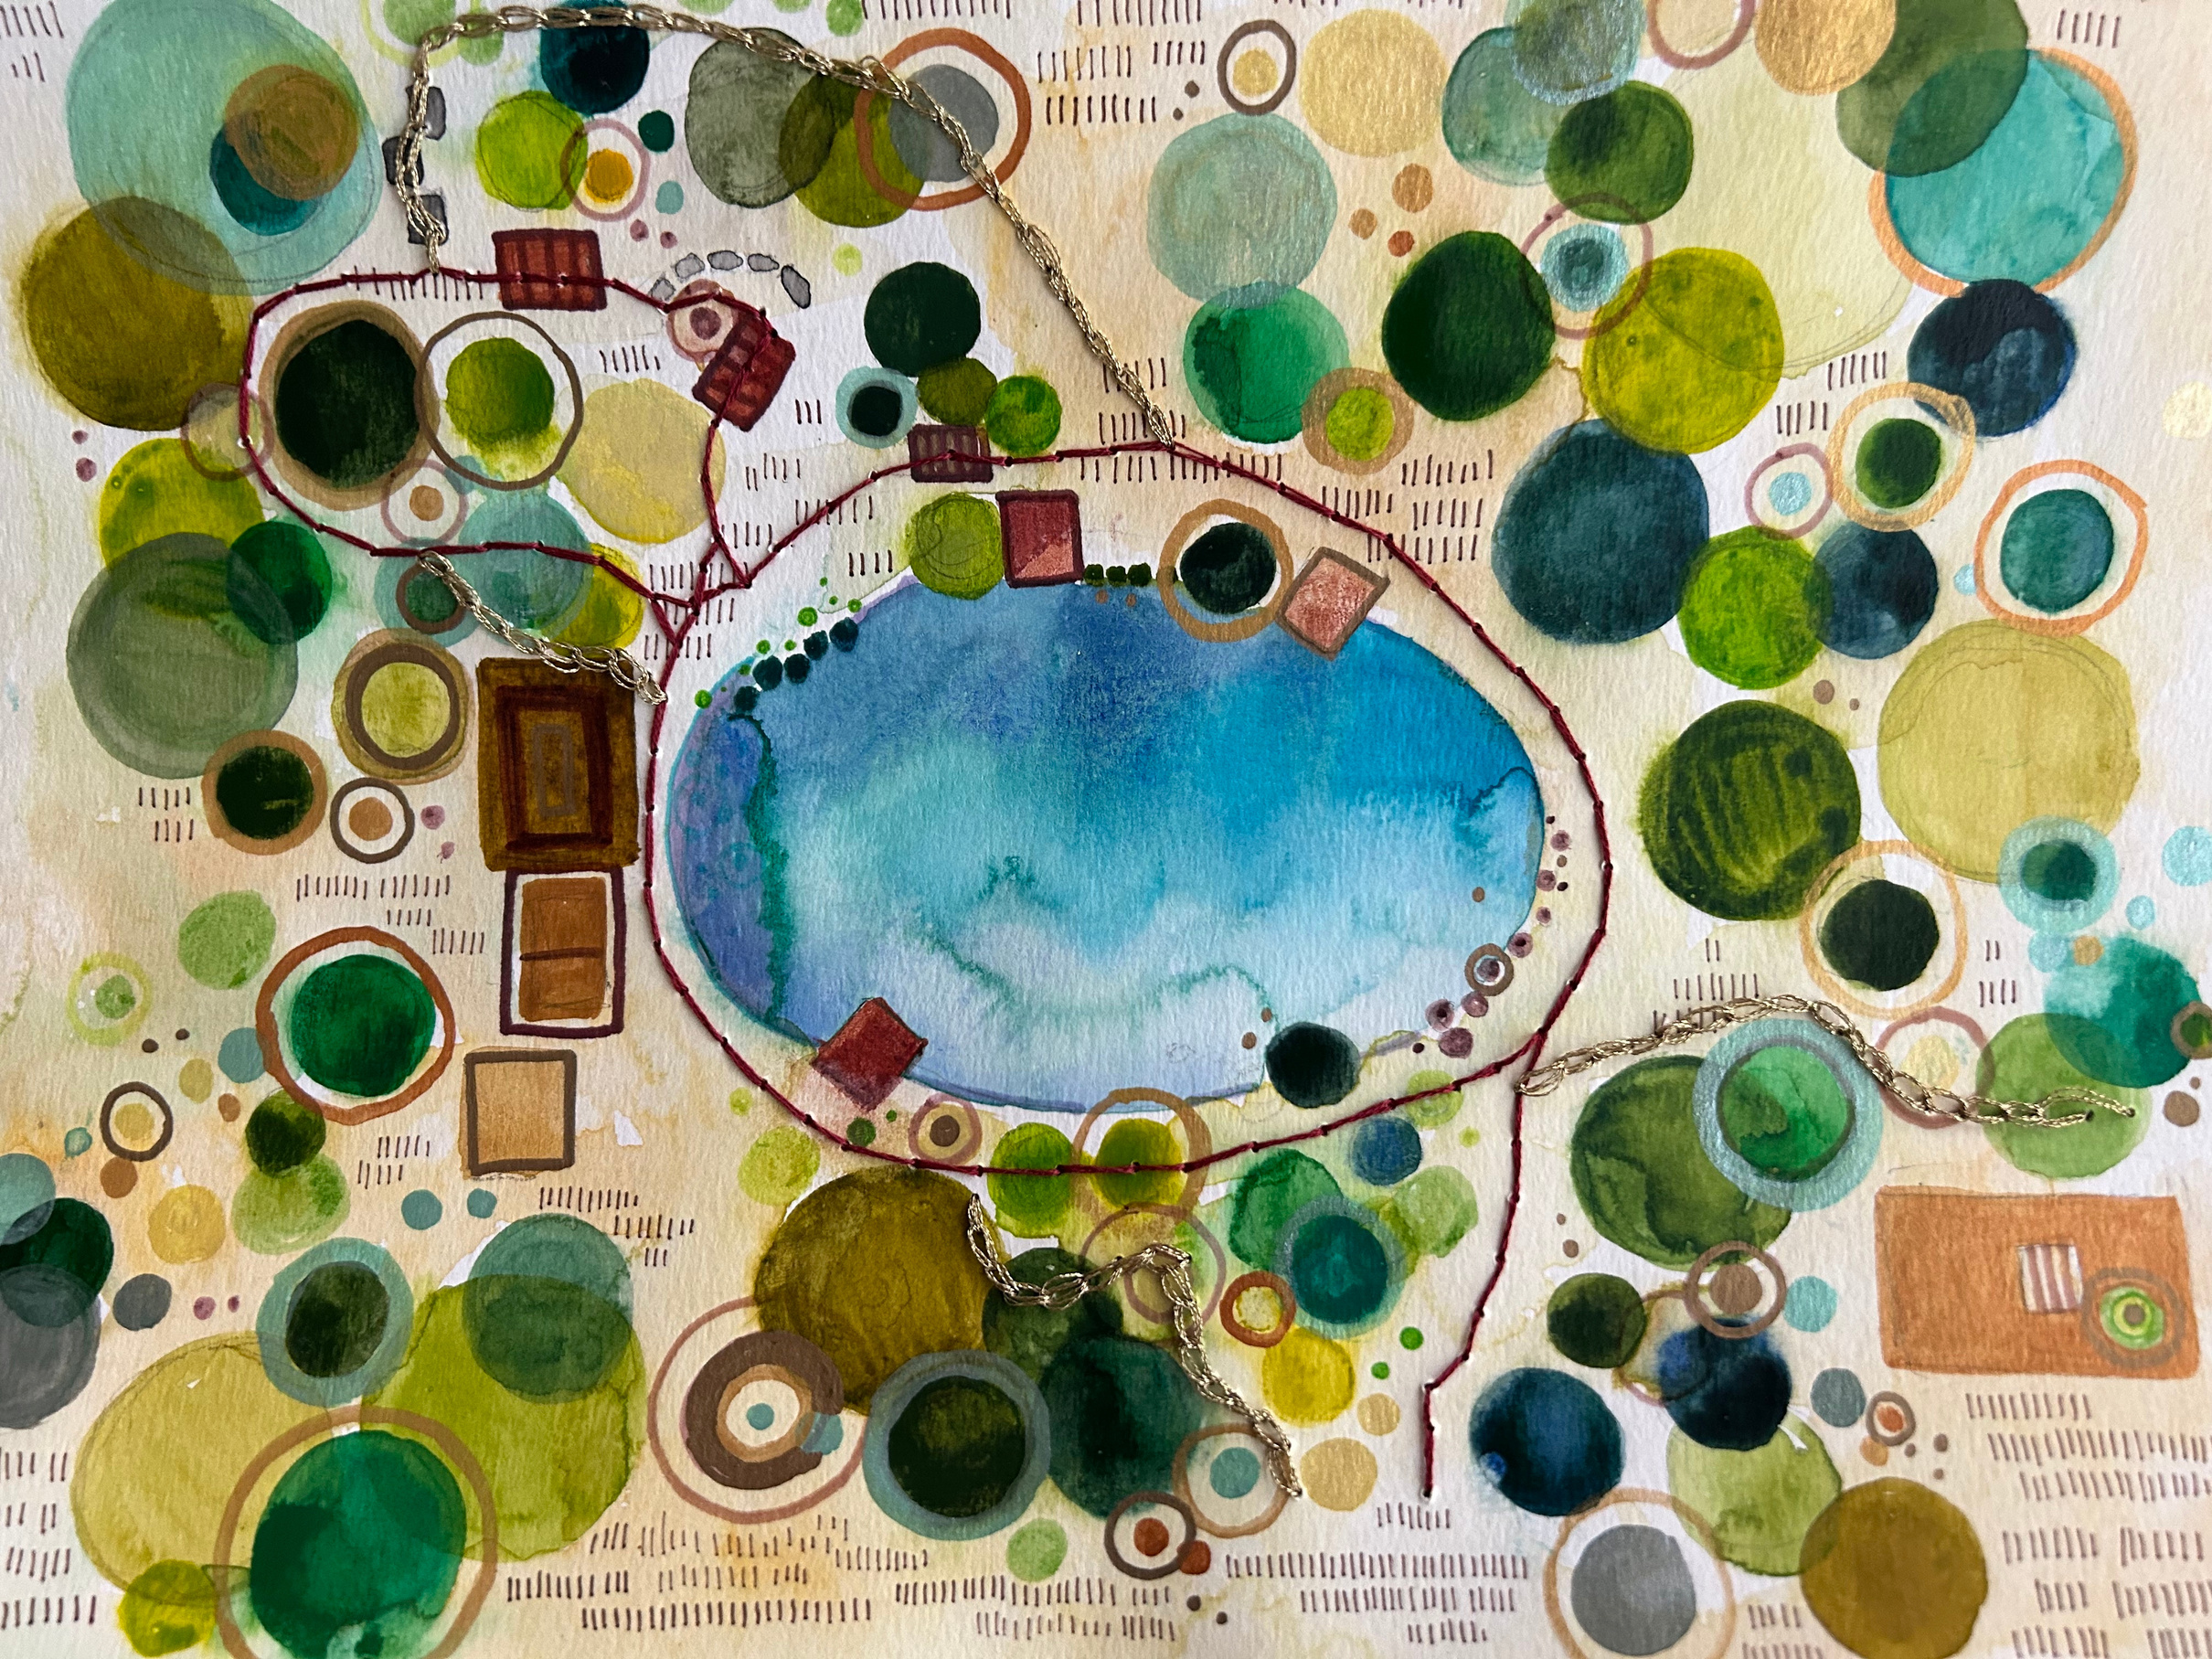
A Walk in the Park, Charlotte Hawkins

Slide 22




Create an artwork based on a place you know
Is it your your classroom?
Is it your house on your street?
Is it a special place you visit?
What landmarks will you show?
Will it include flora or fauna?
What data could you collect and show?
Map Your Place

Slide 23
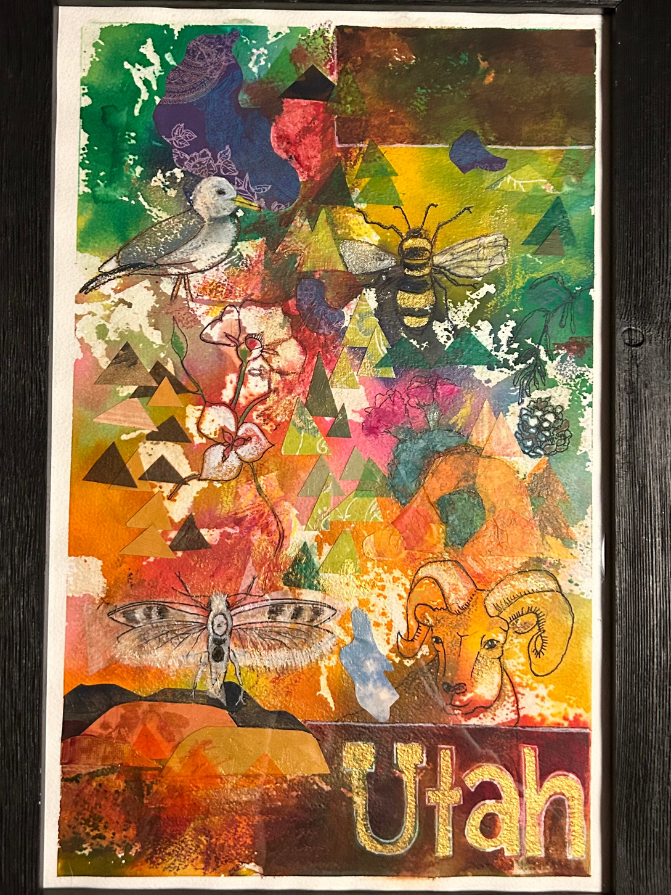




Mix your media
  collage
  watercolor
  oil pastels
  pencils
  textiles
Utah, by Charlotte Hawkins

